Slide 1



Matter & Energy Unit
Week 1 – What happens when something burns?
Developed from Carbon TIME materials (carbontime.bscs.org). Used with permission.
Notes:
Image Credit: Craig Douglas, Michigan State University
Have students start to think about how cows grow.
Tell students that in today’s activity they will learn about how cows grow through digestion and biosynthesis.
Open 5.1 Tracing the Processes of Cows Growing: Digestion and Biosynthesis PPT.

Slide 2
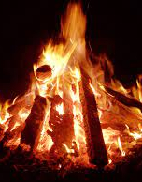
M&E Unit – W1 Driving Question
This week’s driving question: What happens when something burns?
  What happens to matter during combustion?
  What happens to energy during combustion?
  How are matter & energy different from each other?
Source: https://pxhere.com/en/photo/1604625

Slide 3
Part 1 Recap
What claims can we make based on the data above?
Did the wood disappear into ”thin air”?

Slide 4
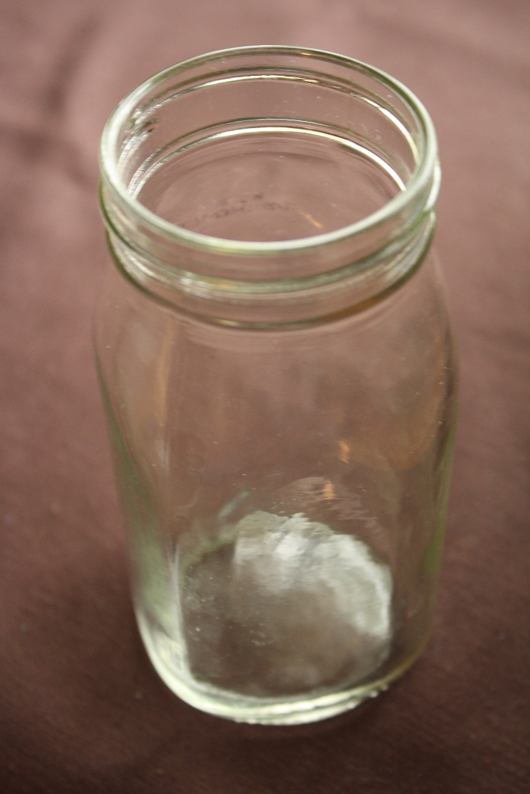

Does air have mass?
Is it empty?
OR
Is it full?
Notes:
Photo Credit: Hannah Miller, Michigan State University
Show students Slide 2 of the 2.3 Zooming Into Air PPT. Ask students to discuss what is air made out of, and vote on whether air has mass, and whether air is made of atoms. Note students’ ideas and discuss them as they go through the activity.

Slide 5

Zoom into Air
Benchmark Scale | Power of Ten | Decimal Style
Large scale | Larger 10⁵ 10⁴ 10³ | Larger 100,000 10,000 1,000
Macroscopic | 10² 10¹ 10⁰ 10⁻¹ 10⁻² 10⁻³ | 100 10 1 meter 0.1 0.01 0.001
Microscopic | 10⁻⁴ 10⁻⁵ 10⁻⁶ 10⁻⁷ | 0.0 001 0.00 001 0.000 001 0.0 000 001
Atomic-molecular | 10⁻⁸ 10⁻⁹ Smaller | 0.00 000 001 0.000 000 001 Smaller
Scale: 10³ meters = 1000 meters
Notes:
Photo Credit: Hannah Miller, Michigan State University
Powers of Ten Graphic Credit: Michigan State University
View slides 4-8 to zoom into air from large scale down to the smallest droplets so students can see air at the macro and micro scales. While zooming in, discuss how each scale is measured, and if you can see each scale with the naked eye.
Note: Slides 4-10 use animations. View in “Presentation Mode” to see the animations.

Slide 6

Zoom into Air
Clouds contain air...
Benchmark Scale | Power of Ten | Decimal Style
Large scale | Larger 10⁵ 10⁴ 10³ | Larger 100,000 10,000 1,000
Macroscopic | 10² 10¹ 10⁰ 10⁻¹ 10⁻² 10⁻³ | 100 10 1 meter 0.1 0.01 0.001
Microscopic | 10⁻⁴ 10⁻⁵ 10⁻⁶ 10⁻⁷ | 0.0 001 0.00 001 0.000 001 0.0 000 001
Atomic-molecular | 10⁻⁸ 10⁻⁹ Smaller | 0.00 000 001 0.000 000 001 Smaller
Scale: 10⁻³ meters = 0.001 meters
Scale: 10⁻² meters = 0.01 meters
Scale: 10¹ meters = 10 meters
Scale: 10⁰ meters = 1 meters
Scale: 10³ meters = 1000 meters
Scale: 10² meters = 100 meters
Scale: 10⁻¹ meters = 0.1 meters
Notes:
Photo Credit: Hannah Miller, Michigan State University
Powers of Ten Graphic Credit: Michigan State University
View slides 4-8 to zoom into air from large scale down to the smallest droplets so students can see air at the macro and micro scales. While zooming in, discuss how each scale is measured, and if you can see each scale with the naked eye.
Note: Slides 4-10 use animations. View in “Presentation Mode” to see the animations.

Slide 7

Clouds contain air...
...and water droplets
Benchmark Scale | Power of Ten | Decimal Style
Large scale | Larger 10⁵ 10⁴ 10³ | Larger 100,000 10,000 1,000
Macroscopic | 10² 10¹ 10⁰ 10⁻¹ 10⁻² 10⁻³ | 100 10 1 meter 0.1 0.01 0.001
Microscopic | 10⁻⁴ 10⁻⁵ 10⁻⁶ 10⁻⁷ | 0.0 001 0.00 001 0.000 001 0.0 000 001
Atomic-molecular | 10⁻⁸ 10⁻⁹ Smaller | 0.00 000 001 0.000 000 001 Smaller
Scale: 10⁻⁵ meters = 0.00 001 meters
Scale: 10⁻³ meters = 0.001 meters
Scale: 10⁻⁴ meters = 0.0 001 meters
Notes:
Photo Credit: Hannah Miller, Michigan State University
Powers of Ten Graphic Credit: Michigan State University
View slides 4-8 to zoom into air from large scale down to the smallest droplets so students can see air at the macro and micro scales. While zooming in, discuss how each scale is measured, and if you can see each scale with the naked eye.
Note: Slides 4-10 use animations. View in “Presentation Mode” to see the animations.

Slide 8

...and water droplets
Zooming in to the edge of a water droplet
Benchmark Scale | Power of Ten | Decimal Style
Large scale | Larger 10⁵ 10⁴ 10³ | Larger 100,000 10,000 1,000
Macroscopic | 10² 10¹ 10⁰ 10⁻¹ 10⁻² 10⁻³ | 100 10 1 meter 0.1 0.01 0.001
Microscopic | 10⁻⁴ 10⁻⁵ 10⁻⁶ 10⁻⁷ | 0.0 001 0.00 001 0.000 001 0.0 000 001
Atomic-molecular | 10⁻⁸ 10⁻⁹ Smaller | 0.00 000 001 0.000 000 001 Smaller
Scale: 10⁻⁶ meters = 0.0 001 meters
Scale: 10⁻⁵ meters = 0.001 meters
Notes:
Photo Credit: Hannah Miller, Michigan State University
Powers of Ten Graphic Credit: Michigan State University
View slides 4-8 to zoom into air from large scale down to the smallest droplets so students can see air at the macro and micro scales. While zooming in, discuss how each scale is measured, and if you can see each scale with the naked eye.
Note: Slides 4-10 use animations. View in “Presentation Mode” to see the animations.

Slide 9
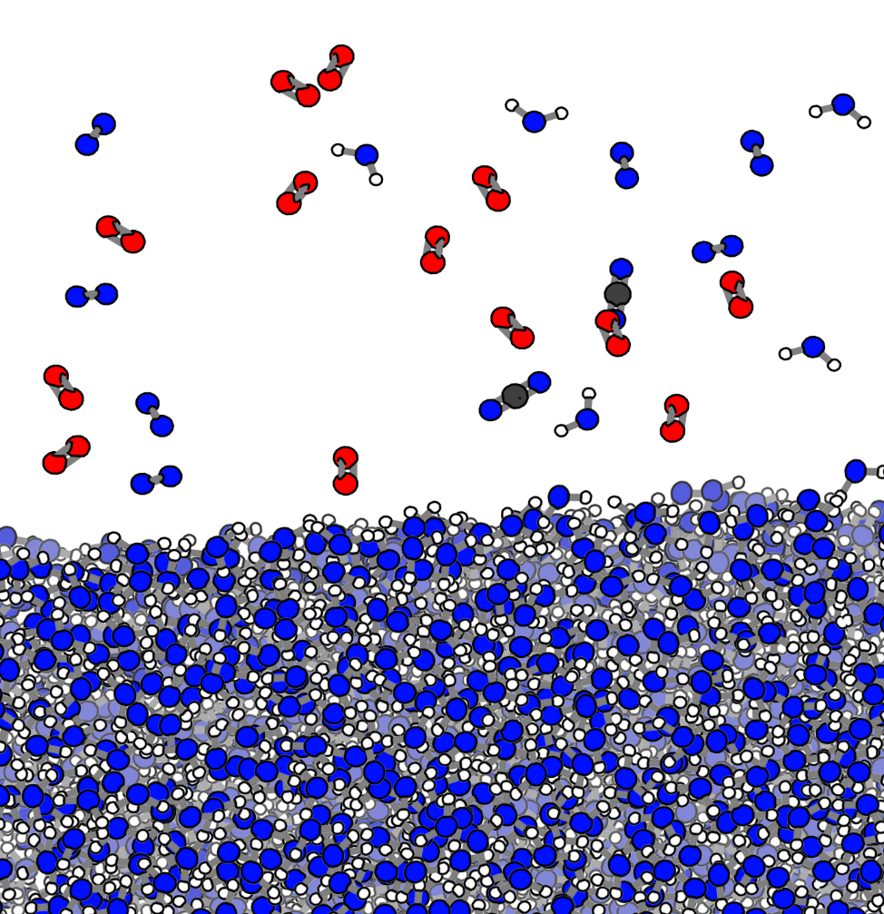
Zooming in to the edge of a water droplet
Showing individual water and air molecules
Benchmark Scale | Power of Ten | Decimal Style
Large scale | Larger 10⁵ 10⁴ 10³ | Larger 100,000 10,000 1,000
Macroscopic | 10² 10¹ 10⁰ 10⁻¹ 10⁻² 10⁻³ | 100 10 1 meter 0.1 0.01 0.001
Microscopic | 10⁻⁴ 10⁻⁵ 10⁻⁶ 10⁻⁷ | 0.0 001 0.00 001 0.000 001 0.0 000 001
Atomic-molecular | 10⁻⁸ 10⁻⁹ Smaller | 0.00 000 001 0.000 000 001 Smaller
Scale: 10⁻⁶ meters = 0.000 001 meters
Scale: 10⁻⁷ meters = 0.0 000 001 meters
Scale: 10⁻⁸ meters = 0.00 000 001 meters
Notes:
Photo Credit: Hannah Miller, Michigan State University
Powers of Ten Graphic Credit: Michigan State University
View slides 4-8 to zoom into air from large scale down to the smallest droplets so students can see air at the macro and micro scales. While zooming in, discuss how each scale is measured, and if you can see each scale with the naked eye.
Note: Slides 4-10 use animations. View in “Presentation Mode” to see the animations.

Slide 10
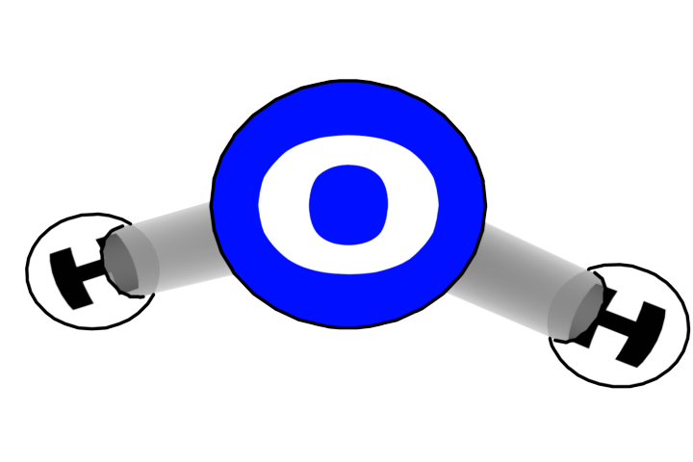
Showing individual water and air molecules
Water molecules inside the drop
Benchmark Scale | Power of Ten | Decimal Style
Large scale | Larger 10⁵ 10⁴ 10³ | Larger 100,000 10,000 1,000
Macroscopic | 10² 10¹ 10⁰ 10⁻¹ 10⁻² 10⁻³ | 100 10 1 meter 0.1 0.01 0.001
Microscopic | 10⁻⁴ 10⁻⁵ 10⁻⁶ 10⁻⁷ | 0.0 001 0.00 001 0.000 001 0.0 000 001
Atomic-molecular | 10⁻⁸ 10⁻⁹ Smaller | 0.00 000 001 0.000 000 001 Smaller
…. we still see water!
Scale: 10⁻⁸ meters = 0.00 000 001 meters
Scale: 10⁻⁹ meters = 0.000 000 001 meters
Notes:
Photo Credit: Hannah Miller, Michigan State University
Powers of Ten Graphic Credit: Michigan State University
Use Slides 9-10 to continue to zoom down to the atomic-molecular scale. Ask students if this matched their initial ideas about what air is made out of.
Note: Slides 4-10 use animations. View in “Presentation Mode” to see the animations.

Slide 11
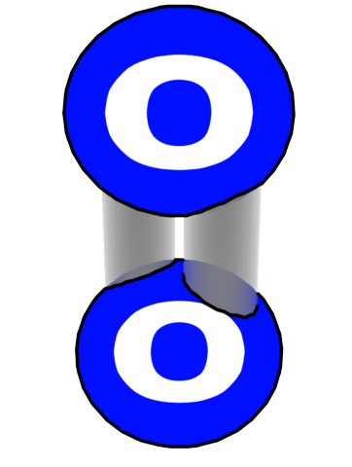
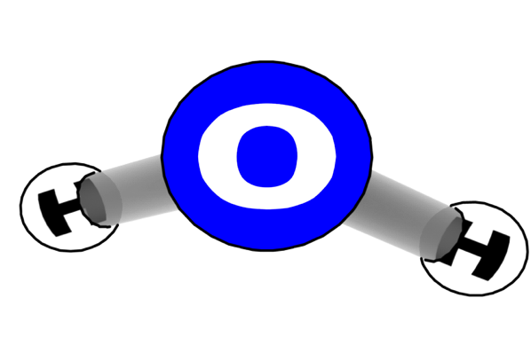
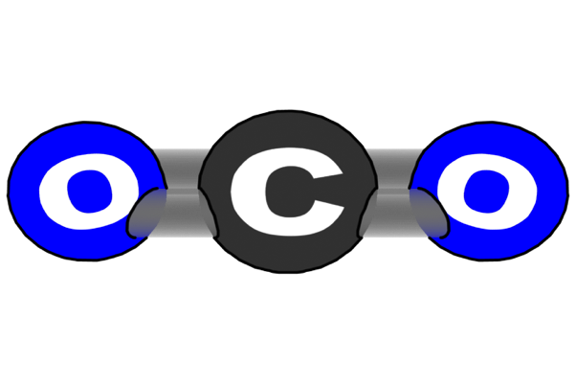

Different kinds of molecules in air
Benchmark Scale | Power of Ten | Decimal Style
Large scale | Larger 10⁵ 10⁴ 10³ | Larger 100,000 10,000 1,000
Macroscopic | 10² 10¹ 10⁰ 10⁻¹ 10⁻² 10⁻³ | 100 10 1 meter 0.1 0.01 0.001
Microscopic | 10⁻⁴ 10⁻⁵ 10⁻⁶ 10⁻⁷ | 0.0 001 0.00 001 0.000 001 0.0 000 001
Atomic-molecular | 10⁻⁸ 10⁻⁹ Smaller | 0.00 000 001 0.000 000 001 Smaller
Oxygen O₂
Water H₂O
Carbon dioxide CO₂
Nitrogen N₂
Atomic-molecular Scale
Notes:
Molecules Credit: Craig Douglas, Michigan State University
Powers of Ten Graphic Credit: Michigan State University
Use Slides 9-10 to continue to zoom down to the atomic-molecular scale. Ask students if this matched their initial ideas about what air is made out of.
Note: Slides 4-10 use animations. View in “Presentation Mode” to see the animations.

Slide 12
Matter & Energy
Everything that exists is either matter or energy.
  In biology, matter and energy are always two separate things.
  Matter does not become energy. Energy cannot become matter.
  Matter stays as matter. Energy stays as energy.
Matter and energy cannot be created or destroyed.
  The amount of matter and energy in the universe always stays the same.
Matter is all the “stuff” that exists.
  Matter consists of physical
  substances that take up space.
  In biology, there are three kinds of
  matter: solids, liquids, and gases.

Slide 13
Matter is made of atoms
All matter is comprised of atoms.
  All solids, liquids, and gases are made
  of particles of matter called atoms.
  If you can touch it, it is made of atoms.
The more atoms something has, the more
mass that it has (i.e., the more it weighs).
  For example, as your body grows larger, it
  gains more atoms.
  The more atoms in your body, the more you
  will weigh more on a scale.
Atoms last forever.
  In biology, an atom never stops existing.
  Atoms can only be moved; they cannot be created or destroyed.

Slide 14
Elements = “kinds” of atoms
Different kinds of atoms are
called elements.
  Carbon, oxygen, and hydrogen are all
  examples of elements.
In biology, each atom always exists as
the same element.
  A carbon atoms is always a carbon atom.
  A hydrogen atom cannot become an
  oxygen atom.
  Just like you will never become one of your friends (you will always be you), a carbon atom will always be a carbon atom.

Slide 15
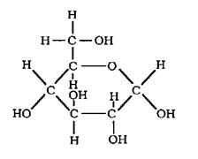
Molecules = Groups of Atoms
Atoms can bond to each other
to form molecules.
  Just like individual students can
  be a part of a class, individual
  atoms can be a part of molecules.
  For example, water is a molecule
  that consists of two hydrogen
  atoms bonded to an oxygen atom.
Atoms can be rearranged to form new molecules.
  For example, the atoms in a sugar molecule (right) were originally found in water (H₂O) and carbon dioxide (CO₂) molecules.
A group of students = a class.
A group of bonded atoms = a molecule.
Atoms from water and carbon dioxide can be rearranged to make sugar.

Slide 16
Energy = changing matter
Energy is how matter (the “stuff”) changes.
  For example, matter can be moved or change temperature.
Like matter, energy can neither be created or destroyed.
  Energy cannot cease to exist. Energy can only change.
  The amount of energy in the universe is always the same.
Energy can change into 4 different forms.
  For example, plants can convert visible
  light energy into chemical energy
  (energy stored within molecules).
  If a cow consumes the chemical
  energy in that plant, it can convert
  this into motion (or kinetic energy)
  Eventually all energy becomes heat
  energy which dissipates into space.

Slide 17
Recap: The “rules” of matter & energy
1) All solids, liquids, and gases are made of tiny particles called atoms.
  Atoms can bond together to form molecules.
  These same atoms can be rearranged to form new molecules.
2) In biology, atoms last forever. Atoms cannot be created or destroyed.
  Atoms cannot change (e.g., carbon atoms are always carbon atoms).
  If something gains mass, it gains atoms. If it loses mass, it loses atoms.
3) In biology, energy lasts forever. Energy cannot be created or destroyed.
  Energy can exist as light, heat, motion, or as chemical energy stored in the bonds of molecules.
  Energy in one form can be transferred into a different form (e.g., light energy can be transformed into heat energy).

Slide 18
Part 1 Revision
Can we now improve our claims about the data above?

