Slide 1

Classroom & Laboratory Safety
By Dr. Kohn
Science Dept.
Waterford WI

Slide 2

General Expectations
Ask if unsure. Report if unsure. Do not act if unsure.
Follow Instructions.
Know all safety precautions & equipment so that you can act if/when needed.
Keep areas neat and clean with chairs pushed in in case of emergency.
You are responsible for
preventing accidents.
Never handle an unknown
substance. Ask first.
Source: 123rf.com

Slide 3

General Expectations
Alert your instructor of all emergencies and wait for their response before taking action.
Never eat or drink in the classroom.
Wash your hands after handling anything potentially harmful.
Never work alone in a room or lab.
If there is an emergency,
stop what you are doing
and be prepared to assist.
Source: PRWeb -flickr.com

Slide 4
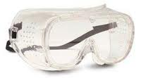
Eyewear
Eyewear is needed any time we have…
  Lab chemicals are being used
  Glassware is being used
  Substances are being heated
  Open flames are present
  Organs or other live tissues are being dissected
Eyeglasses do not
count as eye protection.
Source: medical-supplies-equipment-company.com

Slide 5
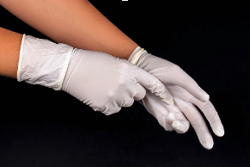
Gloves
Gloves are needed anytime we have…
    Lab chemicals are being used
    Organs or other live tissues are being dissected
Replace any gloves with rips or tears.
Tell your instructor if we
are running low on gloves
before they run out.

Slide 6
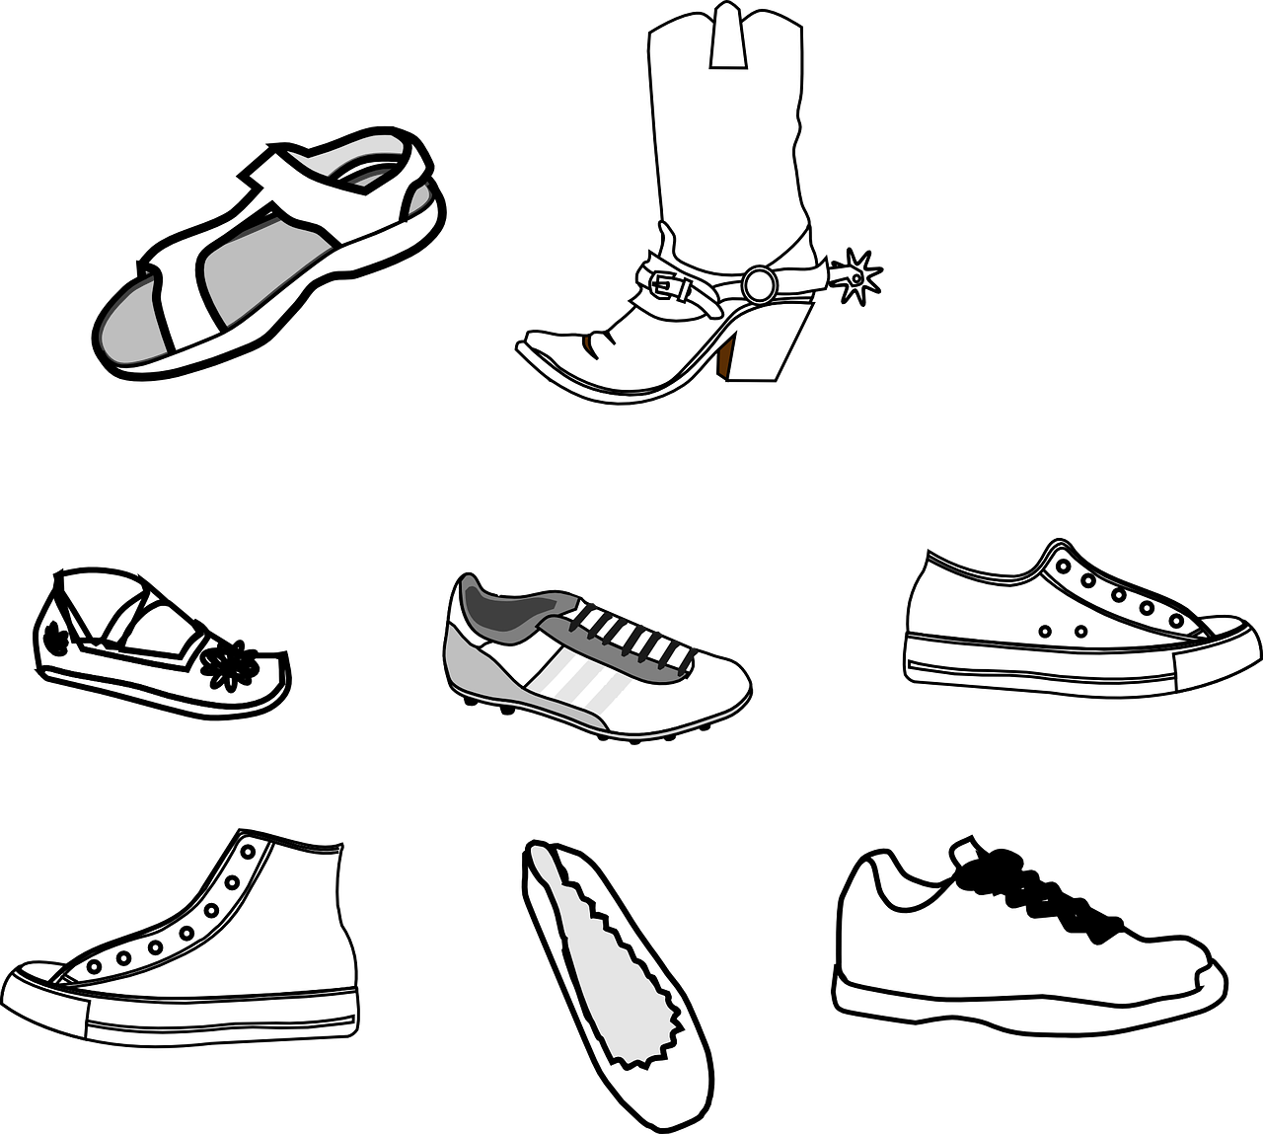
Apparel & Footwear
When working with glass, lab chemicals, live tissue, or outdoors, closed-toed shoes are needed.
Do not wear overly-loose clothing when performing a lab.
Dress appropriately if
we go outdoors.

Slide 7

Eyes & Contact Lens
If you spill a liquid in your eye (chemical, blood, etc.), alert your instructor if you have contacts.
  Just because a spill in your eye does not hurt does not mean it is not causing damage.
  Always rinse your eyes in
  an eyewash station in the
  event of a spill.
  Where is our eyewash station?

Slide 8

Glassware
Always clean glassware before using if in doubt.
Hot glass looks identical to cold glass.
Test tubes should always be heated with the open end
pointed away
from people.
Never use chipped,
dirty, or broken glass.
Source: ehs.washington.edu

Slide 9

Sharps
Always carry sharp objects securely with the sharp end pointed down.
  Never try to catch a falling sharp object.
  Move away as it falls while alerting everyone nearby.
Always cut away
from your body.

Slide 10

Heat & Flames
Glass can shatter when heated and gas flames can have flare-ups – always use eye protection when heating or burning something.
Never leave a burner or flame unattended. Always have a partner.
Long or loose hair or
clothing must be tied back.
Where is our fire extinguisher?
Source: fundraw.com

Slide 11

Laboratory Chemicals
Assume every chemical can be dangerous. Always read the side of the bottle before using a lab chemical.
Once it’s out it stays out - never return used chemicals back into a container.
Always turn on a faucet before dumping a chemical
  Never add water to acid.
Only the instructor should have access
to chemical supply areas.
If you spill a chemical on your skin or
in your eyes, immediately flush with
water while alerting your instructor.
Where is our nearest chemical shower?
Source: altecweb.com

Slide 12

Animals
All animals have the potential to carry serious disease.
Always wash your hands after handling animals
Alert the instructor of any loose animals and wait for their response before taking action.
Never work with animals alone.
Humane treatment of animals is required to be in this classroom.

Slide 13
Organ/Tissue Dissection
Gloves, goggles, and aprons/coats are needed whenever handling organs or tissue.
Know how organs or tissue should be disposed of before beginning.
If a fluid gets into a mucus membrane (mouth, nose, eyes), immediately flush with lots of water.

Slide 14
Emergency Response Protocols

Slide 15

General Principles
Alert your instructor first.
If additional help is needed, call “0” on the phone AND get a neighboring instructor to assist.
  After school hours, dial 8-911.
Assist only if needed or requested.
Stay safe and out of
harm’s way.

Slide 16
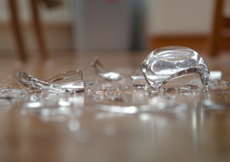
Spilled Chemical/Broken Glass
If there is broken glass or a chemical spill, first alert the instructor.
  Next stand guard at a safe distance while alerting everyone else to prevent another student from being exposed.
  Be prepared to assist if the instructor asks.
Do not pick up broken glass with your bare hands.
  Leave the room if there are
  chemical fumes.
  Do not wait to flush with water
  if you spill a chemical on your skin.

Slide 17
Fire
If a fire breaks out, alert the instructor before anything else.
If a fire alarm goes off, stop what you are doing and immediately leave the classroom.
  Exit the main classroom door, turn left, go down the stairway, and exit the nearest door.
  Stay together! We must take attendance.
  Do not leave your class to find someone
  else. Stay with your instructor.

Slide 18

Tornado
If a tornado watch is issued, keep doing as you were before but remain prepared.
  This only means conditions are favorable for a tornado.
If there is a tornado warning, immediately stop what you are doing, leave the room, turn left, and go downstairs.
  Do not wait or hesitate – a tornado warning
  means a tornado is already on the ground.
  Cover the back of your head and neck with
  your hands and duck forward.

Slide 19
Violent Critical Incident (Intruder)
A.L.I.C.E. (non-sequential)
  Alert - First awareness of danger; overcome denial and doubt.
  Lockdown - Secure door, create barricades, spread out, prepare to evacuate/counter, & communicate.
  Inform - Alert law enforcement, etc. if safe to do so
  Counter - Physical actions that interrupt the intruder, making it impossible to aim (only if in immediate danger)
  Evacuate - Remove yourself from danger as soon as it is safe to do so and go to a safe area/rally point.
    Keep your hands up & visible if you see police; do not scream or ask questions.
A.L.I.C.E.

Slide 20
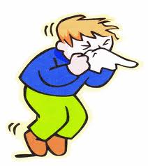
Allergic Reaction
It is your responsibility to alert the instructor about any allergies you may have and any time your allergies are a problem.
If you have a need for an Epi-pen, state this immediately and explain where it is.
If another student is having
an allergic reaction, stop
what you are doing and be
prepared to assist.
Source: health198.com

Slide 21
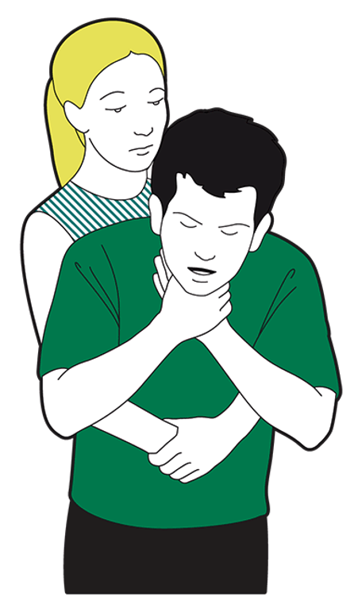
Choking
If someone is choking, stop what you are doing and alert the instructor.
Seek additional help if needed (by phone and/or in a neighboring classroom).
Be prepared to assist the instructor.

Slide 22
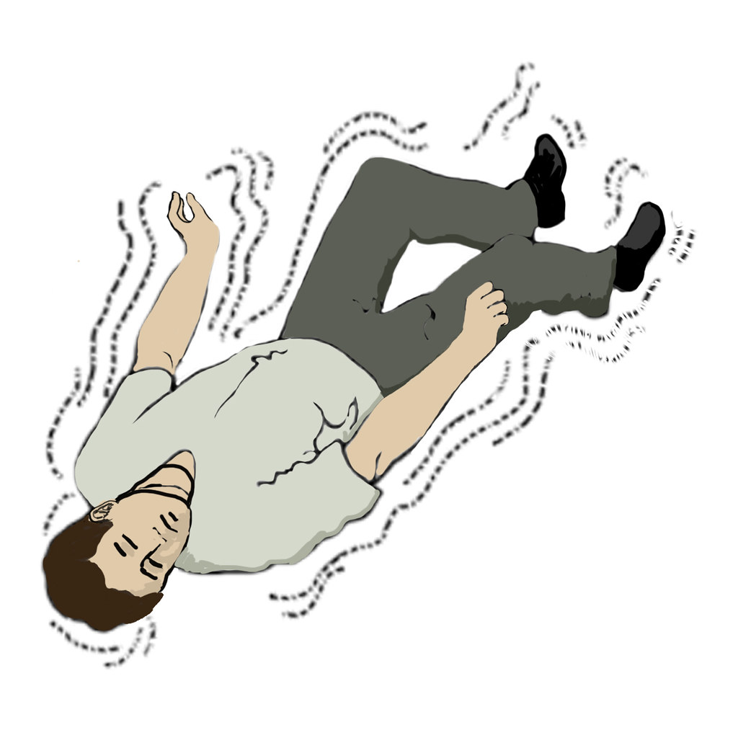
Seizure
If a student or instructor is having a seizure, push away anything they might strike with their body.
Protect their head with a sweatshirt, backpack, or other padding.
Do not try to hold down their body – allow them to flail freely.
Be prepared to seek
assistance from another
instructor or via phone.

Slide 23
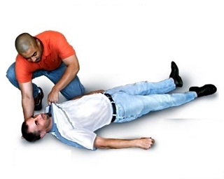
Unconsciousness
Unconsciousness is always life threatening.
  Seek immediate assistance from the instructor, main office, and neighboring instructors if someone becomes unconscious.
Be prepared to check the CBAs –
  1) Circulation (Do they have a pulse?
  Are they turning blue?).
  2) Breathing (Look, listen, &
  feel for breathing).
  3) Airway (Is it clear?).

Slide 24
Classroom Procedures

Slide 25
Locate the following
Exits
Fire Extinguishers
Fire Blanket
Eye Wash Stations
Chemical Rinse Station

Slide 26

Classroom Policies
Hand-in Box
Daily Announcements
Labs, Assessments, & Grades
Website – www.DrKohn.org
  Everything is always on the website!!!!
    Inform me if it isn’t!

Slide 27

The 3 Rules

Slide 28
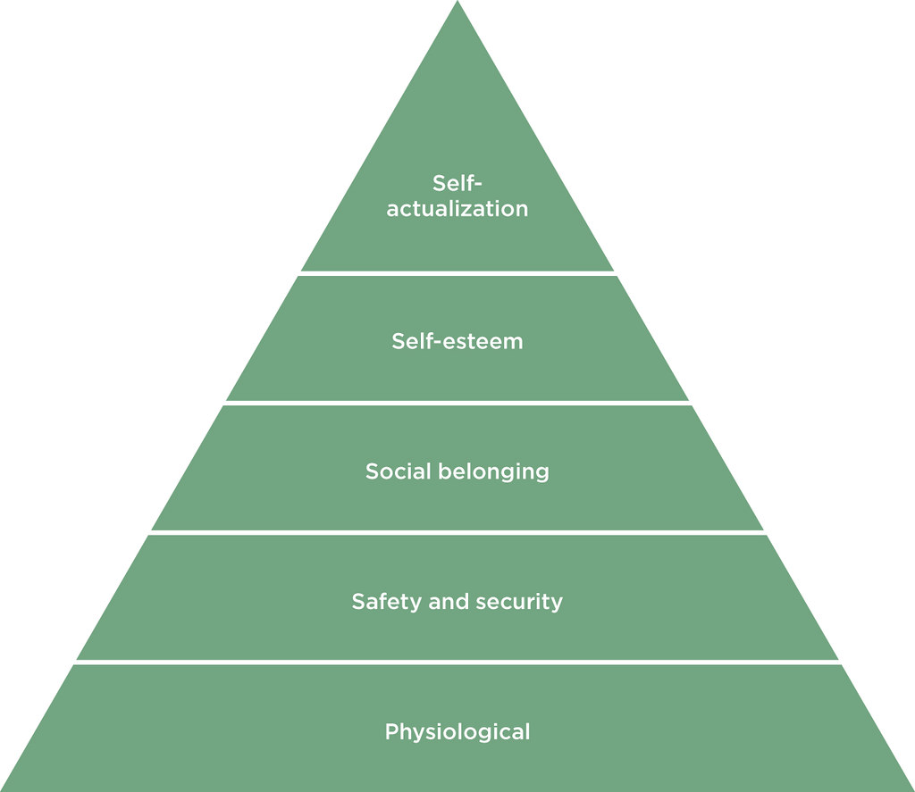
1) Support Learning
1. Everyone has an obligation to support safe learning & achievement for everyone in this room.
  If your actions hurt the ability of others to learn or to do their job, you will be asked to leave.
  Examples of inacceptable actions
  include disruption of…
    Physical Safety
    Psychological Well-being
    Classroom Function

Slide 29

2) Support Each Other
2. Effective learning depends on a respectful environment.
  When someone is appropriately speaking to the entire class, you have an obligation to provide them with your full attention.
    This is true for both teachers and students.
    Doing otherwise makes it harder for all of
    us to learn and do our jobs.
  Disrespecting someone based on gender, race, ethnicity orientation, religion, nationality, disabilities, age, etc. will result in immediate disciplinary action, including a phone calls to parents/guardians.

Slide 30

3) Don’t Cross the Line
3. You are responsible for knowing what is acceptable and what is not.
  You know where the line is –
  do not cross it.
  If you are unsure if something
  is acceptable, it probably isn’t.
  Use common sense.
If we work together, both our jobs will be much easier.
    Let’s have a great year!

