Slide 1
Life of Stars Unit Week 2 – Why do stars die?
Notes:
Image Credit: Craig Douglas, Michigan State University
Have students start to think about how cows grow.
Tell students that in today’s activity they will learn about how cows grow through digestion and biosynthesis.
Open 5.1 Tracing the Processes of Cows Growing: Digestion and Biosynthesis PPT.

Slide 2
Sun Unit – W2 Driving Question
This week’s driving question: Why do stars die?
Why can atoms fuse? What factors determine whether atoms can fuse or not fuse?
Why can some elements undergo nuclear fusion whereas some other elements undergo nuclear fission?
How do these factors affect how a star ages and why stars die?

Slide 3
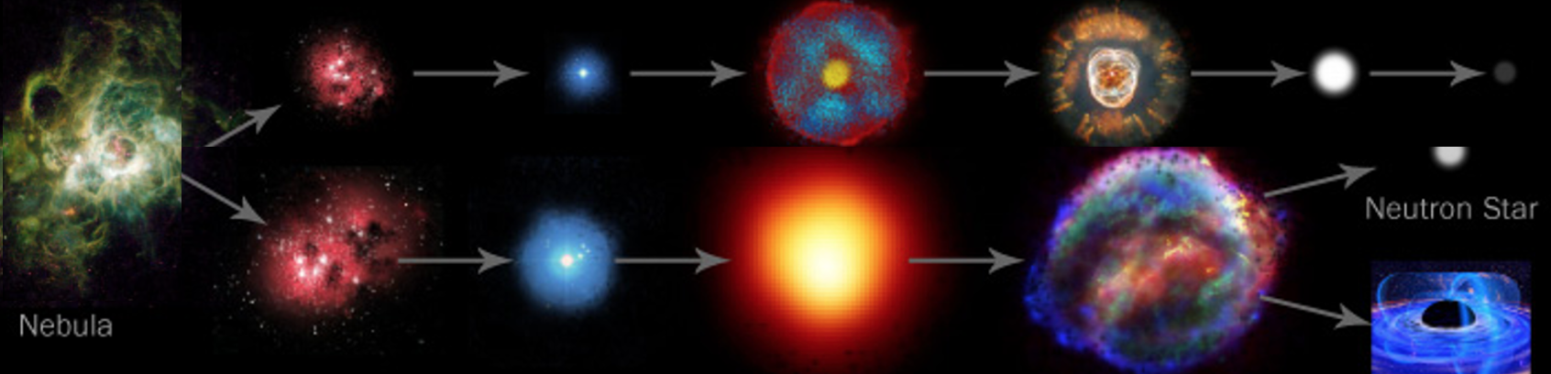
Stars Week 1 Recap
We now know that the mass of stars determines their outcomes.
All stars form from interstellar nebula.
Low mass stars enter the main sequence, become red giants, and then white dwarfs.
High mass stars also start in the main sequence.
After a supernova, high mass stars either form a neutron star or a black hole.

Slide 4
The Big Ideas
The mass of a star determines the extent to which nuclear fusion can occur in the star’s core.
In low mass stars, fusion slows as hydrogen is fused into helium and as helium fuses into carbon.
In the cores of high mass stars, elements can fuse up to iron before fusion eventually ends.

Slide 5
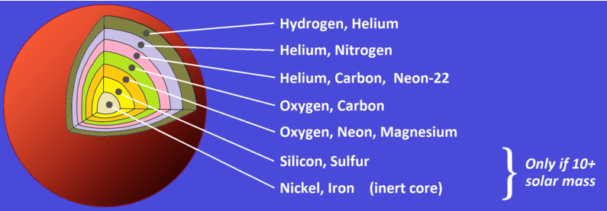
The Big Ideas
This week we’ll focus on why fusion is possible, and why stars start to die when their cores form iron.
Why would the fusion of hydrogen into helium release so much energy?
Why does fusion in the cores of stars stop at iron?
Source: Wikimedia

Slide 6
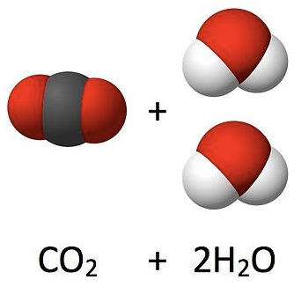
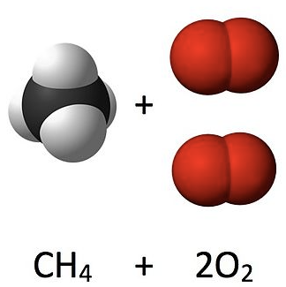
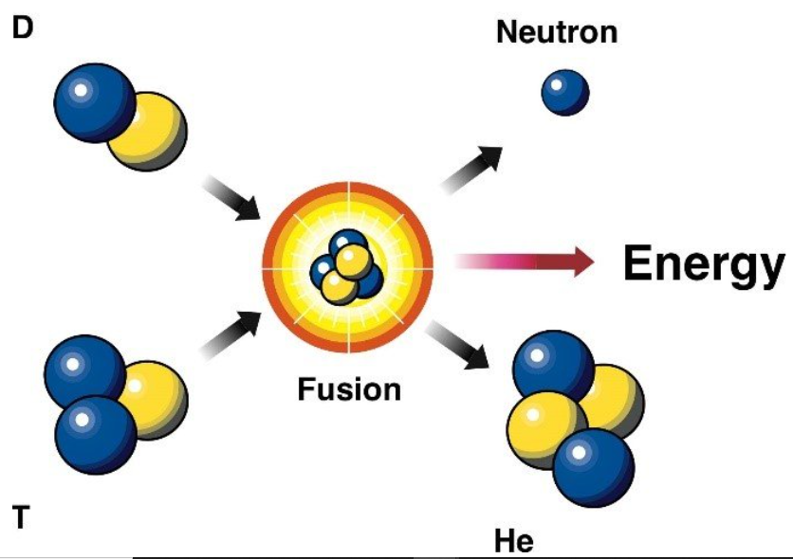
Fusion vs. Combustion
Fusion is very different from combustion
In combustion, chemical energy is converted into heat and light energy.
However, atoms are not being destroyed.
The mass of the products is the same as the mass of the reactants.
In fusion, matter is converted into energy (per Einstein’s equation, E = mc²).
The products of fusion have less mass than the reactants.
Source: Energy.gov

Slide 7
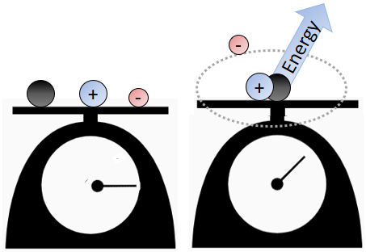
Mass Defect
Except for hydrogen, the mass of an atom is always less than the sum of the masses of its component particles.
Mass defect of a nucleus is the difference between the sum of the masses of the subatomic components and the measured atomic mass.
When protons, neutrons, and electrons assemble into a stable atom, energy is released.
This is like how atoms in molecules are more stable than isolated atoms.
E.g., Na+ and Cl- are highly reactive, while NaCl is not.
Mass defect: the difference between the masses of the subatomic components and the atomic mass of an atom.

Slide 8
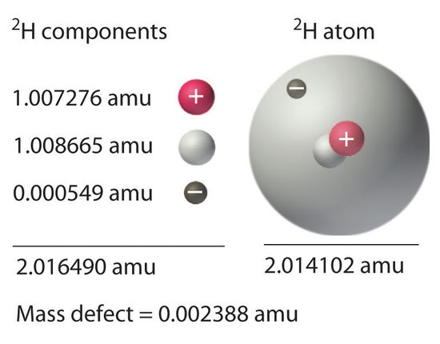
Mass Defect
Mass defect is evident in deuterium (heavy hydrogen, or hydrogen with a neutron).
The electron, proton, and neutron individually weigh a total of 2.0165 amu (amu = atomic mass unit = 1/12 the mass of a carbon atom).
However, a deuterium atom weighs 2.0141 amu.
This equates to a mass defect of ~0.0024 amu
When subatomic particles form a stable atom, they release energy converted from matter.
Mass defect value is proportional to the nuclear binding energy (the energy needed to divide a nucleus into separate protons & neutrons).
Both values are measures of the stability of the nucleus of an atom.
Source: chem.libretexts.org

Slide 9
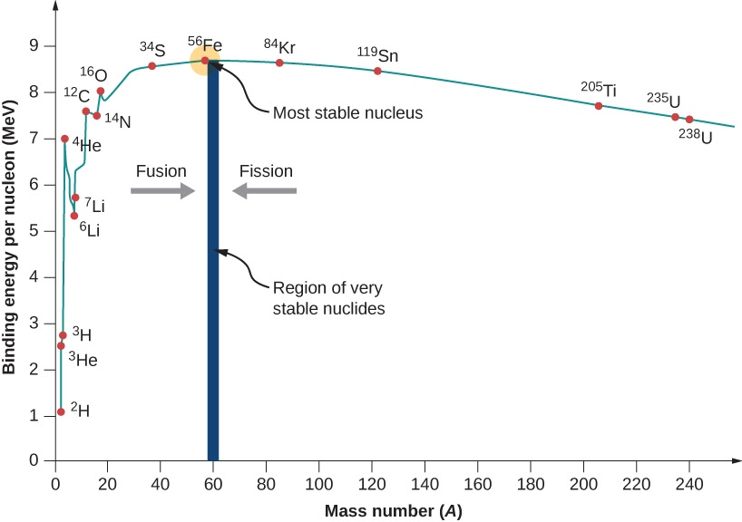
Mass Defect Curve
Not all nuclei are equally stable.
The ratio of binding energy to neutrons & protons determines the stability of an element.
As hydrogen fuses into helium, the binding energy to nucleon* ratio increases.
It takes more energy to separate the nucleons of helium compared to those of hydrogen.
Similarly, binding energy increases as helium fuses into carbon.
*Nucleon = neutrons & protons
Source: https://opentextbc.ca/universityphysicsv3openstax/chapter/nuclear-binding-energy/

Slide 10
Mass Defect Curve
Nuclear fusion creates subsequently more stable nuclei as you move from hydrogen to iron on the periodic table (i.e., it would take more energy to pry a nucleon from the nucleus as you move towards iron).
Source: https://opentextbc.ca/universityphysicsv3openstax/chapter/nuclear-binding-energy/
Notes:
Per https://opentextbc.ca/universityphysicsv3openstax/chapter/nuclear-binding-energy/
This graph is considered by many physicists to be one of the most important graphs in physics. Two notes are in order. First, typical BEN values range from 6–10 MeV, with an average value of about 8 MeV. In other words, it takes several million electron volts to pry a nucleon from a typical nucleus, as compared to just 13.6 eV to ionize an electron in the ground state of hydrogen. This is why nuclear force is referred to as the “strong” nuclear force.
Second, the graph rises at low A, peaks very near iron and then tapers off at high A. The peak value suggests that the iron nucleus is the most stable nucleus in nature (it is also why nuclear fusion in the cores of stars ends with Fe). The reason the graph rises and tapers off has to do with competing forces in the nucleus. At low values of A, attractive nuclear forces between nucleons dominate over repulsive electrostatic forces between protons. But at high values of A, repulsive electrostatic forces between forces begin to dominate, and these forces tend to break apart the nucleus rather than hold it together.

Slide 11
Mass Defect & Star Death
Mass defect causes the demise of high-mass stars.
Unlike low mass stars, high mass stars have enough heat and pressure to continue nuclear fusion up to iron.
Iron is the stopping point because of properties of atoms as described by the mass defect curve.
The fusion of elements that are lighter than iron releases energy, but the fusion of elements heavier than iron would require an input of energy.

Slide 12
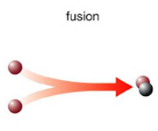
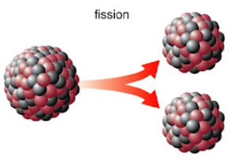
Fusion vs. Fission
This also explains why both nuclear fusion and fission are possible.
Nuclear fission occurs when a neutron breaks apart an atomic nucleus into two smaller atoms.
Elements above iron give off energy when split.
Elements below iron give off energy when fused.
Source: Duke Univ
Notes:
One note – Uranium 238 is further from iron along the mass defect curve, and yet U-235 is more capable of undergoing nuclear fission. This is due to the effects of the strong nuclear forces, which complicates what otherwise seems like a simple relationship between mass defect and fusion/fission. Per https://socratic.org/questions/how-is-nuclear-stability-related-to-the-neutron-proton-ratio:
At close distances, a strong nuclear force exists between nucleons. This attractive force comes from the neutrons.
More protons in the nucleus need more neutrons to bind the nucleus together.
The graph below is a plot of the number of neutrons versus the number of protons in various stable isotopes.
The stable nuclei are in the pink band known as the belt of stability.
They have a neutron/proton ratio between 1:1 and 1.5.
As the nucleus gets bigger, the electrostatic repulsions between the protons gets weaker.
The nuclear strong force is about 100 times as strong as the electrostatic repulsions.
It operates over only short distances.
After a certain size, the strong force is not able to hold the nucleus together.
Adding extra neutrons increases the space between the protons.
This decreases their repulsions but, if there are too many neutrons, the nucleus is again out of balance and decays.

Slide 13
Revisions to W2 Driving Question
Can we now improve our answers to our driving questions?
Why do stars die?
Why can atoms fuse? What factors determine whether atoms can fuse or not fuse?
Why can atoms undergo both nuclear fusion OR nuclear fission?
How do these factors affect how a star ages and why stars die?

Slide 15
Mass Defect
Except for hydrogen, the mass of an atom is always less than the sum of the masses of its component particles.
Mass defect of the nucleus is the difference between the sum of the masses of the subatomic components and the measured atomic mass.
When isolated nucleons (a proton or neutron) assemble into a stable nucleus, energy is released.
This is like how atoms in molecules are more stable than isolated atoms.
E.g., Na+ and Cl- are highly reactive, while NaCl is not.
Energy
-
+
+
-

