Slide 1
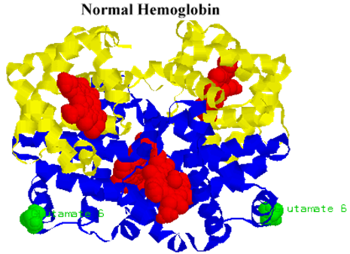
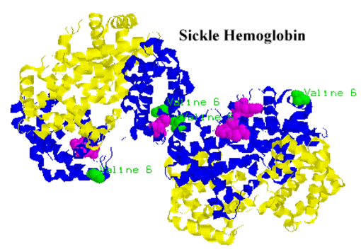
WUHS Biology: DNA & Proteins Unit
Week 3 – How does a protein determine traits?

Slide 2
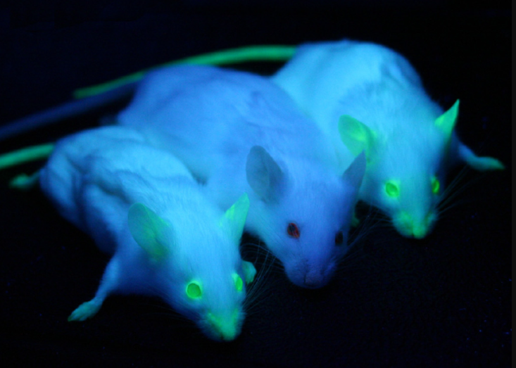
DNA & Proteins Unit – W3 Driving Question
Driving Question: How does a protein determine traits?
How does a chain of amino acids form a functional protein?
How do the properties of the amino acids determine the shape and function of the protein?
How can genes for traits be added to new species?
Image Source: Wikimedia

Slide 3
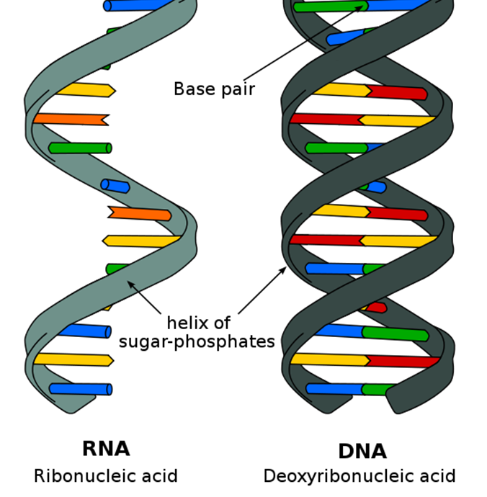
Recap of Week 2
RNA serves as a link between the information stored in DNA and the assembly of proteins.
Unlike DNA, RNA is 1) single stranded, 2) has a slightly different sugar molecule, and 3) uses U instead of T.
Transcription produces an RNA copy of DNA known as mRNA (short for messenger RNA).
RNA polymerase is the enzyme that creates the mRNA copy. RNA polymerase assembles complementary bases in a 3’ → 5’ direction.
Transcription factor proteins determine when and how RNA polymerase binds to DNA. These proteins play an important role in determining whether genes are expressed as proteins and traits.

Slide 4
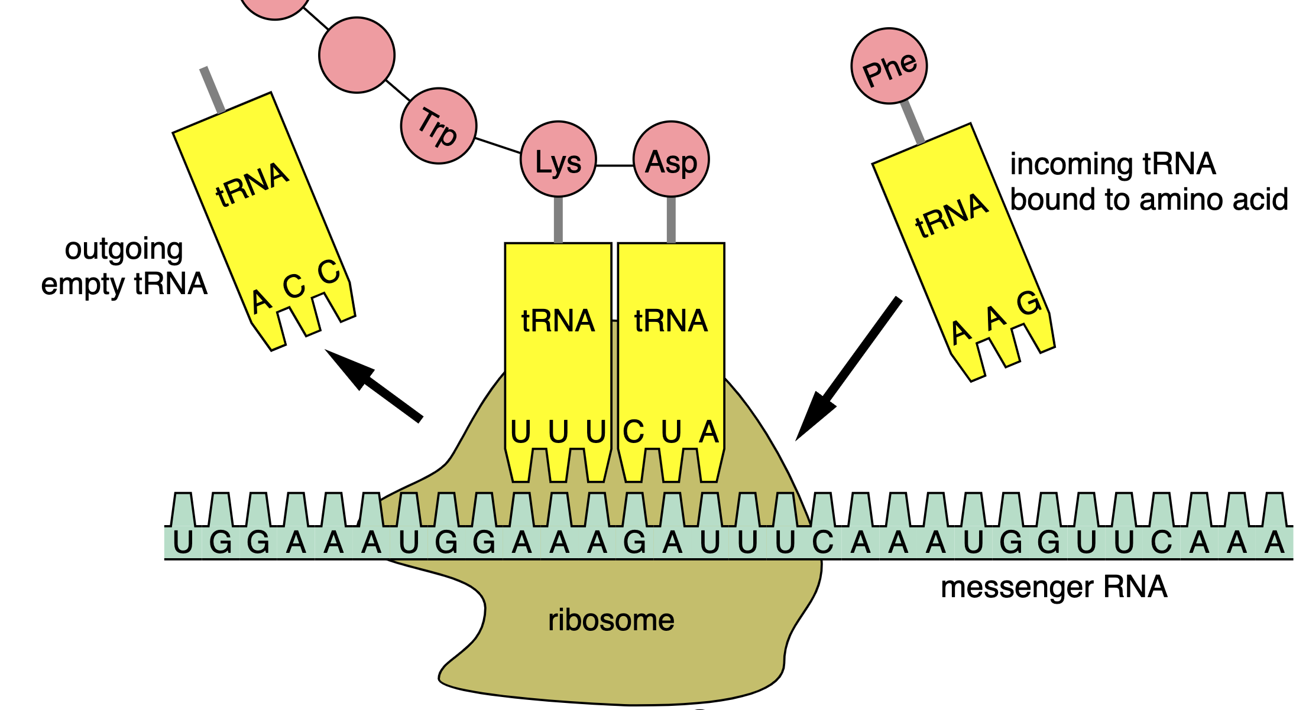
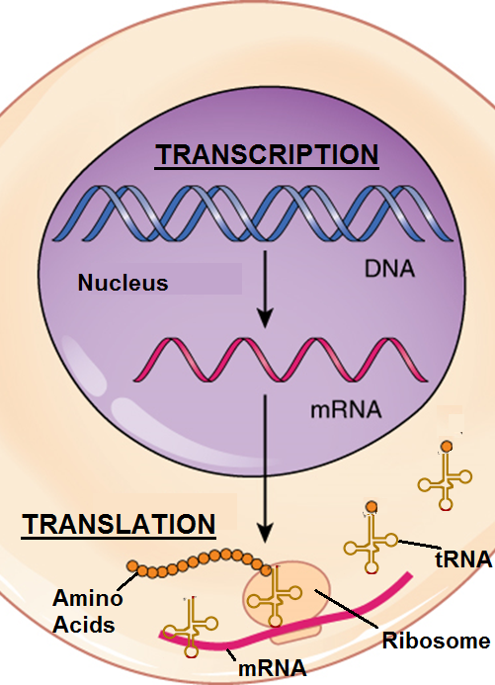
Recap of Week 1
Translation is the actual assembly of a protein using the mRNA copy.
Ribosomes are made from ribosomal RNA (rRNA); they function like molecular factories that assemble proteins from amino acids.
As mRNA moves through the ribosome, tRNA delivers amino acids to the ribosome based on each mRNA codon.
A tRNA containing the complementary bases will deliver an amino acid specific to that codon and add it to the growing chain that will become the protein.

Slide 5
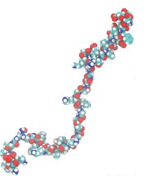
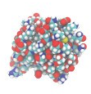
Protein Shape Determines Function
All cells assemble proteins in generally the same way.
The order of bases in the mRNA copy of DNA determines the order in which amino acids are delivered and assembled at a ribosome.
A protein generally consists of a chain of hundreds of amino acid molecules.
Each protein has a different shape and function.
Amino acids do not stay in a straight line as they leave the ribosome.
Instead, they will fold into a compact blob, eventually forming a specific shape.
The shape of a protein is what primarily determines its function.
The shape of a protein is determined by the order in which amino acids are assembled into a long chain.
Image Source; Medium
Chains of amino acids fold into a specific shape. This shape determines the function.

Slide 6
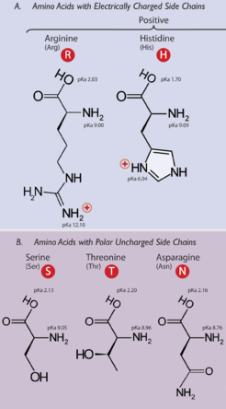
Amino Acid Properties
Different amino acids have different properties that determine the three-dimensional shape of the protein.
Some amino acids are attracted to water (hydrophilic). Some amino acids repel water (hydrophobic)*.
Some amino acids are attracted to some amino acids. Some amino acids repel some amino acids.
These properties determine the shape of the protein made from those amino acids.
The shape of the amino acid chain is determined by whether individual amino acids love/hate water, and whether they love/hate neighboring amino acids.
The shape of the protein determines its function.
* This matters because the inside of cells is primarily comprised of water.
Image Source: Wikimedia

Slide 7
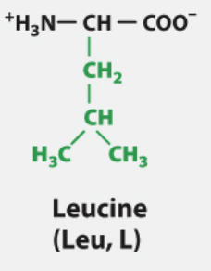
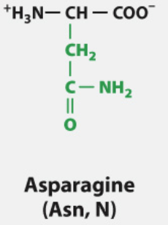
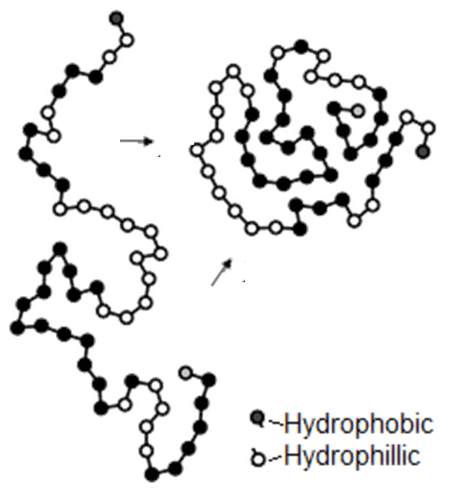
Hydrophobic vs. Hydrophilic
Image Source: Macmillan
The kinds of elements* found in each amino acid determines whether it is hydrophobic or hydrophilic.
Amino acids that are mostly carbon and hydrogen tend to repel water (hydrophobic).
E.g., Leucine is a hydrophobic amino acid.
Amino acids with more oxygen and nitrogen atoms are attracted to water (hydrophilic).
E.g., Asparagine is a hydrophilic amino acid.
Whether amino acids are hydrophobic or hydrophilic affects their placement.
Hydrophobic amino acids move to the center of a group of amino acids to “hide” from water. →
Hydrophilic amino acids move to the outside of a group of amino acids to be closer to water. →
Source: chemwiki.ucdavis.edu
Hydrophobic AA’s move to the center; hydrophilic AA’s move to the outside.
*Elements are types of atoms, such as carbon, oxygen, hydrogen, & nitrogen.

Slide 8
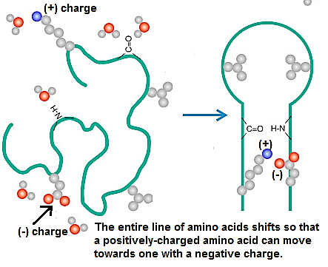
Electrical Charge
Some amino acids have a positive or a negative charge.
Oppositely-charged amino acids are attracted to each other.
A negatively-charged amino acid will move closer to a positively-charged amino acid.
This is similar to how opposite ends of a magnet are attracted to each other.
Similarly-charged amino acids repel each other.
Two amino acids with the same charge (positive-positive or negative-negative) will try to move further apart.
Source: scitechconnect.elsevier.com

Slide 9
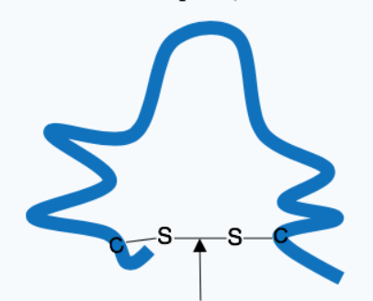
Cysteine Bonds
Amino Acid Chain
One type of amino acid, called cysteine, forms special bonds with other cysteine molecules.
Two cysteine amino acids will move the whole chain of amino acids to bond together.
The bonds between two cysteine amino acids is very strong and provides additional stability to a protein.
Amino acid properties (attraction/repulsion to water, positive/negative charge, and cysteine bonds) are what determine the shape the chain of amino acids that form the protein.
The shape of the protein determines the function of the protein.
Cysteine Bond
Two cysteine amino acids will form an extra-strong bond the strengthens and reinforces the protein.

Slide 10
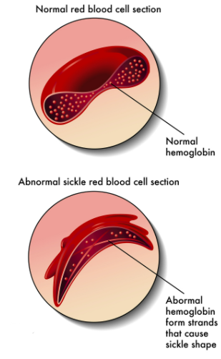
Protein Folding & Misfolding
The function of a protein depends whether a chain of amino acids folds into a correct shape.
For example, hemoglobin is the protein that binds oxygen molecules on a red blood cell.
Hemoglobin must form a ring shape in order to bind to oxygen.
Small changes in amino acid sequences can have major consequences for protein folding.
For example, a mutation in the gene for the hemoglobin protein changes a single amino acid in that sequence.
This causes the entire amino acid chain to fold into a different shape (resembling a sickle, or half moon shape).
This results in a disease called sickle cell anemia, causing tissue damage and reduced blood flow.
Image Source: Wikimedia

Slide 11
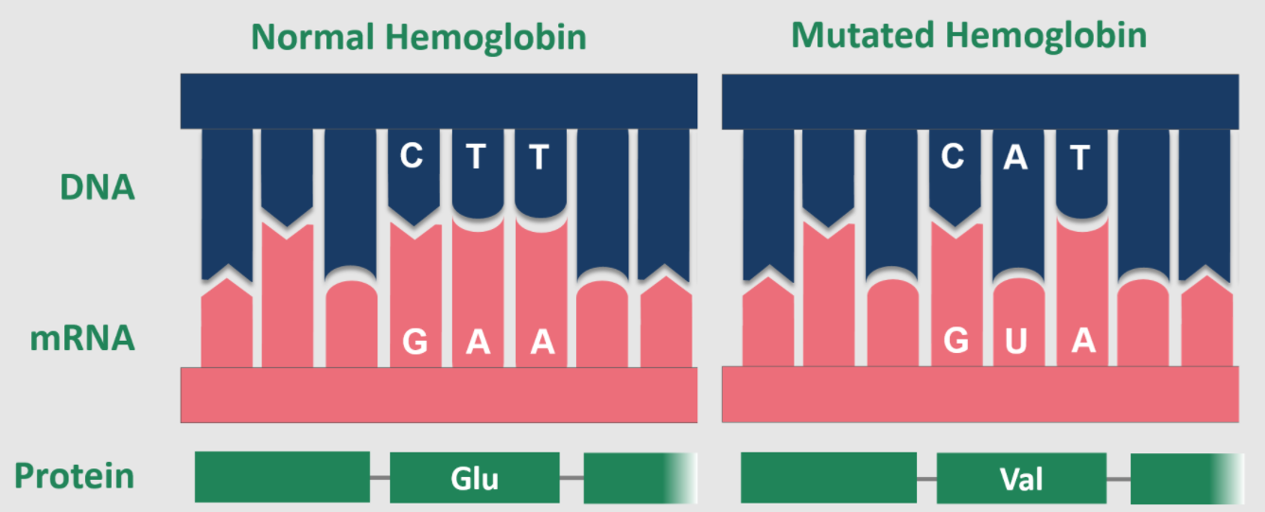
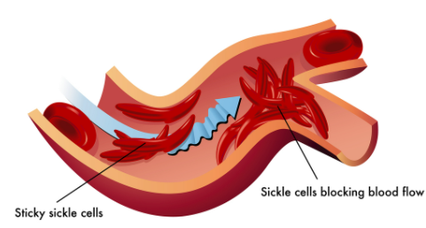
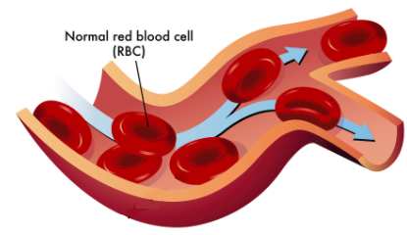
Sickle Cell Anemia
Image Source: Wikimedia
Sickle cell anemia occurs when a T-base in DNA is substituted for an A.
This causes the ribosome to add a valine instead of the glutamate amino acid.
Changing one amino acid causes the shape of the entire protein to change.
This changes the shape of red blood cells, causing clots and tissue damage.
Image Source: PBWorks
Image Source: Wikimedia

Slide 12
Genetic Modification
Image Source: Wikimedia
Adding new genes to different species.

Slide 13
Genetic Engineering
Cells perform transcription and translation in generally the same manner.
Because of this, genes from one organism can be moved to the cells of another organism and will still be functional.
Genetic engineering is the process of changing the DNA of an organism by adding or removing DNA from an organism’s genome.
A genome is the complete set of genes in an organism’s cells.
Genetically modified organisms (GMOs) are organisms that have been genetically engineered (genes were added or deleted from their genome).
Genetically modified organisms express an inserted gene in the same way they would express any other gene in their DNA.
The added gene is copied by mRNA and moved to a ribosome.
tRNA then delivers amino acids from consumed food to assemble the new cellular protein.
Image Source: Wikimedia
The mouse on the left has been genetically modified so that its cells contain the gene needed to produce glowing proteins.

Slide 14
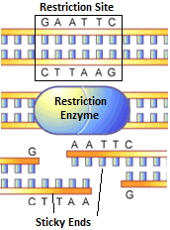
Restriction Enzymes
Genetic engineering most often involves the removal of a gene from one organism so that it can be inserted it into another organism.
To remove a gene from a genome, a restriction enzyme must be used.
A restriction enzyme is a protein that cuts DNA any time it encounters a specific sequence (such as GAATTC).
A restriction enzyme is like a chemical scissors for DNA.
The specific sequence at which a restriction enzyme cuts DNA is called the restriction site.
There are many kinds of restriction enzymes, and each one has a unique restriction site.
For example, the the EcoRI restriction enzyme cuts DNA anytime it encounters the sequence GAATTC.
Source: www.scq.ubc.ca

Slide 15
Sticky Ends
Most restriction enzymes cut DNA in a zig-zag fashion.
This causes one portion of the double-stranded DNA to stick out farther than the other portion. This is called a sticky end.
If both the inserted gene and the genome are cut with the same restriction enzyme, the gene will often insert itself into the genome.
The sticky ends of the cut gene will be complementary to the cut genome.
For example, if the inserted gene and the genome are cut so that they have AATT and TTAA for sticky ends, the AATT side of the inserted gene will be attracted to the TTAA side of the genome (because A’s always bond to T’s).
Source: www.bbc.co.uk

Slide 16
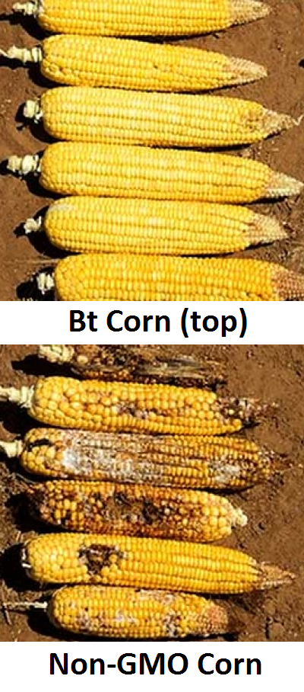
Bt Corn
Genetically modified organisms (GMOs) are increasingly common in society.
For example, Bt Corn is a widely-used variety of corn that produces its own pesticide to fight harmful insects.
A gene was added to its genome so its cells can produce a protein pesticide (a substance that fights harmful insects or other pests).
For animals like cows and humans, this protein is harmlessly disassembled into amino acids by digestive enzymes.
The insect-fighting protein in Bt Corn is naturally produced by bacteria called Bacillus thuringiensis (or Bt).
Scientists moved the gene from the DNA of this bacteria to the genome of corn.
The cells of the corn produce this protein through transcription and translation in the same way as the thousands of other proteins its cells produce.

Slide 17
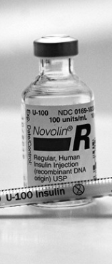
CRISPR-Cas9
Genetically modified organisms are now widely used in the United States, particularly for medicine and food.
For example, over 90% of corn and soybeans grown in the US are genetically modified.
Similarly, almost all human insulin used to treat individuals with diabetes is produced using genetically modified bacteria.
The newest method of genetic modification is called CRISPR-Cas9.
Earlier forms of genetic modification would take months or even years.
CRISPR allows for a genome to be modified in a matter of days.
CRISPR can also be used to modify the genome of fully-developed organisms (instead of a single fertilized egg cell, as was usually the case for earlier methods).
Image Source: Flickr
Notes:
Prior methods of genetic modification depended on changing genes before the fertilized egg started dividing. In addition to being faster, CRISPR can also modify the genes of developed organisms, providing a much greater range of opportunities for genetic modification.

Slide 18
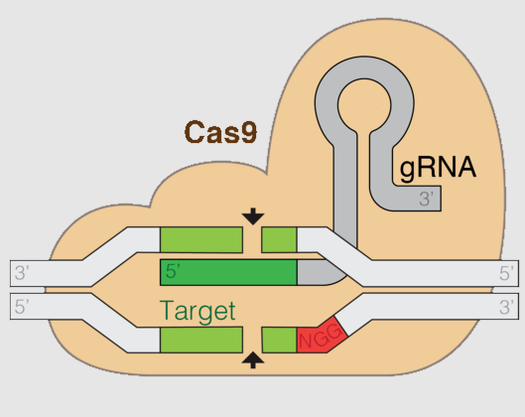
CRISPR-Cas9: What It Is
CRISPR-Cas9 is a two-part system.
CRISPR* refers to a mechanism for identifying specific sequences of DNA (like a homing device) using guide RNA.
Cas9 is an enzyme that cuts DNA whenever it encounters this specific sequence of DNA (like a chemical scissors).
CRISPR-Cas9 is similar to a restriction enzyme - it cuts DNA wherever a specific sequence of bases occurs.
However, unlike a restriction enzyme, CRISPR-Cas9 can also remove an entire gene from a genome.
Newer versions of CRISPR-Cas9 can rewrite the DNA of an organism one base at a time.
*CRISPR is an acronym for “Clustered Regularly Interspaced Short Palindromic Repeats”
Image Source: Wikipedia

Slide 19
CRISPR-Cas9: How it Works
1. A type of RNA called guide RNA (or gRNA) guides the Cas9 enzyme to the gene that need to be removed or edited.
2. Cas9 attaches to the gene and cuts the DNA at this site.
3. The cell detects that DNA has been cut and attempts to fix the breakage.
4. As the cell fixes the break, it can disable the gene or replace it with another gene.
This can be useful for eliminating harmful genes that could cause problems.
More advanced forms of CRISPR-Cas9 can insert new genes where they did not exist.
Image Source: Wikipedia

Slide 20
Revising Our Claims
Image Source; Medium
Revisit your ideas from Part 1.
How could you improve your responses to our Driving Questions?
How does a protein determine traits?
How does a chain of amino acids form a functional protein?
How do the properties of the amino acids determine the shape and function of the protein?
How can genes for valuable traits be added to new species?

Slide 21
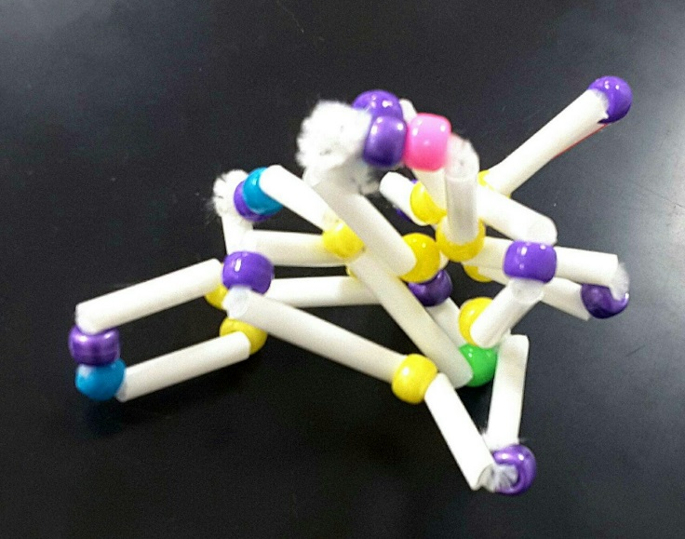
Looking Ahead: Part 3 Investigation
In Part 3 you will use models to demonstrate how chains of amino acids fold into specific shapes based on the properties of each amino acid.
Image Source: Craig Kohn

Slide 22
Key Points
The shape of a protein determines its function.
The shape of the protein is determined by the order in which amino acids are assembled (which is coded in the mRNA copy strand).
Different amino acids have different properties.
These properties determine the shape of the protein.
Some amino acids are attracted to water (hydrophilic). Some amino acids repel water (hydrophobic).
Hydrophobic amino acids move to the center of a group of amino acids.
Hydrophilic amino acids move to the outside of a group of amino acids.
Some amino acids that are attracted to each other. Some amino acids that repel each other.
Oppositely-charged amino acids are attracted to each other.
Similarly-charged amino acids repel each other.

Slide 23
Key Points
Cysteine amino acids form special bonds with other cysteine molecules.
Cysteine bonds are very strong and provides additional stability to a protein.
Small changes in amino acid sequences have major consequences for protein folding.
For example, sickle cell anemia is caused when a single base is changed in the gene, changing one amino acid which disrupts the folding of the entire protein.
This deforms red blood cells, causing clots and tissue damage.
Due to similarities between cells, genes from one organism can be moved to the cells of another organism.
Genetic engineering is the process of changing the DNA of an organism by adding or removing DNA from an organism’s genome (the complete set of genes in an organism’s cells).
Genetically modified organisms (GMOs) are organisms that have been genetically engineered.

Slide 24
Key Points
Restriction enzymes cut DNA any time it encounters a specific sequence (such as GAATTC); this sequence is the restriction site.
A restriction enzyme is like a chemical scissors for DNA.
Most restriction enzymes cut DNA in a zig-zag fashion, which causes one portion of the double-stranded DNA to stick out farther than the other portion (sticky end).
If a gene and genome are cut with the same restriction enzyme, the gene will insert itself due to complementary bases.
Genetically modified organisms are now widely used in the United States, particularly for medicine and food.
Examples include Bt corn as well as the insulin used to treat patients with diabetes.
CRISPR-Cas9 is a new gene editing technique that cuts DNA wherever a specific sequence of bases occurs.
gRNA guides the Cas9 enzyme to the gene that need to be removed or edited. Cas9 cuts the DNA at this site. As the cell fixes the break, it can disable the gene or replace it with another gene.
CRISPR-Cas9 is far faster and more effective than prior options for genetic engineering.

Slide 25
Key Vocab
Hydrophilic: attracted to water. Hydrophobic: repelled by water.
Cysteine: an amino acid that forms unique bonds with other cysteines.
Genetic engineering is the process of changing the DNA of an organism by adding or removing DNA from an organism’s genome (the complete set of genes in an organism’s cells).
Genetically modified organisms (GMOs) are organisms that have been genetically engineered
A restriction enzyme is a protein that cuts DNA any time it encounters a specific sequence (restriction site).
Sticky end: when DNA is cut so that one portion of the double-stranded DNA sticks out farther than the other portion.
CRISPR-Cas9: a new gene editing technique that cuts DNA wherever a specific sequence of bases occurs.
gRNA guides the Cas9 enzyme to the gene that need to be removed or edited.

