Slide 1
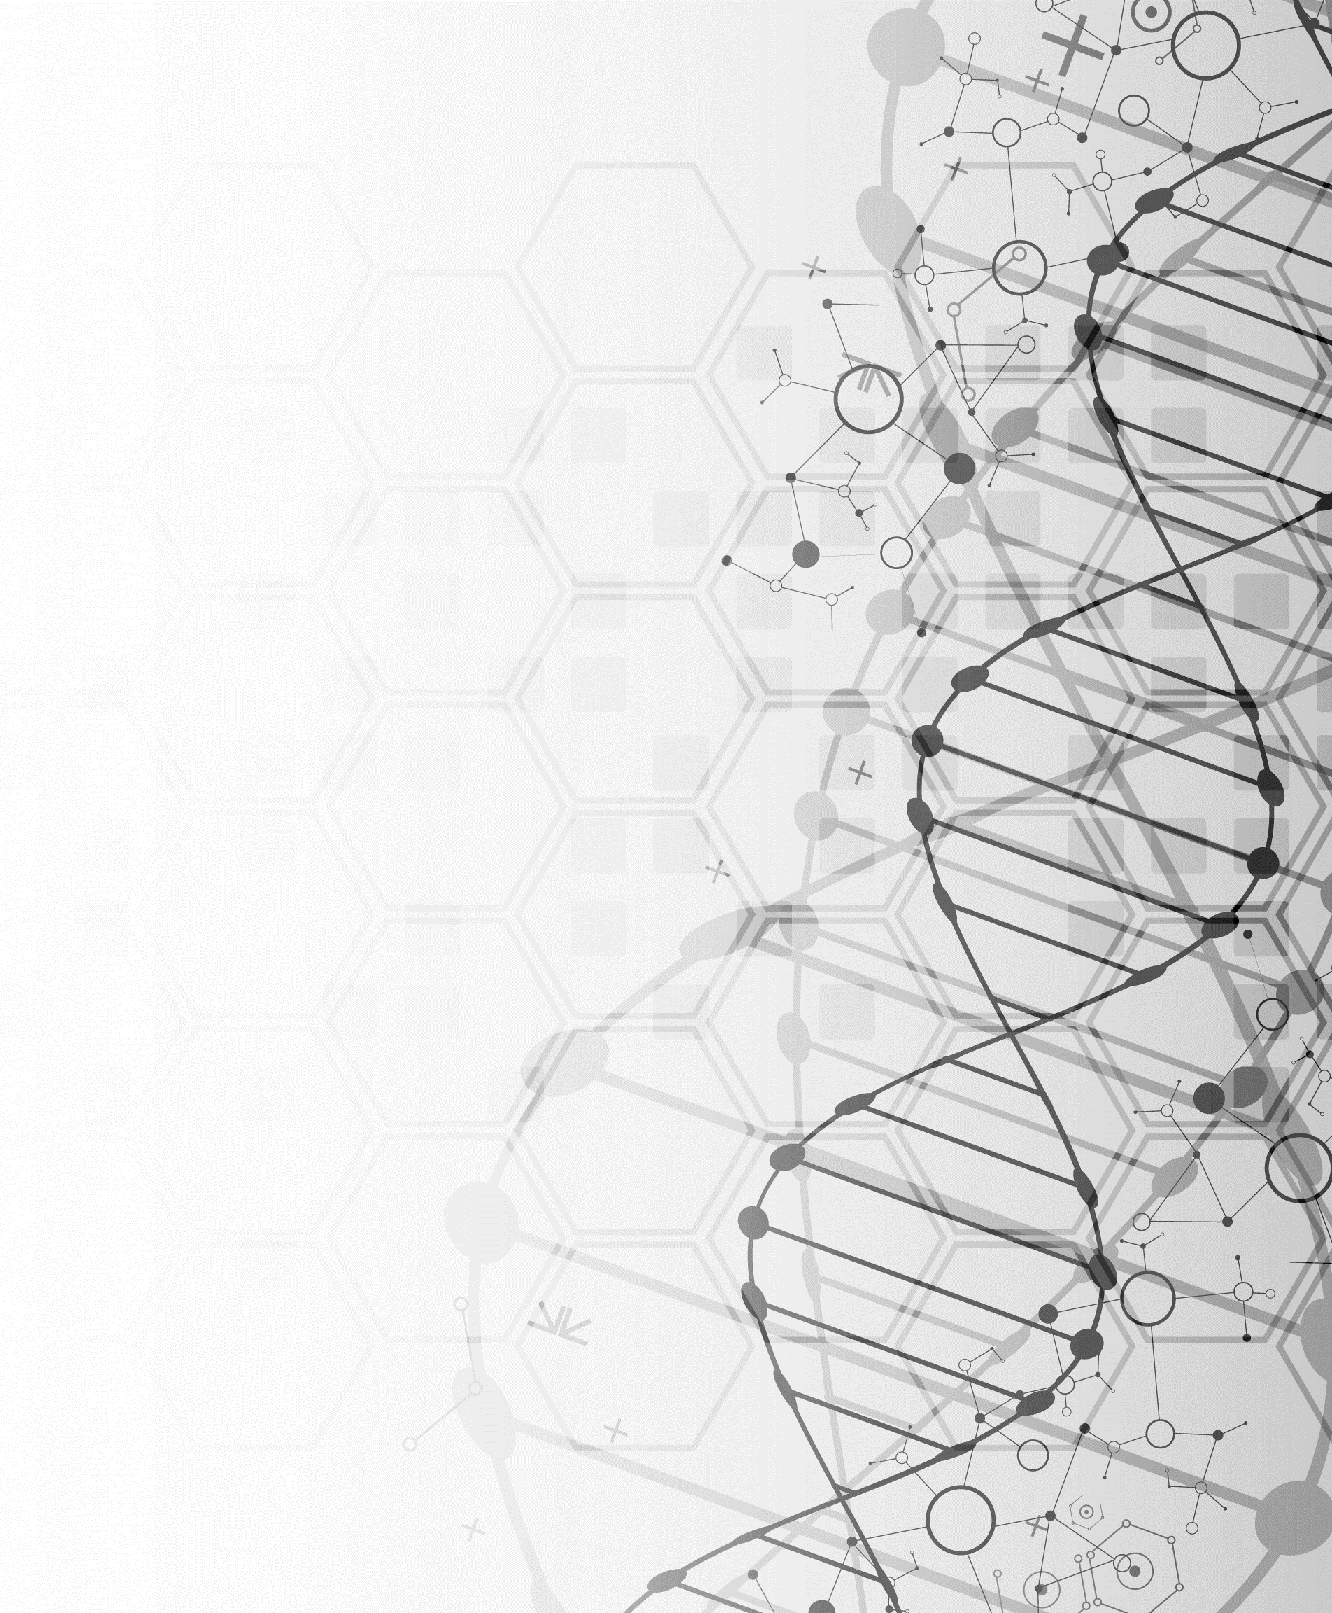

WUHS Biology: Mutations Unit
Week 1 – How do mutations change genes and proteins?

Slide 2
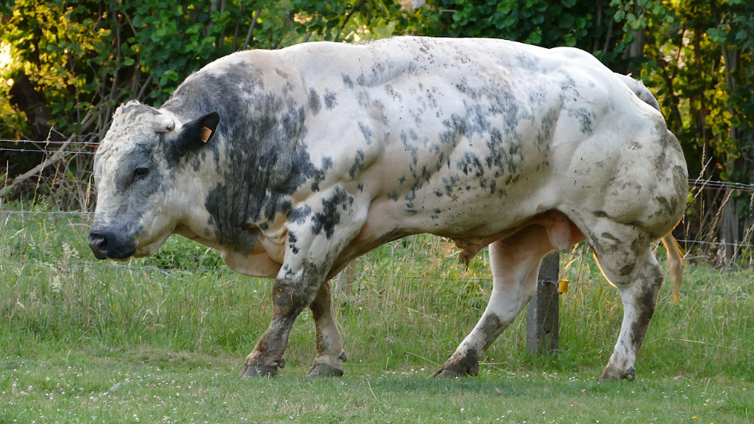
Mutations Unit – W1 Driving Question
Driving Question: How do mutations change genes & proteins?
What kinds of mutations can occur?
Why do mutations occur?
What are the impacts of different mutations?
Image Source: : Pixabay

Slide 3
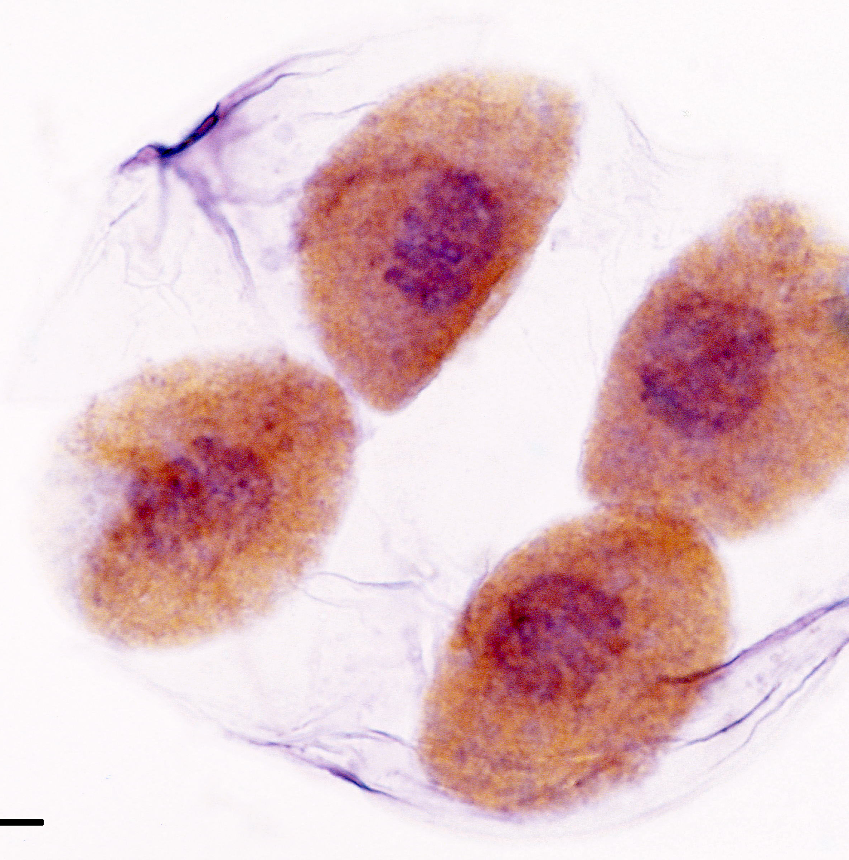
Recap of the Previous Units

Slide 4
Recap: How DNA is used by cells.
An organism’s genes (segments of DNA) determine how their cells assemble proteins.
  Proteins are primarily responsible for the observable traits of an organism.
When a cell undergoes mitosis (cell division), the DNA must be duplicated.
  The double-stranded DNA is opened by helicase; each strand of DNA is then duplicated by polymerase.
This DNA is then packaged into chromosomes and evenly divided between the two cells.
  Each cell must have its own copy of DNA to assemble its own proteins.

Slide 5
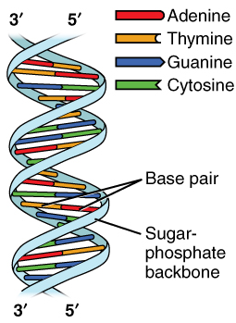
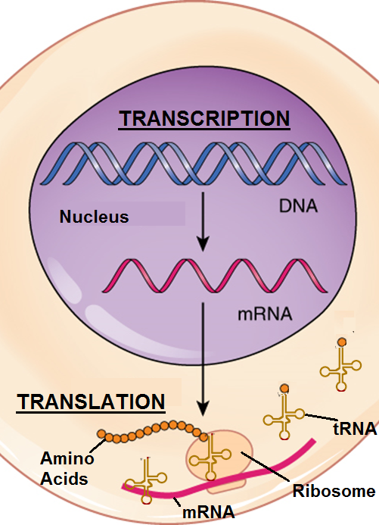
DNA & Proteins Unit Recap
DNA is a macromolecule made from repeating chains of nucleotides.
  Nucleotides consist of phosphate, sugar, and base molecules.
  DNA provides instructions for assembling proteins.
DNA contains four bases: G, C, A, and T.
  G always binds to C. A always binds to T.
  Groups of 3 bases (codons) code for specific amino acids.
  The order of codons determines the order of amino acids.
During transcription, a copy of DNA (mRNA) is made.
During translation, a ribosome assembles a protein
based on the information copied in mRNA.
  The properties of amino acids determine the shape &
  function of the protein.

Slide 6
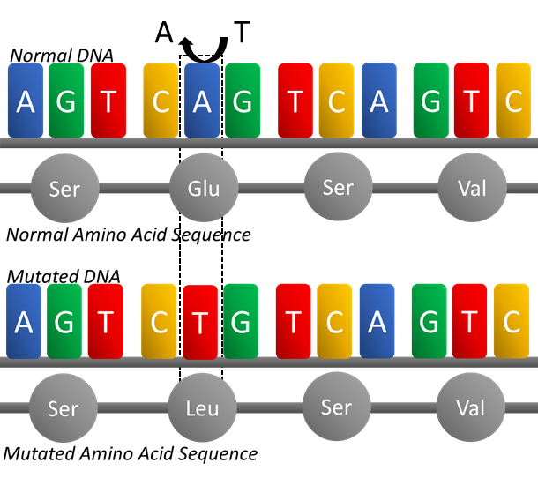
Types of Mutations

Slide 7


Mutations = Mistakes
Sometimes mistakes happen when DNA is being replicated or copied.
  A mutation occurs when DNA undergoes a permanent but unintentional change through the loss, addition, or switching of at least one base.
  For example, if a CAG codon is mistakenly copied
  as CGA, it will code for a different amino acid.
Changing a codon in a gene can change the order
in which amino acids are assembled.
  This can change the shape of that protein, which could
  change the function of that protein.
There are several different kinds of mutations.
  Mutations can range from only affecting a single base
  to changing multiple genes on a chromosome.
  The more codons affected by a mutation, the more a mutation changes the shape and function of a protein.
Glu
Arg

Slide 8
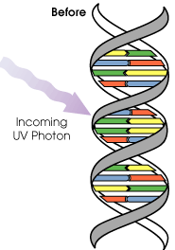
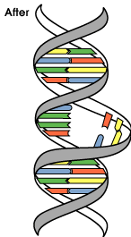
Acquired Mutations
Mutations can be either acquired or hereditary.
Acquired mutations occur sometime during the life of an organism (i.e., these mutations did not initially exist in an organism’s DNA in their early cells).
  Acquired mutations are only found in some cells in an organism.
  Acquired mutations are usually not passed on to offspring.
Acquired mutations can be caused by environmental factors or by replication mistakes during mitosis.
  Environmental factors that cause mutations are called mutagens.
    Potential sources of mutagens include UV radiation (sunlight), processed food, cigarette smoke, and X-rays.
  Acquired mutations can also result from mistakes that occur as DNA is duplicated by polymerase during mitosis.
Image Source: NASA

Slide 9
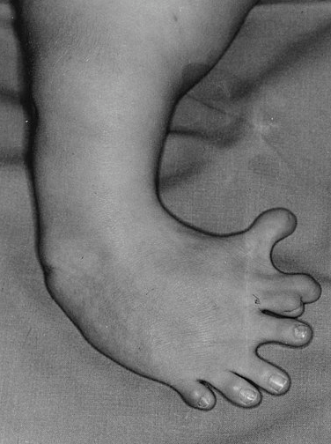
Case Study: Thalidomide
Source: Wikimedia
Thalidomide was a drug used to treat nausea in pregnant women in the mid-1900s.
  Researchers soon discovered that thalidomide treatment caused severe birth defects in thousands of children.
Thalidomide caused acquired mutations – the DNA of affected children changed as they were developing in the uterus because of the drug.
  The mutations that affected these children were not found in the sperm or egg cells of their parents.
  Instead, the mutations developed after fertilization.
  Thousands of children had
  incidences of birth defects
  as a result of thalidomide.

Slide 10
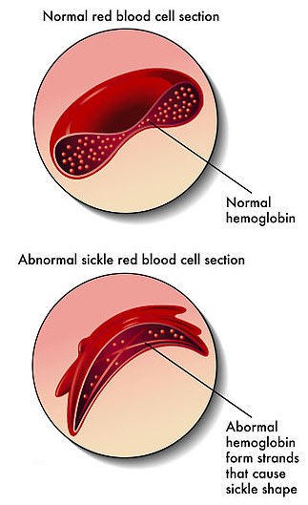
Hereditary Mutations
Source: Wikimedia
Hereditary mutations are those that can be passed on to subsequent generations and are present throughout the life of an organism.
  These mutations are found in every cell of an organism.
A mutation becomes hereditary if found in sperm or eggs cells.
  During fertilization, a sperm and egg cell combine their DNA.
  If either the egg or the sperm cell carry a mutation, all cells that divide from this cell will also replicate this mutation.
Hereditary mutations can result from different causes.
  Some hereditary mutations result from copying errors in meiosis.
  Some hereditary mutations occur during crossing over in meiosis.
    For example, bases of a gene can be lost or added when
    chromosomes exchange segments during crossing over.
  Mutagens can also change DNA in sperm and egg cells,
  resulting in hereditary mutations.
Genetic diseases, such as
sickle anemia, are usually
examples of hereditary
mutations because they are
usually inherited from parents.

Slide 11
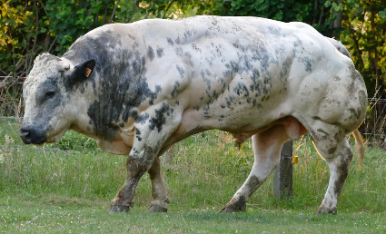
Case Study: Double Muscle Cattle
“Double muscling” is a genetic condition that can occur in cattle.
  Animals affected by this condition inherit a mutation in their gene for the myostatin protein.
  This protein regulates muscle development and limits the rate at which animals can develop muscle fibers.
Cattle with the mutated myostatin protein
are born with 2-3x as many muscle fibers.
  This results in visibly greater muscle growth
  compared to unaffected cattle.
  This is a hereditary mutation - it is passed on
  from parents and affects all cells of the organism.
Image Source: Pixabay

Slide 12
Mutations Mechanisms –
How DNA is Altered

Slide 13
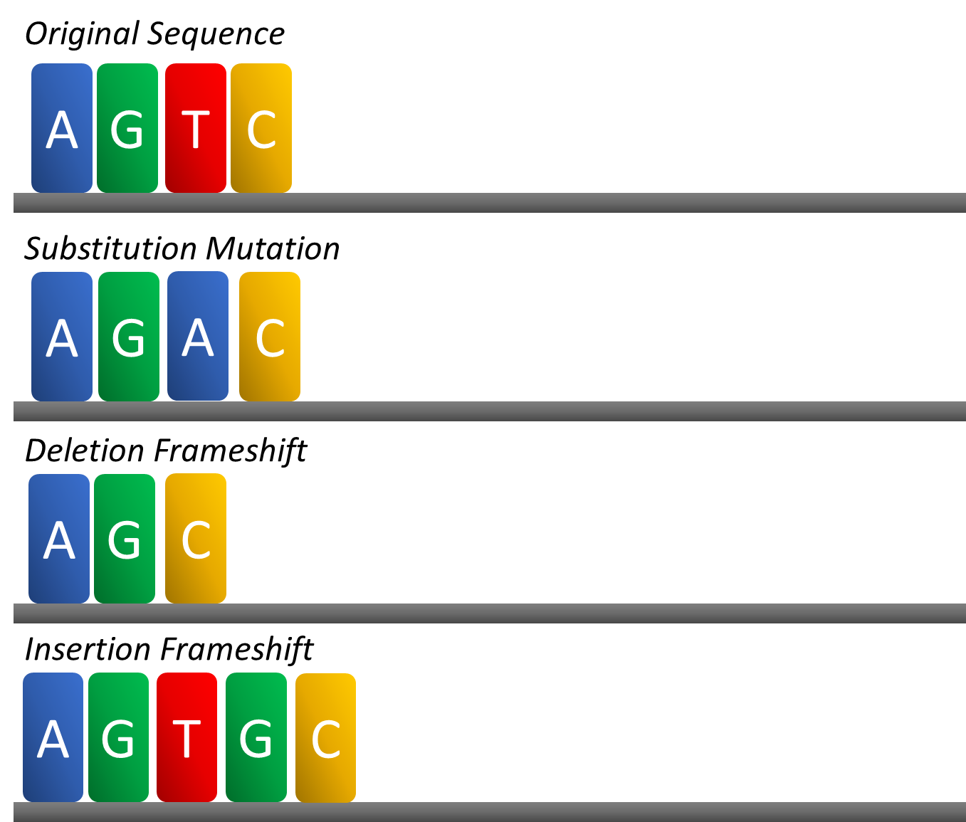
Mutations Mechanisms
A substitution mutation (or point mutation) occurs if one base is replaced by another base.
  In these mutations, usually only one codon is changed.
Some substitutions have no impact.
  For example, changing AAG to AAA still codes for lysine).
If a substitution results in a different amino acid, this can change the protein shape and function.
  If a substitution creates a stop codon, protein assembly will stop prematurely, resulting in only a partial protein.

Slide 14
Mutations Mechanisms
A frameshift mutation changes every codon that occurs after the mutation due to the insertion or deletion of a base.
  Frameshift mutations tend to have the biggest impact on protein assembly because they affect codons and amino acids after the mutation.
Frameshift mutations can be caused by insertion or deletions.
  Insertions: bases are added to genes.
  Deletions: bases are removed from genes.

Slide 15
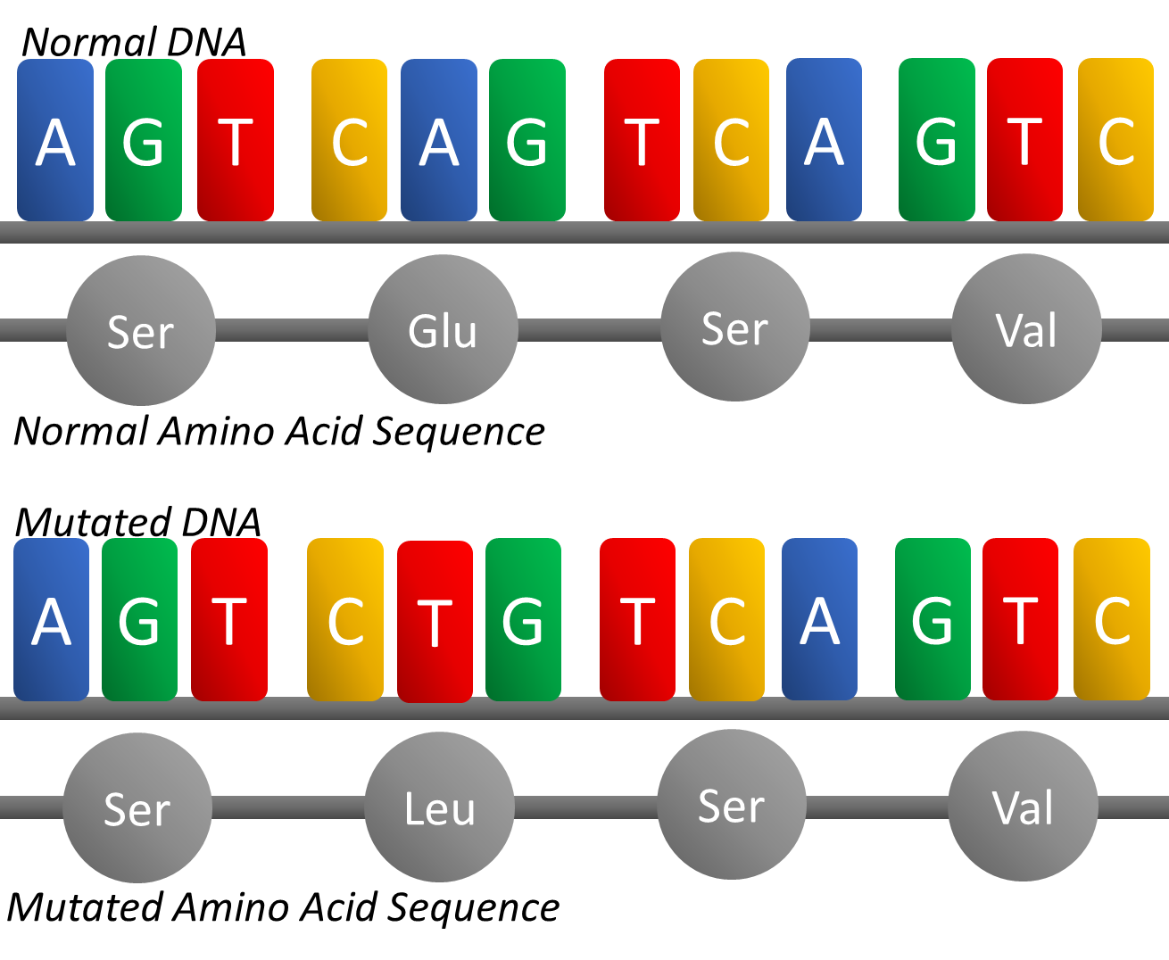
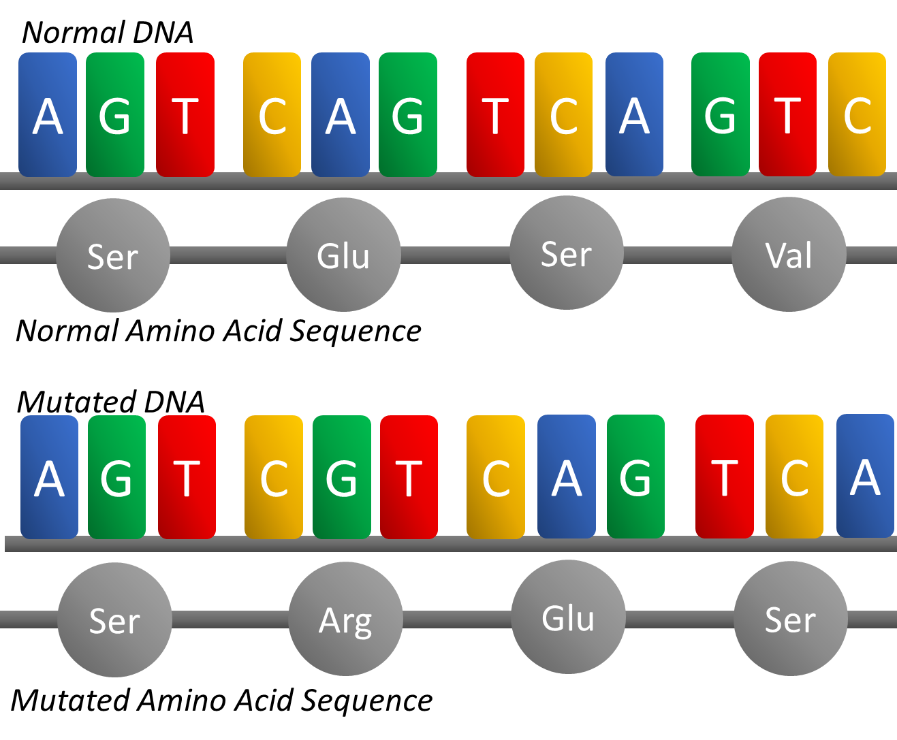
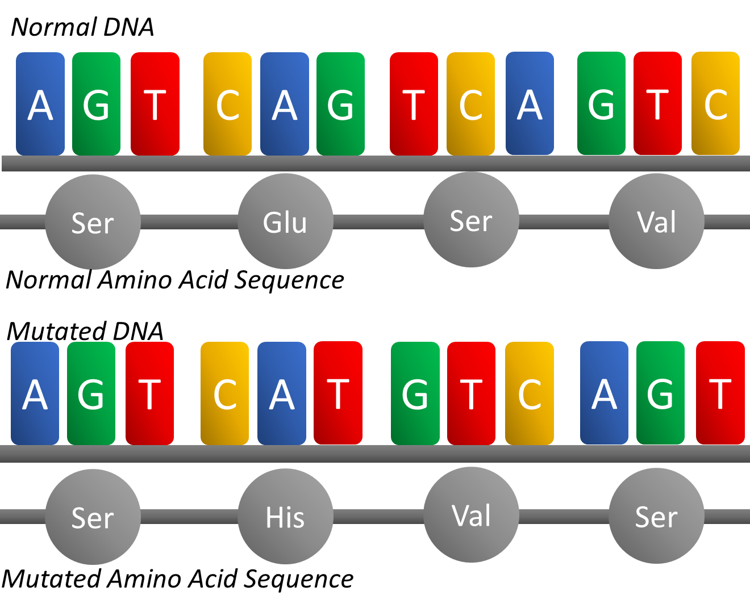
Mutations Mechanisms w/ Effects on Translation
A T
T
Substitution: one base is swapped for another.
All other bases are unaffected.
Other codons are unaffected (unless a stop codon is created).
Deletion Frameshift: one base is removed from the gene.
All other bases shift one space backward.
All subsequent codons change.
Insertion Frameshift: one base is added to the gene.
All other bases shift one space forward.
All subsequent codons change.

Slide 16
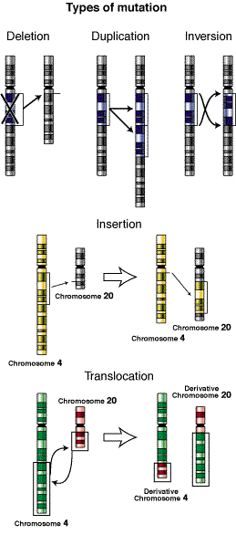
Chromosomal Mutations – Changing Multiple Genes

Slide 17
Chromosomal Mutations
Sometimes mutations can involve multiple genes.
  These are known as chromosomal mutations because they involve changes in the structure of a chromosome.
Chromosomes can be mutated in four key ways.
  Deletion: when part or all of the genes in a chromosome are lost.
  Duplication: when all or part of a chromosome is unintentionally replicated.
  Inversion: when the order of genes on a chromosome is reversed.
  Insertion/Translocation: when part of one chromosome is unintentionally inserted onto another chromosome.
Image Source: Wikimedia

Slide 18
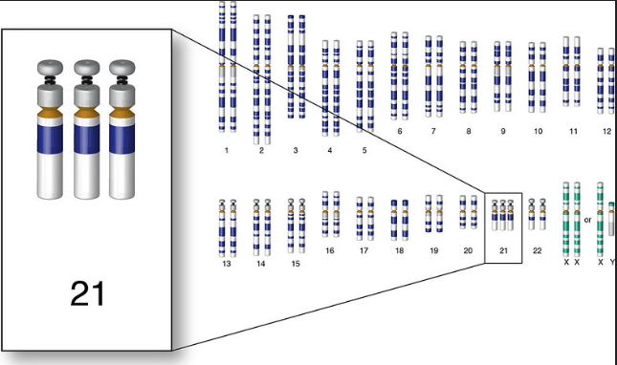
Effects of Chromosomal Mutations
The effects of chromosomal mutations can vary.
  Some chromosomal mutations may have no effect on a person's health; some chromosomal mutations can result in significant health problems.
  The impact of these mutations depend on how many genes are affected, which genes are affected, whether gene function is interrupted, and whether any genes are gained or lost.
One common example of a chromosomal
mutation is Down’s syndrome.
  Down’s syndrome results from errors during
  meiosis, resulting in gametes (sperm or egg
  cells) with three copies of the 21st chromosome.
  As a result, individuals with Down’s syndrome
  possess 47 chromosomes instead of 46.
Image Source: Flickr

Slide 19
Revising Our Claims
Revisit your ideas from Part 1.
  How could you improve your responses to our Driving Questions?
Driving Question: How do mutations change genes & proteins?
What kinds of mutations can occur?
Why do mutations occur?
What are the impacts of different mutations?
Image Source: : Pixabay

Slide 20
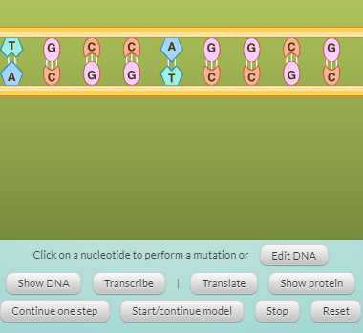
Looking Ahead:
Part 3 Investigation
In Part 3 you will be using a computer simulation to explore different kinds of mutations and their impacts of protein assembly.
Image Source: Biology Corner

Slide 21
Key Points
A mutation occurs when DNA undergoes a permanent but unintentional change through the loss, addition, or switching of at least one base.
  This changes codons, which can change the order of amino acids, which can change the shape and function of a protein.
Acquired mutations occur sometime during the life of an organism.
  Acquired mutations are only found in some cells and are not passed on to offspring.
  These mutations can be caused by replication errors during mitosis or by mutagens (environmental factors like UV radiation that can cause mutations).
Hereditary mutations are those that can be passed on to subsequent generations and are present throughout the life of an organism.
  These mutations are found in every cell of an organism and can be passed on to offspring.
  These mutations can be caused by replication errors during meiosis, by crossing over during meiosis, or by mutagens that affect the DNA of sperm or egg cells.

Slide 22
Key Points
A substitution mutation (or point mutation) occurs if one base is replaced by another base.
  Only one codon is changed, which can change the amino acid it codes for.
  Unless the substitution mutation results in a stop codon, these mutations generally do not affect the other codons or amino acids.
A frameshift mutation changes every codon that occurs after the mutation due to the insertion or deletion of a base.
  Frameshift mutations tend to have the biggest impact on protein assembly because they cause all the other amino acids to change after the mutation.
  Frameshift mutations result from the insertion or deletion of a base.
Chromosomal mutations involve changes in the structure of a chromosome and affect multiple genes.
  Chromosomal mutations can be caused by deletion or duplication of genes.
  They can also result from inversions (reversal of gene order) or insertions/translocations (movement of genes to new chromosomes).

Slide 23
Key Vocab
Mutation - when DNA undergoes a permanent but unintentional change through the loss, addition, or switching of at least one base.
Acquired mutations occur sometime during the life of an organism and cannot be passed on to offspring.
Mutagens - environmental factors that cause mutations.
Hereditary mutations are those that can be passed on to subsequent generations and are present throughout the life of an organism.
A substitution mutation occurs if one base is replaced by another base.
A frameshift mutation changes every codon that occurs after the mutation due to the insertion or deletion of a base.
Chromosomal mutations affect multiple genes and involve changes in the structure of a chromosome.

