Slide 1
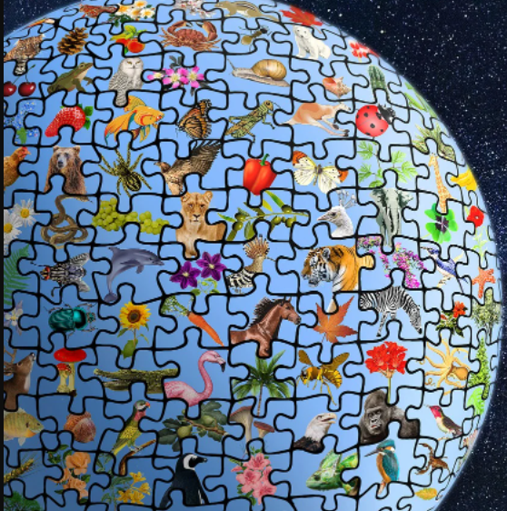
WUHS Biology: Biodiversity & Extinctions Unit
Week 1 – How does biodiversity affect ecosystems?
Image Source: Pixabay

Slide 2
Biodiversity & Extinctions Unit – Week 1
Driving Question: How does biodiversity affect ecosystems?
How can we measure biodiversity?
How is biodiversity lost?
How do humans affect biodiversity?
Image Source: : Pixabay
Source: Wikimedia Commons

Slide 3
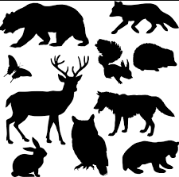
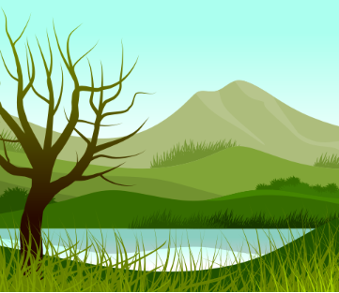
Biodiversity
Genetic Diversity: variety of traits within a species.
Evolution by natural selection increases the diversity and number of species that exist.
Biodiversity consists of the variety of living organisms and diversity of their genetic traits in an environment or area.
Biodiversity exists at multiple levels.
Biodiversity generally refers to the variety of different species (plants, animals, bacteria, etc.).
Biodiversity can also refer to the variety of genetic traits within each species (e.g. hair color, adaptations, etc.).
Biodiversity can also include the varieties of ecosystems that exist in an area.
An ecosystem consists of interactions between living species and the nonliving components.
For example, a particularly diverse area might include forests, prairies, wetlands, and aquatic ecosystems.
Image Source
Species Diversity: variety of species in an area.
Image Source
Ecosystem Diversity: variety of ecosystems in an area.
Image Source

Slide 4
How do we determine biodiversity?
There are many ways in which to measure biodiversity.
All methods measure the variety of living species in an area.
One common method is to measure species richness (the number of species in comparison to the number of individual organisms).
A common formula for measuring species richness is: number of species ÷ √number of individuals
For example, assume Ecosystem A has 10 species & 25 individual organisms. Ecosystem B has 18 species & 36 organisms.
Ecosystem A: 10 ÷ √25 = 10 ÷ 5 = 2
Ecosystem B: 18 ÷ √36 = 18 ÷ 6 = 3 Ecosystem B has greater species richness, so Ecosystem B has more biodiversity.
Notes:
More info at http://www.bio.miami.edu/dana/161/161S19_biodiversity_intro.pdf

Slide 5
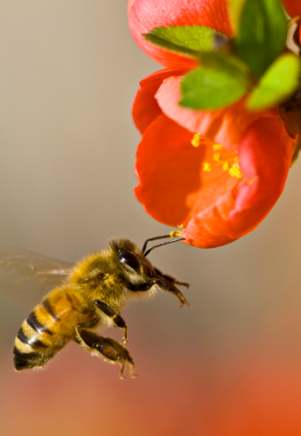
Ecosystem Services & Resiliency
Image Source: Wikimedia
The health of an ecosystem is directly dependent on the amount of biodiversity that exists in that ecosystem.
Greater levels of biodiversity result in greater levels of ecosystem services.
Ecosystem services are the benefits that an ecosystem can provide.
These benefits can range from reducing flooding and droughts to providing food and water to enabling soil formation and nutrient cycling.
Ecosystem services range from increased food production from pollinators (above) to the ability of wetlands (left) to reduce the frequency & severity of flooding.
Image Source: Geograph

Slide 6
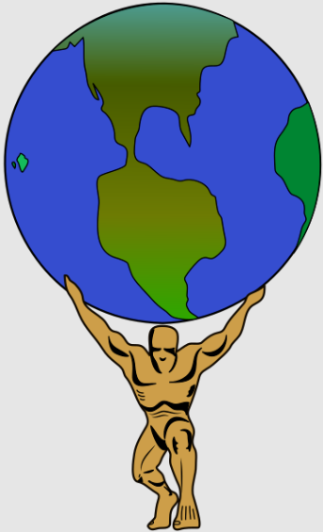
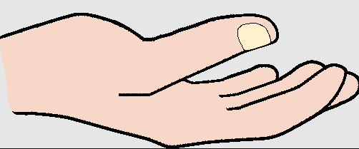
Ecosystem Services
Supporting
Nutrient Cycles
Provisioning
Food & Water
Soil Formation
Wood & Fuel
Regulating
Climate & Weather
Disease & Pests
Cultural
Spiritual/Mental Health
Education & Recreation
Pollination
There are 4 major kinds of ecosystem services.
Supporting, such as nutrient cycles, soil formation, and crop pollination.
Provisioning, such as the production of food, fuel, and fresh water.
Regulating, such as the control of climate, prevention of disease, and purifying water.
Cultural, such as spiritual, educational, and recreational benefits.
High levels of biodiversity are necessary to enable the ecosystem services that are vital for human health and well-being.
Humans would be unable to exist without a wide variety of other species.

Slide 7
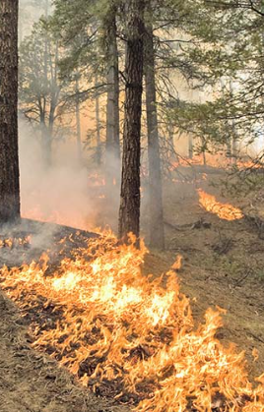
Ecosystem Resiliency
Image Source: USDA
Ecosystems with greater biodiversity also have greater amounts of resiliency to threats and disturbances.
Ecosystem resiliency is the ability of a habitat or ecosystem to recover from a threat or disturbance (such as a fire, pollution, or habitat loss).
When multiple species provide similar ecosystem services (species redundancy), a habitat becomes more resilient.
For example, ecosystems with a greater variety of plants can recover more quickly from a disturbance.
If a plant species is lost from a disturbance, others can replace it.
An ecosystem with reduced biodiversity is less capable of fully recovering from threats and disturbances.
Ecosystems with low biodiversity don’t have ‘back-up’ species to provide services if one is lost.
Ecosystems with greater biodiversity have greater species redundancy; if one species is lost, others can replace the ecosystem services it provides.

Slide 8
Relationships Among Concepts

Slide 9
Extinctions
Source: Wikimedia Commons

Slide 10
Extinction
Environmental conditions determine which genes and traits will provide a competitive advantage for survival and reproduction.
When environmental conditions change, it will changes whether the genes & traits of an organism are beneficial.
Environmental changes can lead to the extinction of species.
Extinction occurs when an entire species is eliminated from the earth.
A species goes extinct if their adaptations are insufficient for their survival needs.
If a species cannot evolve as quickly as their environment changes, an extinction will eventually occur.
Source: National Park Service
The American bison was nearly driven to extinction in the 1800s due to overhunting. The bison’s adaptations were insufficient for the changes that resulted from human predation.

Slide 11
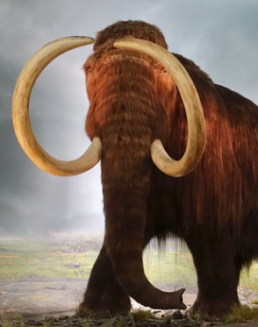
Case Study - Mammoths
Image Source: Flickr
For example, a large species of elephant called mammoths used to graze across large portions of North America.
As the last ice age ended, the traits of the mammoth became less advantageous and less competitive in its changing environment.
Beneficial mutations did not occur quickly enough to allow the mammoth to adapt to these warming conditions.
Because the changes to its environment made the mammoth’s traits less beneficial, this resulted in a lower ability to function and thrive.
This caused the mammoth to eventually go extinct.
The rate at which the mammoth’s environment changed was faster than the rate at which this animal could adapt. Eventually, this caused the mammoth to go extinct.

Slide 12
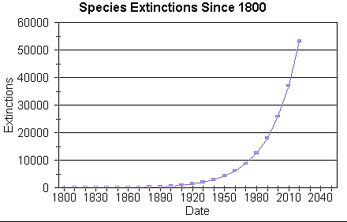
Human Caused Extinctions
Image Source: Quora
The primary cause of today’s rate of extinction is human activity, which is causing rapid environmental changes throughout the world.
As a result, current rates of extinction are far more rapid than normal.
The planet is currently losing an average of about 4-6 species an hour.
This is roughly 300 times faster than the extinction rate of the dinosaurs.
This rate of extinction threatens ecosystem function & living species.
All species (even humans) depend on high levels of biodiversity for sufficient ecosystem services.

Slide 13
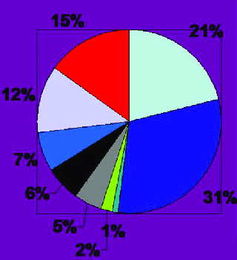
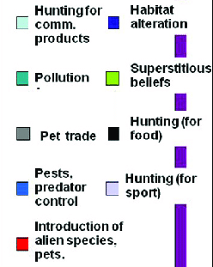
Human Causes of Extinction
Image Source: Research Gate
Four kinds of disturbances from human activity are primarily responsible for this unsustainable rate of extinction. These include:
1) Habitat loss and habitat degradation.
2) Invasive species (introduced from human transportation).
3) Imbalances in matter and energy caused by pollution.
4) Overharvesting/overhunting of species and natural resources.

Slide 14
Revising Our Claims
Revisit your ideas from Part 1.
How could you improve your responses to our Driving Questions?
Driving Question: How does biodiversity affect ecosystems?
How can we measure biodiversity?
How is biodiversity lost?
How do humans affect biodiversity?
Source: Wikimedia Commons

Slide 15
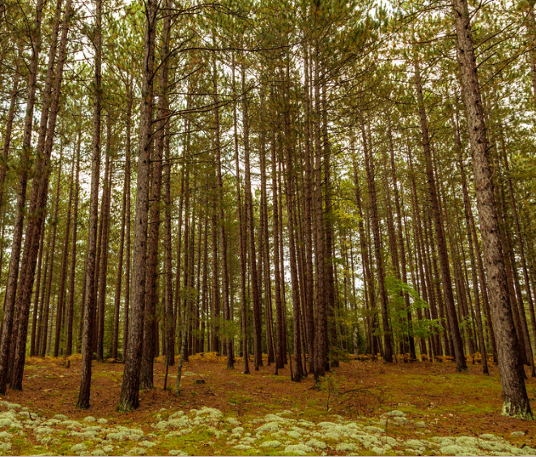
Looking Ahead: Part 3 Investigation
In Part 3 you will be visiting a local habitat to determine if any of the primary causes of extinction from human activity can be observed in that area.
Image Source: Flickr

Slide 16
Key Points
Biodiversity consists of the variety of living organisms and diversity of their genetic traits in an environment or area.
Biodiversity can refer to the variety of genetic traits, the diversity of different species, or the varieties of different ecosystems in an area.
One common way to measure biodiversity is by calculating species richness (the number of species in comparison to the number of individual organisms).
Species richness can be measured by dividing the number of species by the square root of the total number of organisms (species ÷ √individuals).
Greater levels of biodiversity result in greater levels of ecosystem services (the benefits that an ecosystem can provide).
Four kinds of ecosystem services: supporting (e.g., soil formation, pollination), provisioning (e.g., water & food), regulating (e.g., climate & disease), and cultural.

Slide 17
Key Points
Ecosystems with greater biodiversity also have greater amounts of resiliency to threats and disturbances.
Biodiversity increases species redundancy (multiple species to provide similar ecosystem services), which makes a habitat more resilient.
If a species is lost from a disturbance, others can still provide its services.
When environmental conditions change, it also changes whether the genes and traits of an organism are beneficial.
A species goes extinct if their adaptations are insufficient for their survival needs as their environment changes.
E.g., as the last ice age ended, the mammoth’s traits were less advantageous; beneficial mutations did not occur quickly enough, causing extinction.
The primary cause of today’s rate of extinction is human activity, which is causing rapid environmental changes throughout the world.

Slide 18
Key Points
The planet is currently losing an average of about 4-6 species an hour.
This is roughly 300 times faster than the extinction rate of the dinosaurs.
This rate of extinction threatens ecosystem function & living species.
All species (even humans) depend on high levels of biodiversity for sufficient ecosystem services.
Four kinds of disturbances from human activity are primarily responsible for this unsustainable rate of extinction. These include:
1) Habitat loss and habitat degradation.
2) Invasive species (introduced from human transportation).
3) Imbalances in matter and energy caused by pollution.
4) Overharvesting/overhunting of species and natural resources.

Slide 19
Key Vocab
Biodiversity consists of the variety of living organisms and diversity of their genetic traits in an environment or area.
Species richness: the number of species in comparison to the number of individual organisms. Species richness is one way to measure biodiversity.
Ecosystem services are the benefits that an ecosystem can provide.
Ecosystem resiliency is the ability of a habitat or ecosystem to recover from a threat or disturbance (such as a fire, pollution, or habitat loss).
Species redundancy: when multiple species provide similar ecosystem services.
Extinction occurs when an entire species is eliminated from the earth.

