Slide 1
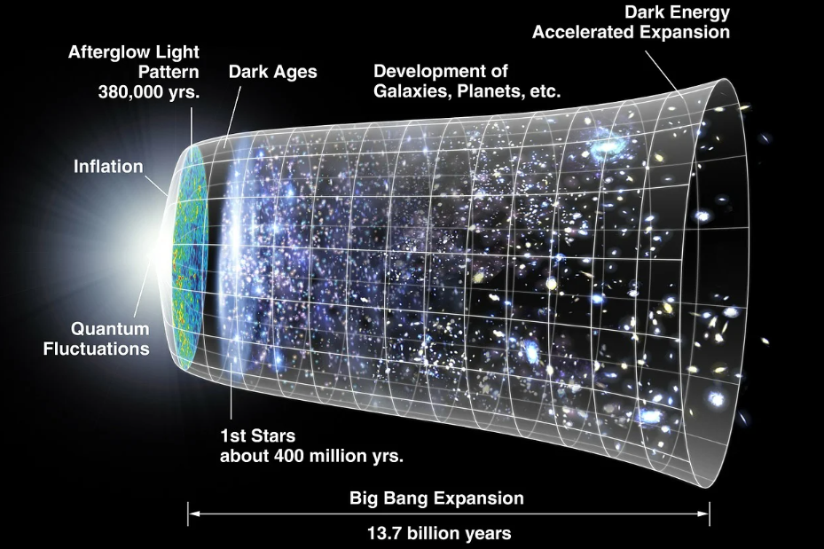
Week 2 – How can expansion determine the universe’s age?
Image Source: Pixabay
Big Bang Unit - Waterford Astronomy

Slide 2
Driving Questions
Image Source: Wikimedia
How can expansion determine the universe’s age?
How did matter and energy change as the Big Bang occurred?
How does the ratio of hydrogen and helium provide evidence for the Big Bang?
What is antimatter, dark matter, and dark energy?
How has evidence from sources like CERN, the Hubble Telescope, and JWST shaped our existing understanding of the Big Bang?

Slide 3
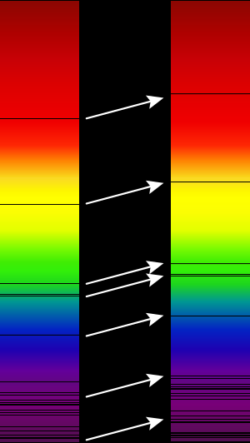
Recap of Week 1
Big Bang Unit
Image Source: Wikimedia

Slide 4
Week 1 Recap
Image Source: Wikimedia
During the 1920s, Harlow Shapely used Cepheid variables to determine distances in the Milky Way.
Cepheid variables pulse with energy at a predictable rate based on their luminosity (brightness).
By comparing the apparent magnitude (perceived brightness) to their luminosity (actual brightness, as calculated by the pulsation rate), Shapely was able to determine distances to distant galaxies (but with errors due to dust from nebulae).
Hubble’s work with Cepheids confirmed that the Milky Way was just one galaxy among many in the universe.
Hubble also determined that the redshift of light from objects was proportional to its distance.
Redshift: as objects move away, the light they emit has longer wavelengths, shifting bands in the spectral signature.

Slide 5
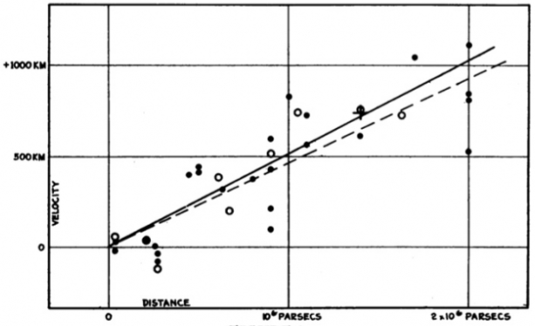
Week 1 Recap
Redshift was key for determining Hubble’s Law & Hubble’s Constant.
Hubble’s Law - the rate at which a galaxy is moving away from a point is proportional to its distance from that point; i.e., the further away the galaxy, the greater its velocity (distance / time).
The Hubble Constant indicates the relationship between the velocity and distance of a galaxy. If you know the Hubble Constant and the velocity of a galaxy (via redshift), you can determine its distance.
Both indicate the universe is expanding.
The idea of an expanding universe is also supported by CMBR – faint uniform electromagnetic radiation that is found throughout the universe.
CMBR suggests the universe was once very hot and very dense but cooled over time.
Source: PSU.edu

Slide 6
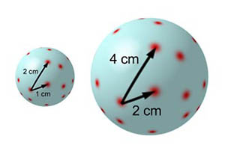
Week 1 Recap
Image Source: Physics World
The greater the distance of an object from earth, the faster at which it is moving away from earth.
The expanding universe is similar to an inflating balloon. As you inflate the balloon, each dot will move further away from each other.
The greater the distance between two dots (or two galaxies), the greater the rate at which they move away.
The math underlying Einstein’s theories of relativity also predict a changing universe that cannot remain static & fixed.
Einstein’s original calculations perfectly predict the expansion of the universe.

Slide 7
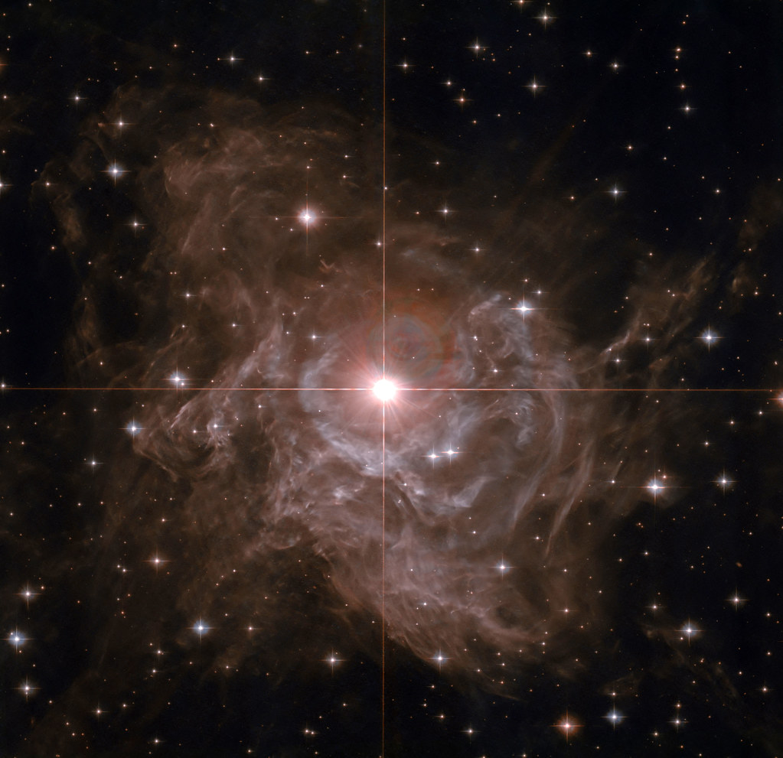
In the beginning…
Image Source: Flickr

Slide 8
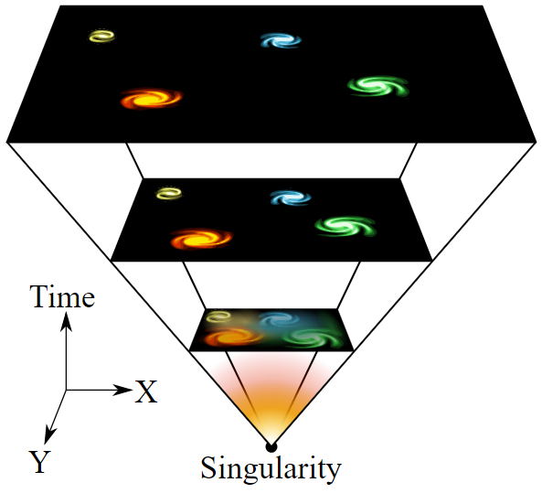
What the Evidence Suggests
Multiple forms of evidence indicates that all galaxies are moving apart at a rate of roughly 70 km/s/Mpc.
This suggests that at some earlier point, all matter in the universe was condensed into a single point of infinite density (known as a singularity).
This is the underlying premise of the Big Bang Theory.
This scientific theory argues that all matter and energy in the universe emerged from a single point with extremely high density and temperature.
Like any scientific theory, the Big Bang is testable, enables predictions, & emerged from valid evidence & observations.
In science, the term theory refers to a testable explanation for a phenomenon based on credible evidence & explanatory models.
A scientific theory is the most widely accepted explanation for a phenomenon based on a consensus of evidence and arguments.
It is not just a hunch or a guess – it’s the most likely explanation based on logical analysis and empirical evidence.
Image Source: Wikimedia

Slide 9
The Radiation Era
Image Source

Slide 10
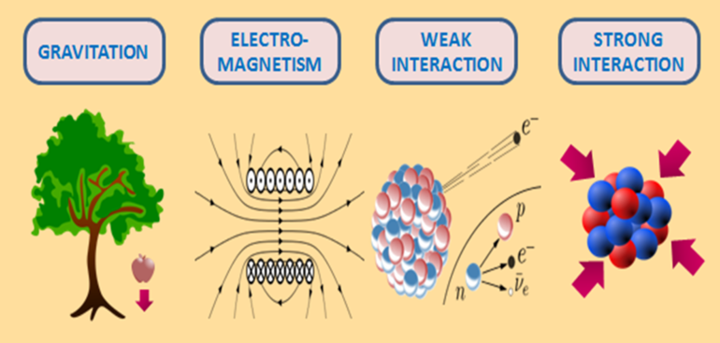
Big Bang Timeline
Events that occurred during the Big Bang can be categorized based on when they occurred.
These timeframes are known as eras.
Radiation Era: 0 to ~50,000 years after the Big Bang.
Initially, all matter and energy were condensed on a single point of infinite density and heat.
Because of this, the state of the universe was highly unstable; matter and energy operated completely differently under these conditions.
At first, the four fundamental forces (gravity, electromagnetism, and strong & weak nuclear forces) were a single unified force.
The Theory of Everything states that at high enough energy levels, all four forces will combine back into one unified force.
Image Source
Notes:
http://ffden-2.phys.uaf.edu/webproj/211_fall_2016/Trevor_Jepsen/trevor_jepsen/plank_epoch.html

Slide 11
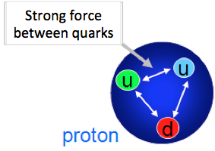
Grand Unification Epoch
About 10⁻⁴³ to 10⁻³⁶ seconds after the Big Bang, the universe expanded & cooled.
This caused the force of gravitation to separate from strong and weak nuclear forces and electromagnetism.
Strong nuclear force is what binds protons and neutrons in atomic nuclei; it is the strongest of the four fundamental forces.
Weak nuclear force affects radiation and the emission of neutrinos during fusion reactions.
This is also when the first elementary particles began to form.
Elementary Particles are the simplest form of matter possible – they have no substructure.
These include quarks (which form neutrons and protons) and leptons (which form electrons).
This also includes bosons, causing attractions that create forces.
Image Source

Slide 12
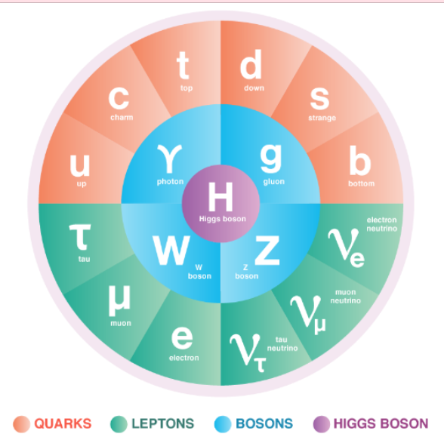
Elementary Particles
Image Source
The Standard Model of Particle Physics argues that...
Particles called quarks make up protons and neutrons; leptons make up electrons.
Quarks & leptons make up all known matter.
Particles called bosons carry forces and influence quarks and leptons.
Electromagnetism is carried by photons.
The Higgs Boson is the fundamental particle and gives mass to other particles.

Slide 13
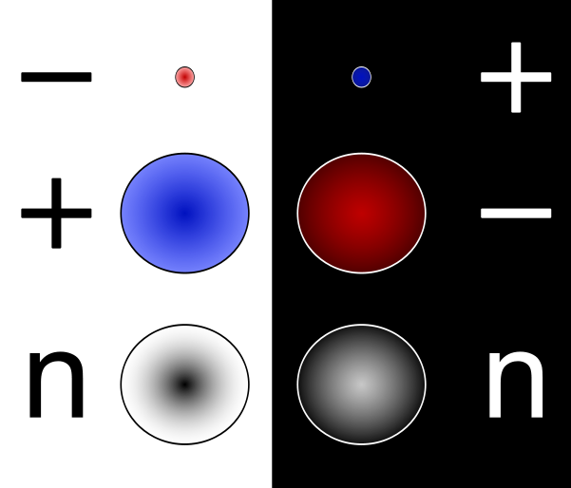
Antimatter
At 10⁻³⁶ seconds after the Big Bang, individual photons carried enough energy to continuously create matter & antimatter.
Antimatter (or antiparticles) exactly match matter but with an opposite charge.
For example, for every electron there should be an "antielectron“ (a positron) which is identical but with a positive electric charge.
When matter encountered antimatter, they annihilated each other in a flash of energy.
Most antimatter and matter have already annihilated each other since the Big Bang.
All that remains is the slight excess of matter (30 million vs. 30 million and one).
Why this imbalance occurred is unknown.
We don’t know why matter ‘outcompeted’ antimatter.
Image Source: Wikimedia
Notes:
https://home.cern/science/physics/antimatter

Slide 14
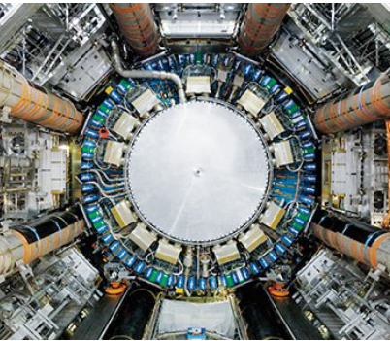
Evidence for Antimatter & Particle Colliders
We know antimatter exists in part because antimatter can be artificially created in high-energy reactions.
Antimatter was first artificially created in 1995 at CERN, which is home to the Large Hadron Collider (LHC), a circular 17 mile “race track” for particles.
This particle accelerator uses powerful magnetic fields to move particles at nearly the speed of light before colliding.
The LHC has led to numerous other discoveries, including confirmation of the existence of the Higgs boson in 2012.
Image Source
*CERN is a French acronym for European Council for Nuclear Research.
Image Source

Slide 15
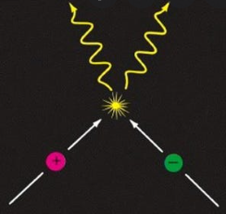
Mass Annihilation
Within the first 100 seconds after the Big Bang, temperatures were no longer sufficient to create new matter & antimatter.
Mass annihilation left in just one in 10¹⁰ of the original protons and neutrons, and none of their antiparticles,
Similar outcomes occurred for electrons and positrons.
These conditions enabled the start of Big Bang nucleosynthesis.
Temperatures dropped to 1 billion kelvin as expansion continued.
This enabled some neutrons and protons to combine and form deuterium (hydrogen isotopes containing both a proton and a neutron).
This deuterium was quickly broken apart by intense gamma radiation.
Image Source

Slide 16
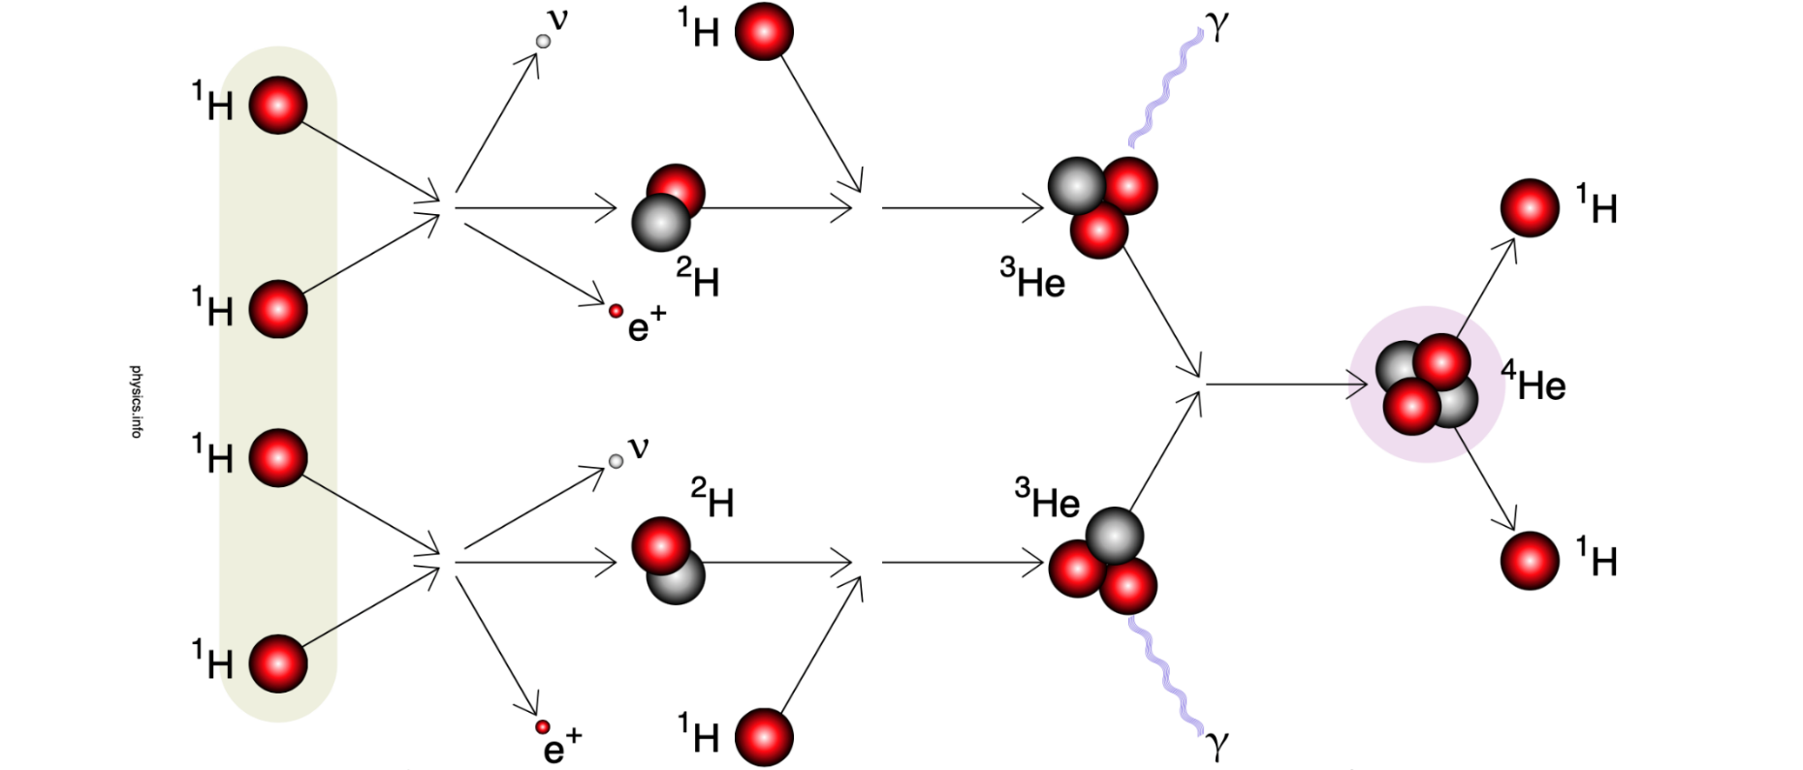
Primordial Nucleosynthesis
At roughly 2 minutes after the Big Bang, the temperature of the universe cooled to 900 million K.
Deuterium could now exist without being broken apart by gamma radiation.
This was still hot enough to fuse into ³He and ⁴He.
This created much of the helium that exists in the universe today.
The existing ratio of hydrogen to helium in the universe provides evidence for the Big Bang Theory.
The amount of helium in the universe today (25%) is far too high to be produced by stellar fusion.
The intense heat in the minutes after the Big Bang enabled fusion of hydrogen into helium.
These fusion reactions continued until about 1000 seconds after the Big Bang.
As the universe continued to expand and cool, this process of primordial nucleosynthesis stopped at helium (w/ trace amounts of lithium).
Image Source: https://physics.info/fusion/

Slide 17
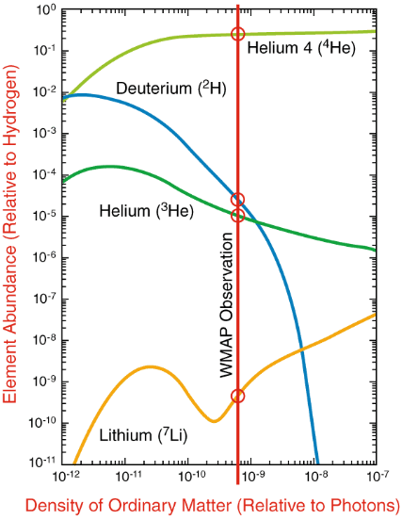
Primordial Deuterium
Image Source: NASA
During primordial nucleosynthesis, most deuterium quickly fused into helium as soon as it formed.
Only a small amount of deuterium remained when these reactions stopped by 1000 seconds after the Big Bang.
Deuterium is destroyed during fusion in stars, so any deuterium now in existence formed during the Big Bang.
Deuterium concentrations provide a way to estimate matter concentrations.
For every 100,000 protons, there should be 2 deuterium.
These analyses indicate that most matter is dark matter, a form of invisible material that can be detected only because of its gravitational effects.
We don’t know what dark matter is, but we know it’s there.

Slide 18
The Matter Era
Image Source

Slide 19
Matter Era
Image Source
The Matter Era occurred from roughly 50,000 to 100 million years after the Big Bang.
Prior to this time, the universe was a ‘hot soup’ of subatomic particles.
As the universe continued to cool, protons and neutrons continued to combine into hydrogen nuclei.
At around 380,000 years, these atoms were able to attract electrons, forming neutrally-charged atoms. This allowed radiation to travel freely.
This radiation is what now constitutes Cosmic Microwave Background Radiation (CMBR), the oldest radiation in the universe.
Perturbations, or disturbances in this radiation may yield insights into the ultimate fate of our universe.
Notes:
https://webb.nasa.gov/content/science/firstLight.html

Slide 20
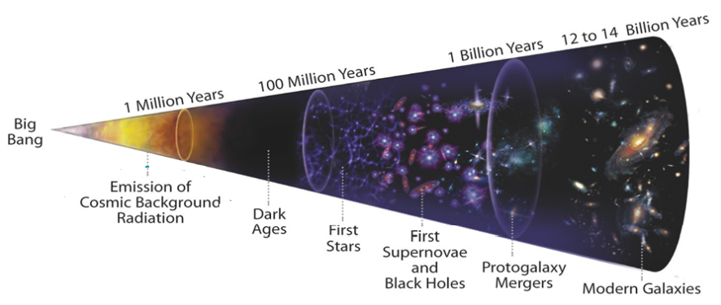
Matter Era
Image Source
The period after the formation of the first atoms (w/ a proton, neutron, and electron) are often called the “dark ages”.
Photons of light are scattered by ionized particles (those with a charge).
As electrons formed neutrally-charged atoms, photons could move in straight paths instead of constantly being scattered by electrons.
This resulted in nearly uniform light radiation that filled the whole universe.
The first stars had not yet formed, hence the “dark ages”.
Notes:
https://lambda.gsfc.nasa.gov/product/suborbit/POLAR/cmb.physics.wisc.edu/tutorial/bigbang.html
https://www.physicsoftheuniverse.com/topics_bigbang_timeline.html?scrlybrkr=89d673a5
https://sites.uni.edu/morgans/astro/course/Notes/section3/bigbang.html
https://lambda.gsfc.nasa.gov/product/suborbit/POLAR/cmb.physics.wisc.edu/tutorial/bigbang.html

Slide 21
Matter Era
Image Source
During the next 100-200 million years, most matter (protons, neutrons, and electrons) were almost uniformly distributed.
Some areas had slightly denser concentrations of matter, and matter in these regions became more dense as a result of gravitational attraction.
This formed the nebulae (gas clouds), which condensed into the first stars.
Between 200 million and 3 billion years after the Big Bang most galaxies had formed and early generations of stars were burning and exploding.
Initially, the universe consisted mostly of hydrogen, with a smaller amount of helium and trace amounts of lithium.
The remaining elements formed through fusion and from supernovae.
Notes:
https://www.astro.ucla.edu/~wright/BBhistory.html

Slide 22
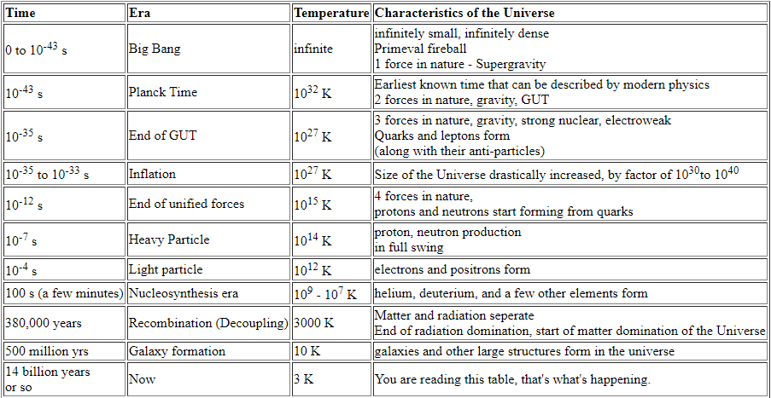
Source: https://sites.uni.edu/morgans/astro/course/Notes/section3/bigbang.html

Slide 23
The Dark Energy Era
Image Source: Pixabay

Slide 24
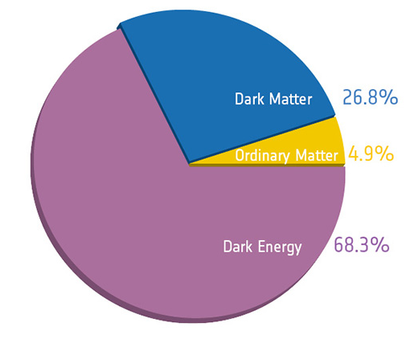
Faster Expansion
Image Source
In 1998, observations from the Hubble Space Telescope (HST) indicated that a long time ago, the universe was actually expanding more slowly than it is today.
The expansion of the universe was not slowing due to gravity, as most initially believed; instead it has been accelerating.
This accelerating rate of expansion is now thought to be caused by dark energy.
Dark energy is a theoretical repulsive force that counteracts gravity and causes the universe to expand at an accelerating rate.
Roughly 68% of the universe is dark energy.
Dark matter makes up about 27%.
All ‘normal matter’ comprises <5% of the universe.
Notes:
https://science.nasa.gov/astrophysics/focus-areas/what-is-dark-energy

Slide 25
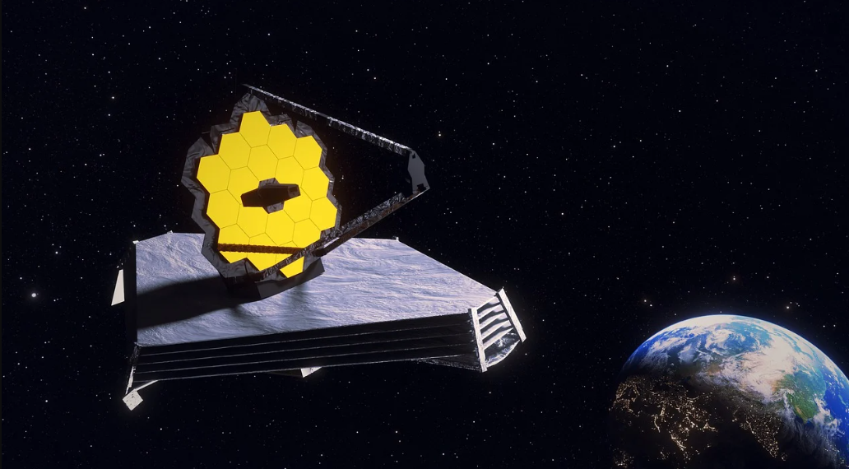
JWST – Studying the Big Bang
Image Source

Slide 26
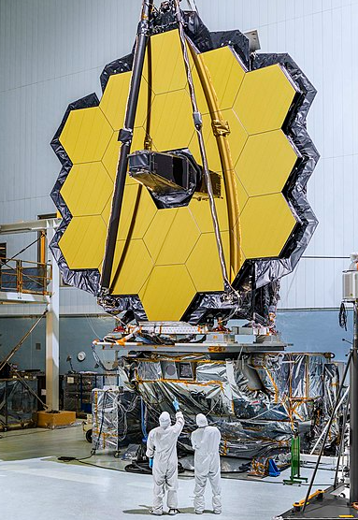
James Webb
Image Source
The James Webb Space Telescope (JWST or Webb) is a large infrared telescope that is being used to study every phase in the history of the Universe.
The telescope’s cameras and spectrometers have detectors that are able to record extremely faint signals.
JWST will be able to analyze light as old as 13.5 billion years to analyze the first stars and galaxies in the early universe.
JWST relies on infrared light.
For very distant objects, redshift is so extreme that it has moved beyond visible light to the infrared radiation (IR) range of the electromagnetic spectrum.
Image Source

Slide 27
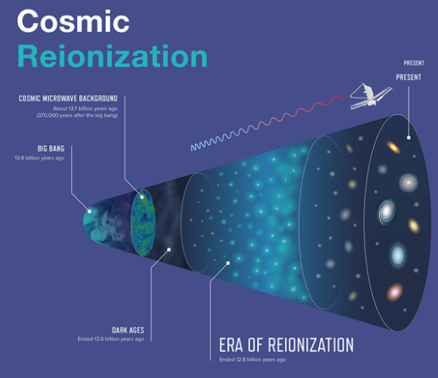
James Webb
Image Source
JWST will primarily study reionization.
The first stars were 30 to 300 times as massive as our Sun.
These stars existed for only a few million years before exploding as supernovae.
The energy released from these first stars was capable of splitting hydrogen atoms back into electrons and protons (reionization).
Reionization is one of the few ways in which scientists can study the earliest stars.
This can clarify exactly when the first stars formed and when this reionization process started to occur.
The light emitted from the first stars enables scientists to better determine how these first stars affected the later formation of galaxies.

