Slide 1
WUHS Biology: Animals Unit
Packet 3 – What happens inside animal cells?
Source: https://www.piqsels.com/en/public-domain-photo-fmlyd

Slide 2
Animals Unit – Packet 3 Driving Question
Driving Question: What happens inside animal cells?
How and where does cellular respiration occur?
How and where does biosynthesis occur?
How do animals acquire more cells and gain mass?
Part 1 Recap – Thirsty Moth: how could a moth larva survive in a container of malted milk powder without any water? Where did water in its body come from?
Source: https://www.piqsels.com/en/public-domain-photo-fmlyd

Slide 3
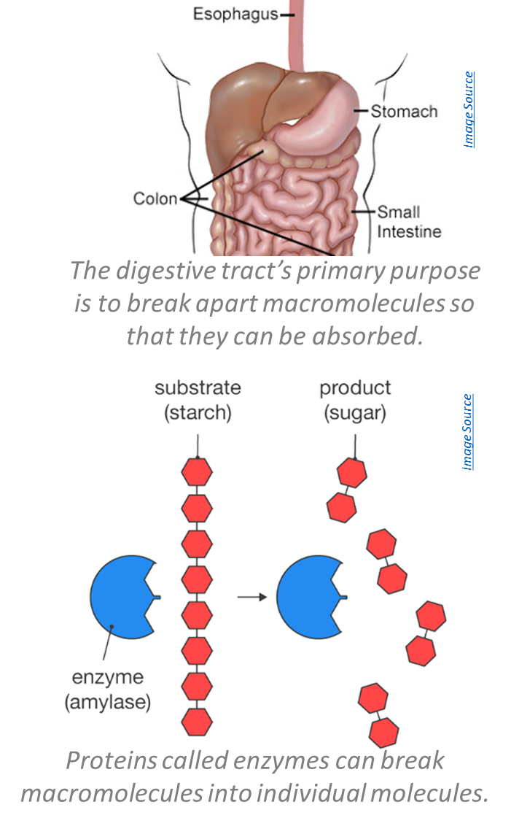
Recap of Packet 2
In digestion, macromolecules in food are broken into smaller individual molecules and absorbed into blood.
Enzymes are specialized proteins that assemble, disassemble, or rearrange molecules.
Once macromolecules have been broken into smaller molecules, they are absorbed into the bloodstream and transported to cells.
Cells use carb’s for chemical energy, and use fat and protein to build and repair cells.
During cellular respiration, cells acquire chemical energy by rearranging atoms in glucose & oxygen to form CO₂ & H₂O.

Slide 4
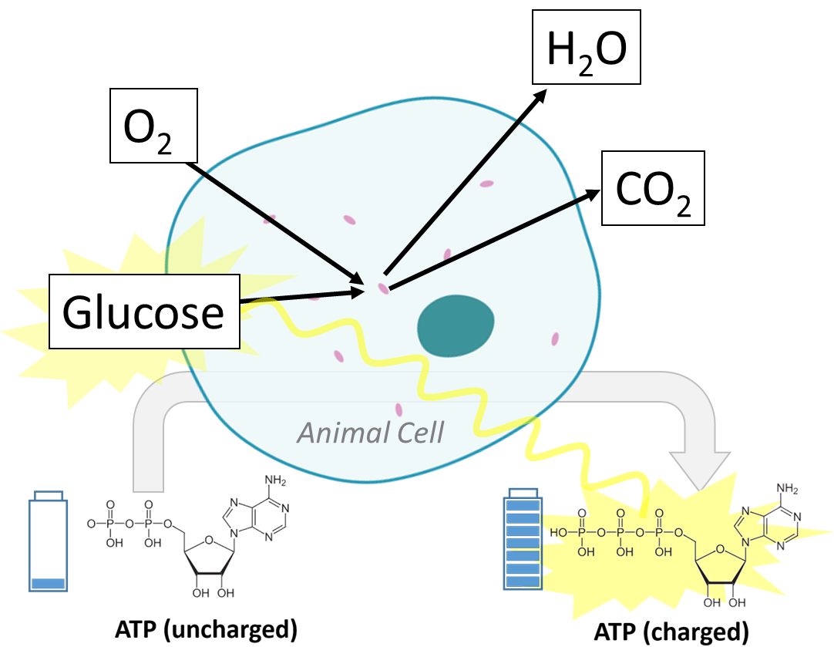
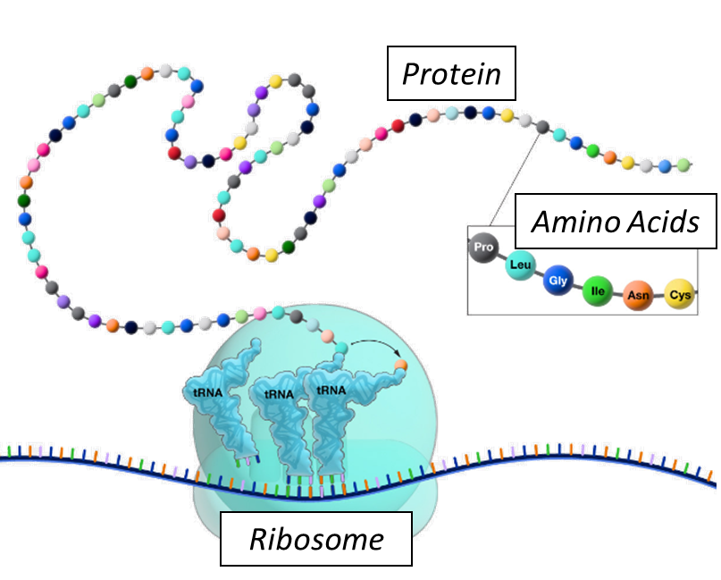
Recap of Packet 2
A small portion of the atoms in consumed food is added to the animal’s body.
Biosynthesis is the process in which organisms use molecules they consume to make the macromolecules needed for their own cells.
The chemical energy in the high energy bonds of glucose is moved to ATP during cellular respiration.
Most matter in consumed food is either breathed out as CO₂ & H₂O or lost as feces (waste).
During cell respiration, glucose and O₂ are rearranged to form CO₂ and H₂O. Chemical energy is moved from glucose to ATP.
Cells assemble proteins from amino acids consumed in food.

Slide 5
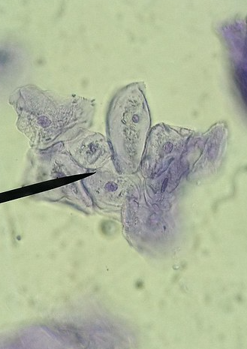
Cell Processes & Macromolecules
We know that there are two main processes that change food molecules.
Cellular respiration: food molecules and oxygen are rearranged to form CO₂ and H₂O in order to recharge ATP with more chemical energy.
Biosynthesis: food molecules are reassembled into the macromolecules needed by the cell.
Food molecules are primarily used in two key ways.
Fat and protein are mostly used for biosynthesis to provide atoms to build and repair cells.
Carbohydrates are mostly used for cellular respiration to provide a quick source of chemical energy.
Image Source

Slide 6
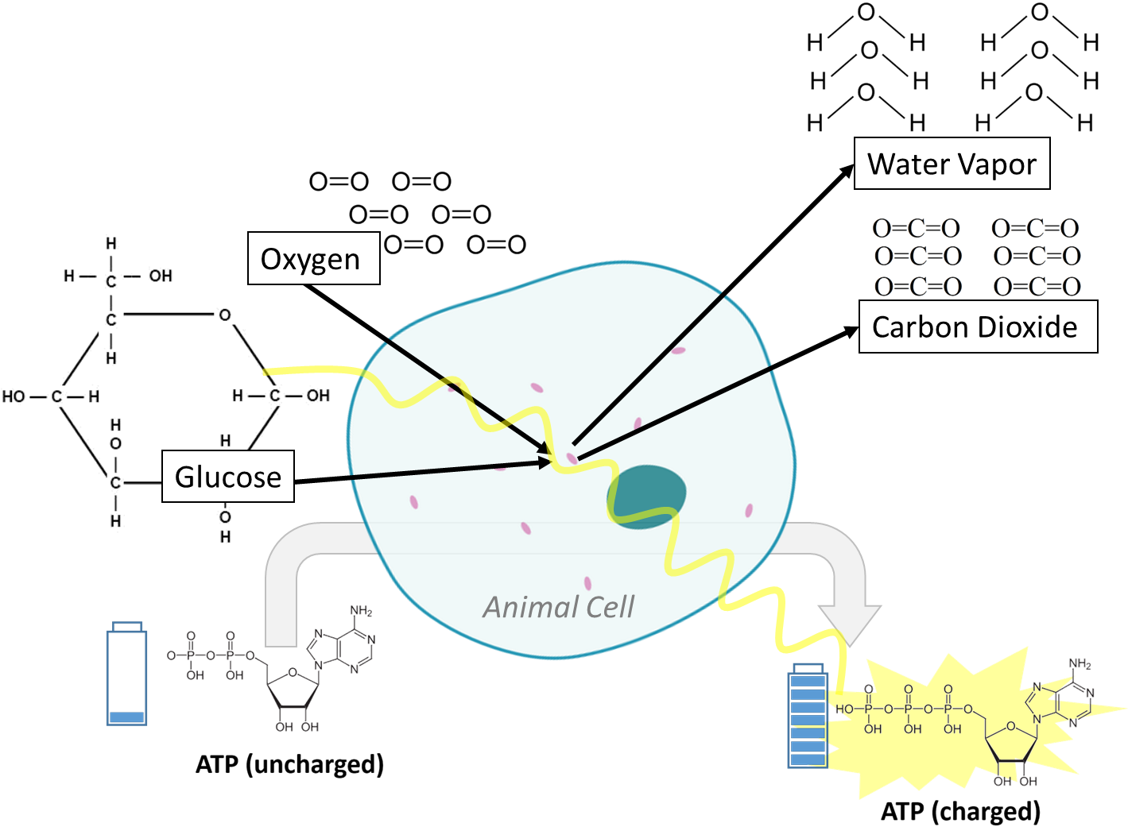
Cellular Respiration
Acquiring chemical energy from glucose

Slide 7
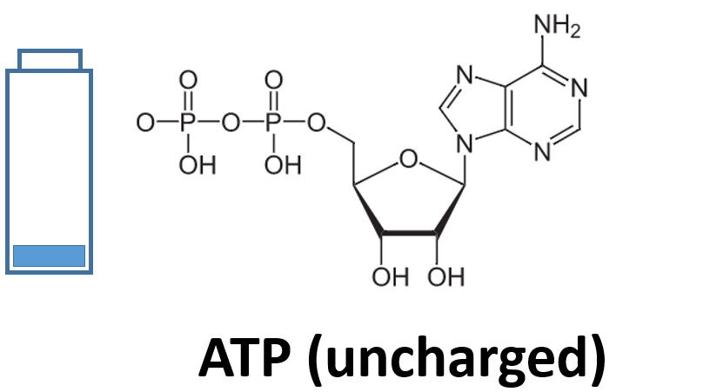
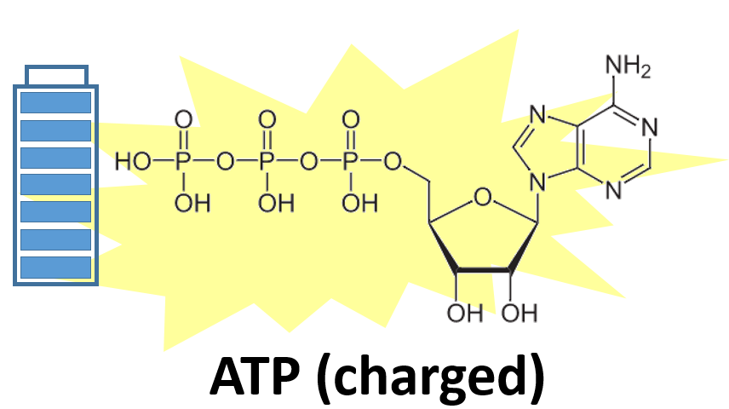
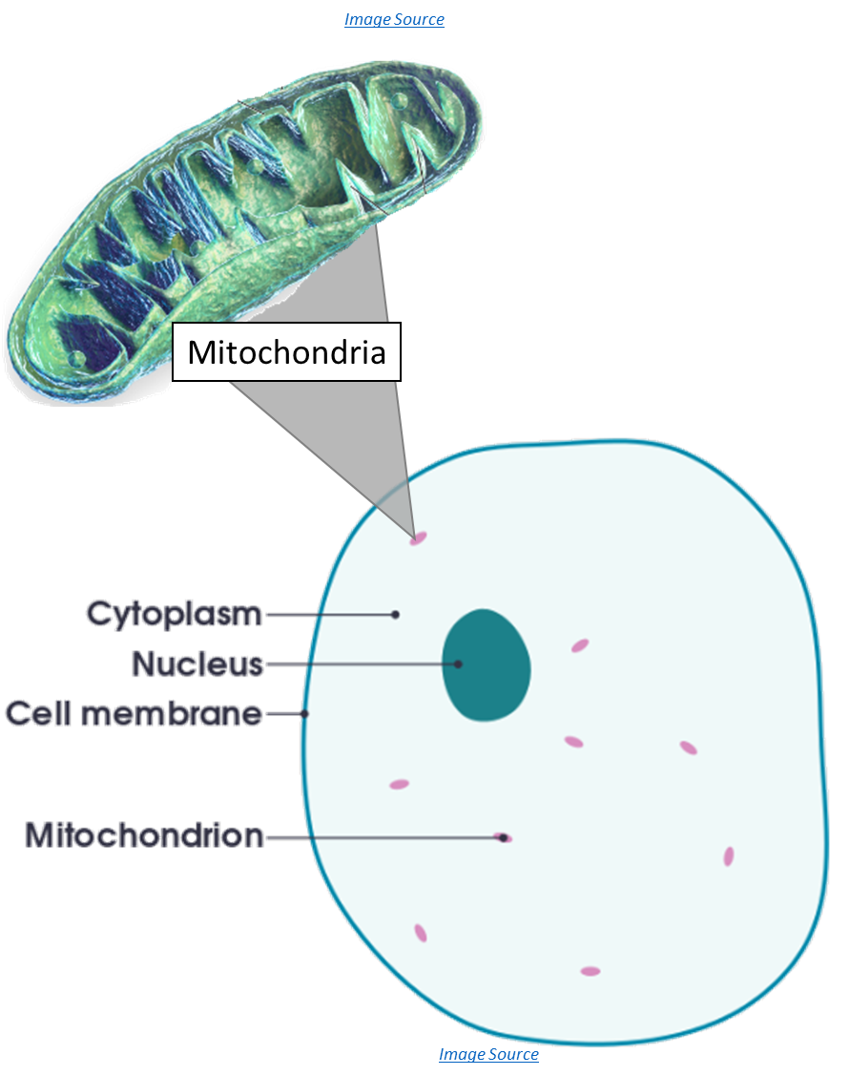
Cellular Respiration
Mitochondria are the organelles where cellular respiration occurs and where ATP is ‘recharged’.
This is where atoms in food molecules & oxygen are rearranged to form CO₂ & H₂O.
This process is how ATP is “recharged” with energy.
Mitochondria = plural; mitochondrion = singular
Glucose (from carbohydrates) is most frequently used for cellular respiration.
Cells can also use fatty acids as a source of chemical energy during cellular respiration (for example, if someone is on a diet, their body will break down body fat as a source of chemical energy to recharge ATP).
Dietary protein is only used for cellular respiration if there are too few carbohydrates and fat in the diet.
Glucose
CO₂
O₂
H₂O
The mitochondria is where cellular respiration occurs in order to recharge ATP.

Slide 8
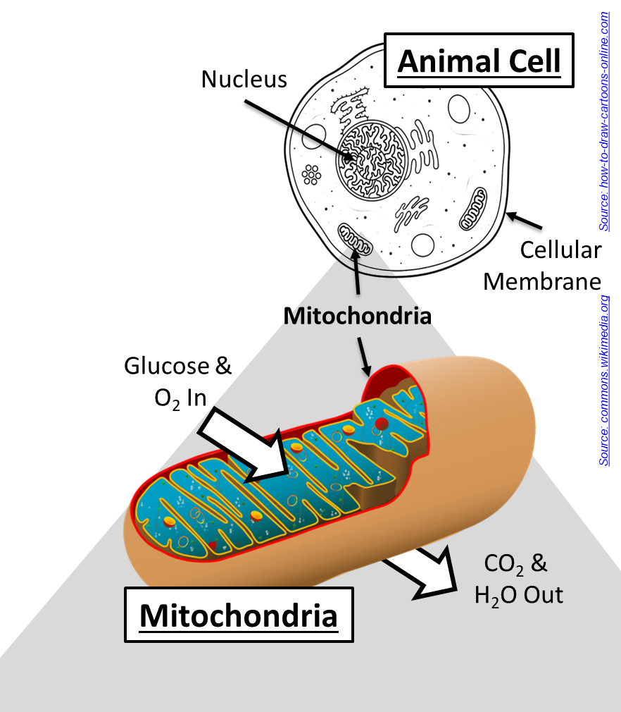
Oxygen & Exhaling Food Atoms
As cellular respiration occurs, CO₂ and H₂O are released from the cell into the bloodstream.
The bloodstream transports CO₂ and H₂O to the lungs, and these molecules are exhaled.
When you see your breath on a cold day, you see water vapor that formed from atoms from food and inhaled oxygen.
Animals need oxygen because it removes leftover atoms from food molecules after cellular respiration.
The mitochondria is the “powerhouse of the cell” because it is where cellular respiration occurs. During this process, chemical energy is moved from food molecules (like glucose) to ATP.

Slide 9
Biosynthesis
Acquiring the atoms needed to build and repair cells

Slide 10
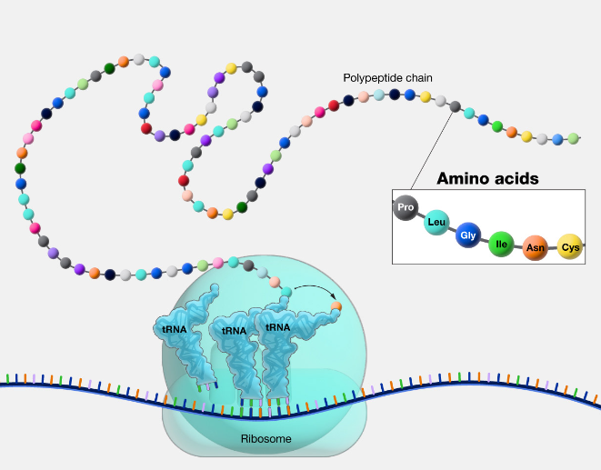
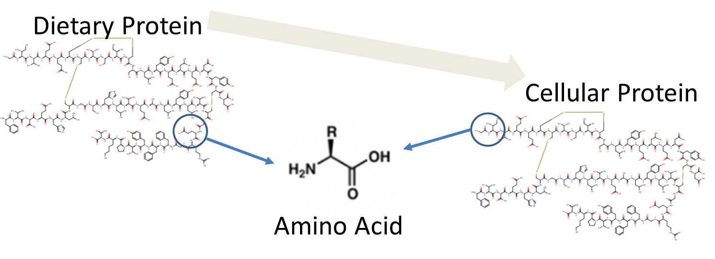
Protein Biosynthesis
Protein
Image Source
Amino Acids
Multiple forms of biosynthesis occur inside animal cells.
Biosynthesis occurs anytime a cell assembles new molecules using atoms consumed in food.
Protein assembly is one of the most common forms of biosynthesis.
Structures called ribosomes are where proteins are assembled using amino acids from food.
During protein biosynthesis, amino acids from food are connected into long chains.
Eventually these amino acid chains form the proteins needed for the cell to function.
Ribosome
Ribosomes are organelles that assemble the amino acids from food into the proteins used by cells.
Digestion
Biosynthesis

Slide 11
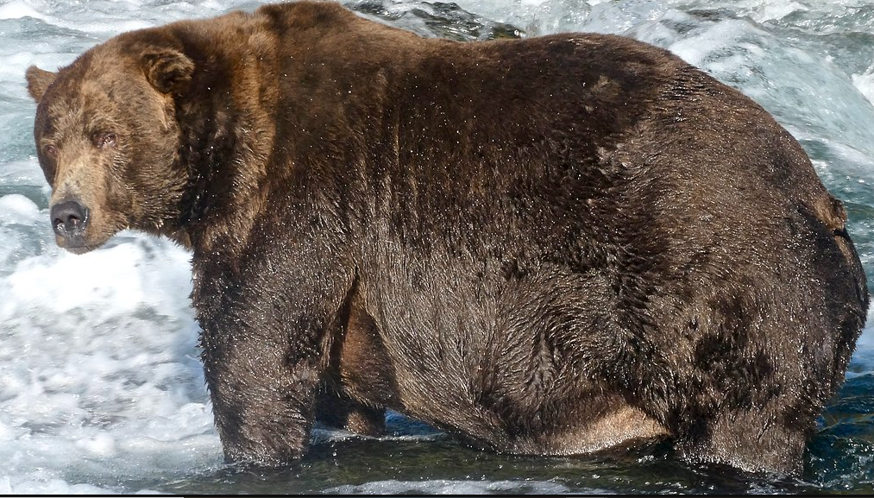
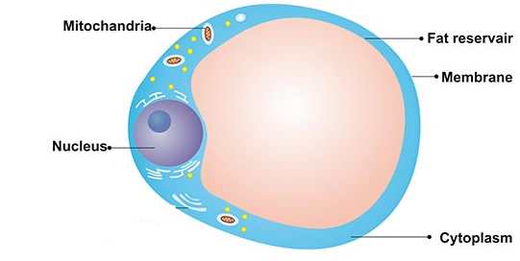
Fat Biosynthesis
Image Source
Cells can also use fatty acids from the diet to assemble the fats needed by the cell.
Fat biosynthesis occurs in the cytoplasm of the cell (cytoplasm = the jelly-like liquid inside the cell).
Fats are used for membranes and for energy storage.
Fat biosynthesis occurs in two different ways.
Cells use enzymes to assemble fats from fatty acids consumed in the diet.
Cells can also use enzymes to rearrange atoms in other molecules (such as glucose) to make new fatty acids.
If an animal consumes too much food, those food molecules will be converted into fats for long-term energy storage.
An animal’s body can rearrange food molecules into fat molecules for long-term energy storage in fat cells (e.g., this occurs in bears before hibernation).
Image Source
Fat cells expand to store more fat macromolecules.

Slide 12
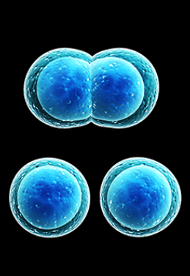
Mitosis
Creating more and more cells.

Slide 13
Mitosis
As cells assemble new fat & protein macromolecules, they grow larger.
If a cell produces enough fat and protein macromolecules, it can divide in half.
Mitosis is the process of dividing one large cell into two smaller cells.
Cell growth and division is important for enabling animals to grow larger.
Mitosis is what enables an organism to significantly increase in size.
Mitosis is also important for building and repairing bodily tissue (such as healing wounds or increasing muscle mass).
A cell splits into two cells via mitosis.
Image Source: https://www.sciencenewsforstudents.org/article/scientists-say-mitosis

Slide 14
Revising Our Claims
Revisit your ideas from Part 1.
How could you improve your responses to our Driving Questions?
Driving Question: What happens inside animal cells?
How and where does cellular respiration occur?
How and where does biosynthesis occur?
How do animals acquire more cells and gain mass?
Image Source
Source: https://www.piqsels.com/en/public-domain-photo-fmlyd

Slide 15
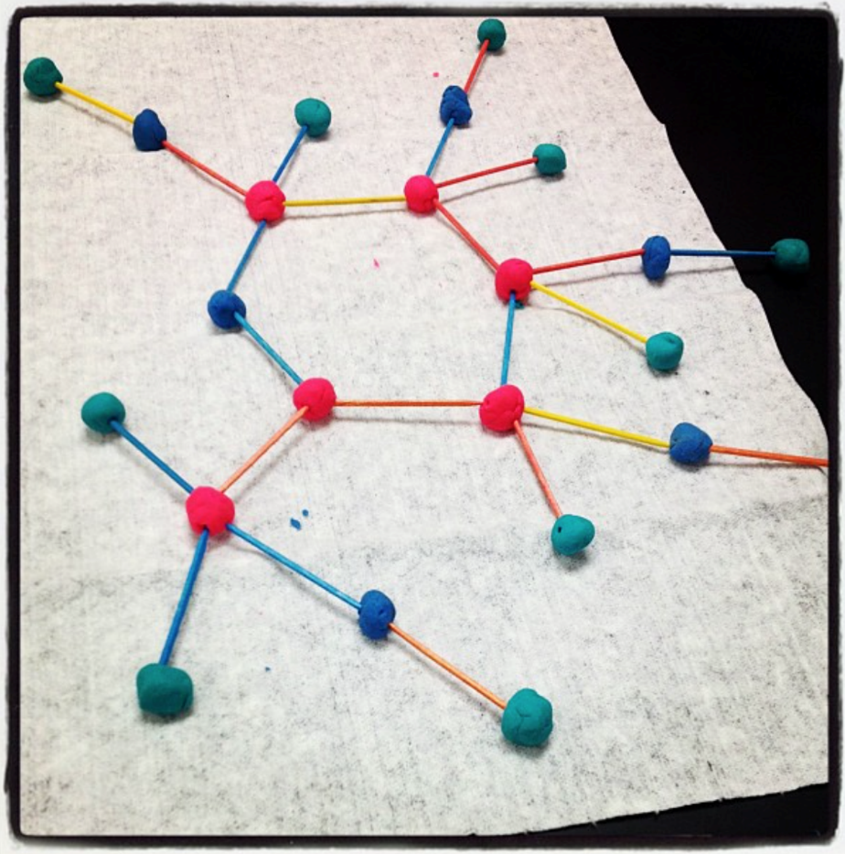
Looking Ahead: Part 3 Investigation
In Part 3A, you will use modeling clay to create molecular models of glucose and oxygen. You will then use these models to show your understanding of cellular respiration.
In Part 3B, you will develop your own protocol for using modeling clay to show your understanding of how molecules change during biosynthesis.

Slide 16
Key Points
Fat and protein are mostly used for biosynthesis. Carbohydrates are mostly used for cellular respiration.
Mitochondria are the organelles where cellular respiration occurs.
This is where ATP is ‘recharged’ by rearranging atoms in food molecules & oxygen to form CO₂ & H₂O.
Glucose (from carbohydrates) is most frequently used for cellular respiration.
Cells also can use fat as a source of chemical energy during cellular respiration.
As cellular respiration occurs, CO₂ and H₂O are released from the cell into the bloodstream and are eventually exhaled.

Slide 17
Key Points
Multiple forms of biosynthesis occur inside animal cells.
Biosynthesis occurs anytime a cell assembles new molecules using atoms from food.
Structures called ribosomes are where proteins are assembled using amino acids from food.
During protein biosynthesis, amino acids from food are connected into long chains that form cellular proteins.
Cells can also use fatty acids from the diet to assemble the fats needed by the cell in the cytoplasm (the jelly-like liquid in the cell).
Fats can be assembled from fatty acids from the diet; enzymes in the cell can also rearrange the atoms in other food molecules to make fat.
As cells assemble new fat & protein macromolecules, they grow larger.
Mitosis is the process of dividing one large cell into two smaller cells.
Mitosis enables organisms to grow larger, heal wounds, and gain tissue like muscle.

Slide 18
Key Vocab
Mitochondria are the organelles where cellular respiration occurs and where ATP is ‘recharged’.
Mitochondria = plural; mitochondrion = singular
Structures called ribosomes are where proteins are assembled using amino acids from food.
Cytoplasm is the jelly-like liquid inside the cell.
Mitosis is the process of dividing one large cell into two smaller cells.

