Slide 1
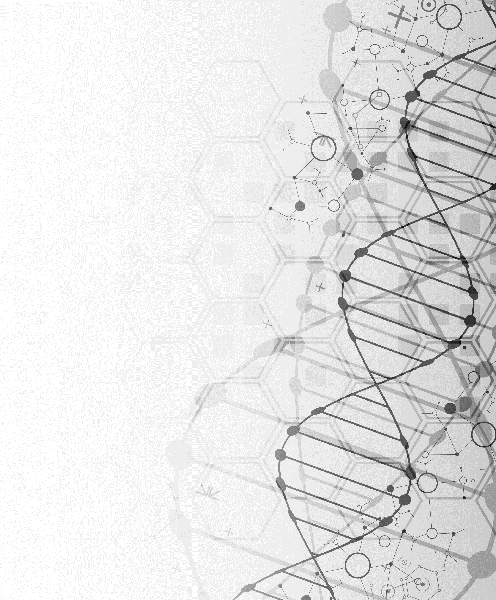
WUHS Biology: DNA & Proteins Unit
Packet 1 – How are traits determined?

Slide 2
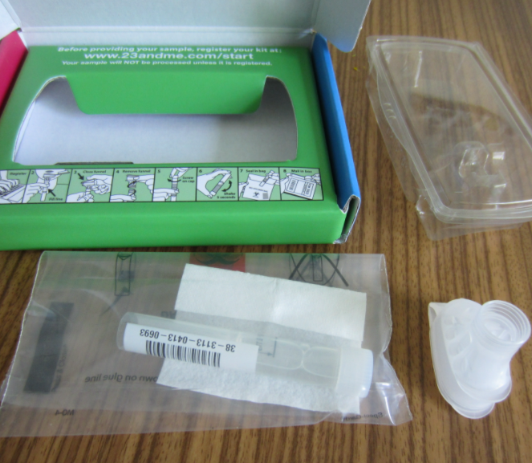
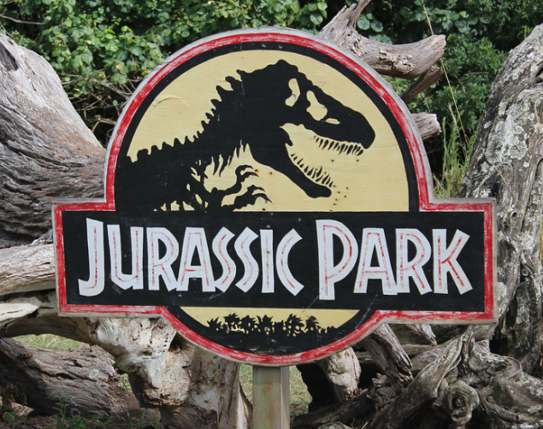
DNA & Proteins Unit – Packet 1 Driving Question
Driving Question: What is DNA and how does it work?
What is DNA made from?
How does the structure of DNA determine its function?
How can a molecule provide instructions for the assembly of another molecule?
Image Source: Wikimedia
Image Source
Image Source

Slide 3
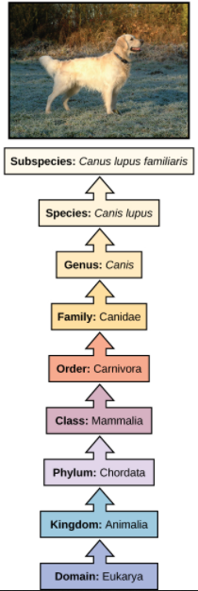
Kingdoms of Life
The world is home to a seemingly endless variety of life.
This includes multiple ‘kingdoms’ of living organisms (plants, animals, fungi, etc.).
Species are grouped based on their observable traits.
For example, a dog is eukaryotic (its cells have organelles) and is a part of the animal kingdom.
Dogs have a spine (chordata), are mammals (warm blooded with fur), are carnivores (eat meat), and are in the dog family.
Each level of classification describes species with traits that are more and more similar.
Source: Wikimedia

Slide 4
DNA – Instructions for Life
While there are many differences among living species, all use DNA in their cells.
DNA determines how proteins are assembled.
Proteins perform the work of the cell and provide organism with observable traits.
The primary function of DNA is to store information.
DNA provides the instructions to assemble amino acids in a particular way to form specific proteins.
If a cell lacked DNA, it be unable to produce the proteins it needs to function.
Image Source: Wikimedia

Slide 5
DNA → Proteins → Traits

Slide 6
The Structure & Function of DNA.
What is DNA made from? And how does this determine how DNA works?

Slide 7
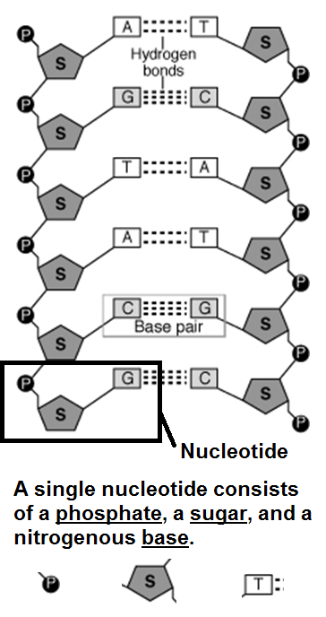
DNA is a Macromolecule
Source: www.biologyjunction.com
DNA is a macromolecule (or polymer).
DNA consists of a long repeating chain of molecules called nucleotides.
Each nucleotide consists of 3 parts.
1) a phosphate molecule.
2) a 5-carbon sugar molecule.
3) a base molecule.
Each part of a nucleotide serves a specific function.
The phosphate and the sugar molecules provide structure to DNA (they hold everything together).
The base molecules store information.
Image Source: Wikimedia

Slide 8
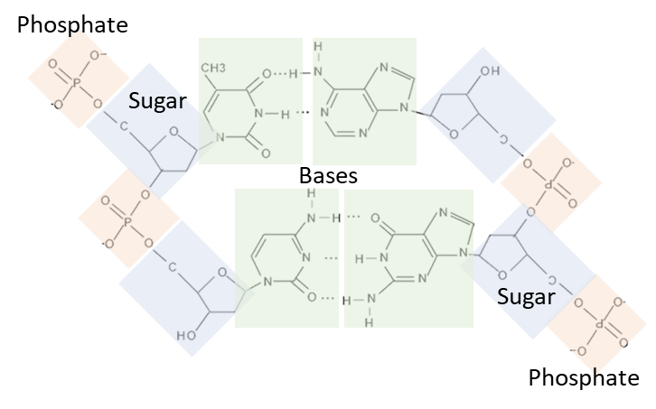
DNA Notebook Analogy
Image Source: PxHere
← Spiral
Pages
Each molecule in a nucleotide functions like the parts of a spiral notebook.
The phosphate molecules are like the spiral. They are on the outside and hold everything together.
The sugar molecules are like the paper pages. They hold the information in place.
The base molecules are like the writing. The bases are what provide the actual information.
The combination of different base molecules of DNA are like the words written in a notebook.
There are four kinds of base molecules (A, T, G, & C).
Different combinations of bases/letters enable different kinds of information to be recorded.
Writing
Image Source: Flickr

Slide 9
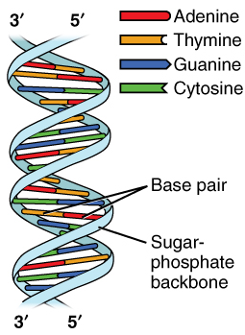
Complementary Base Pairs
The four kinds of base molecules in DNA are called: Adenine (A), Thymine (T), Guanine (G), and Cytosine (C).
Usually these molecules are represented by their first letters.
In DNA, only two combinations of bases are possible: A can only bond with T, and G can only bond with C.
This is because of differences in a) size and b) bonding sites.
These combinations (A&T, G&C) are called complementary base pairs.
A’s are always found with T’s.
G’s are always found with C’s.
Image Source: Wikimedia

Slide 10
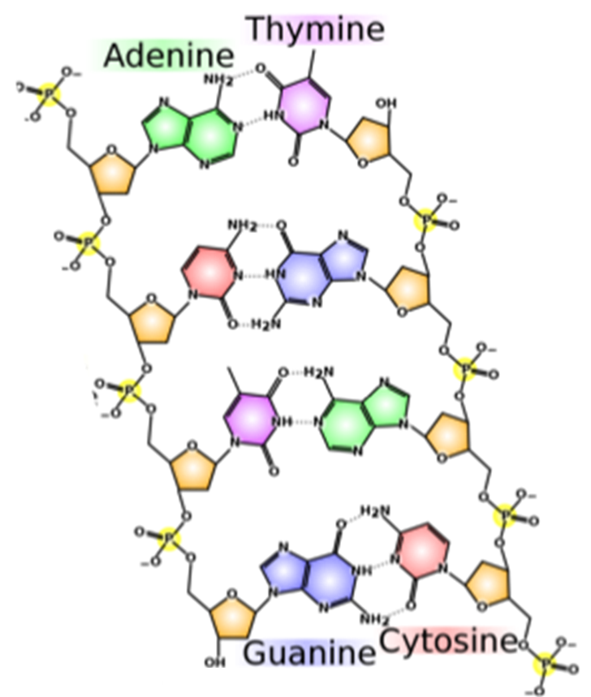
Great Combinations are Always Together
A can only pair with T, and G can only pair with C.
If an A were bonded to a G, they would be too large to fit inside the width of DNA.
If C were bonded to T, it would be too small to reach the sides of the DNA molecule.
This is also why bases can’t pair with themselves.
In addition, differences in bonding sites prevent combinations other than A&T and G&C.
C and G have three bonding sites to attach to each other.
A and T only have two bonding sites.
Pairing A with C, or T with G would be like trying to insert a three-pronged electrical plug into a two-pronged outlet.
A&T and G&C are the only combinations that work based on differences in their bonding sites.
Source: Wikimedia

Slide 11
Using DNA to assemble proteins.
How information stored in DNA is translated into how to assemble a protein from amino acids.

Slide 12
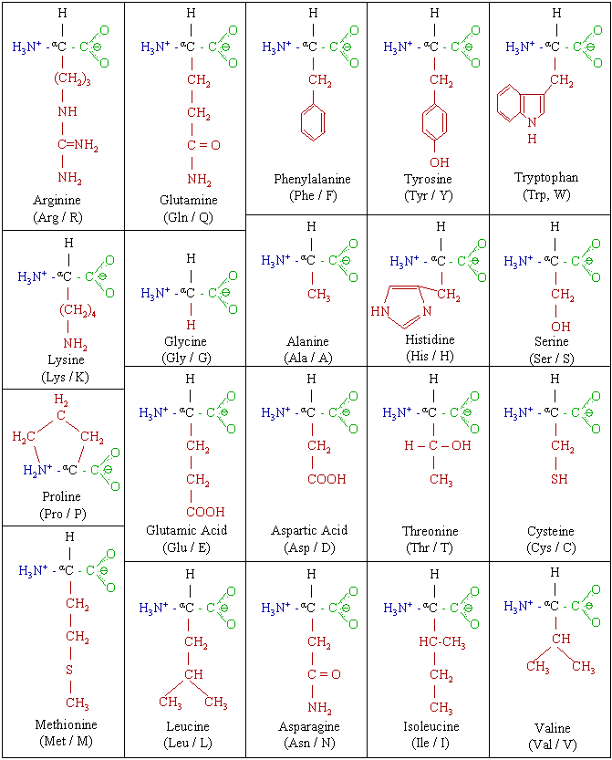
The DNA “Code”
DNA provides the instructions for how to assemble 20 amino acids in a specific order to create a particular protein.
The order in which 20 different kinds of amino acids are assembled determines the shape and function of the protein.
Combinations of three bases (called codons) code for a specific amino acid.
For example, a stretch of DNA containing 9 bases would consist of 3 codons.
These 3 codons would each code for 3 kinds of amino acids.
The order of codons in a gene determines the order in which amino acids are assembled to form a protein.
There are 20 kinds of amino acids. Different combinations of amino acids make different proteins.

Slide 13
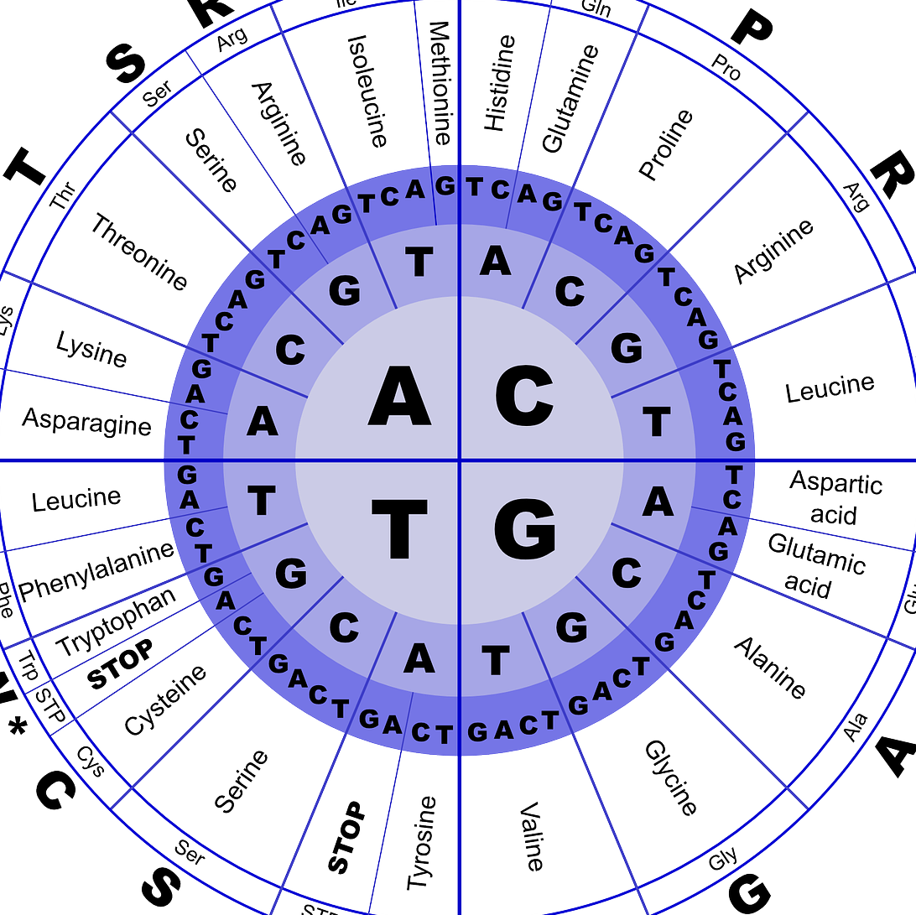
Decoding Codons
Image Source: Pixabay
Each combination of three bases (codon) codes for a different amino acid.
For example, CGA codes for Arginine.
However, AGC codes for Serine.
Some codons indicate where a gene begins and ends.
All genes start with the Methionine amino acid (ATG).
Three different codons (TGA, TAG, and TAA) mark the end of a gene.
This table can be used to translate codons into different amino acids. Start in the center and work towards the outside. E.g., GCA = Alanine.

Slide 14
Codons → Amino Acids
The 3-letter combinations in each codon are specific to one kind of amino acids.
The order of bases (A, G, C, T) in a gene (segment of DNA) directly correlates to the order of amino acids in a protein.
In the image below, each codon (3-letter combination) is specific to an amino acid.
Codon
Image Source
Amino Acid

Slide 15
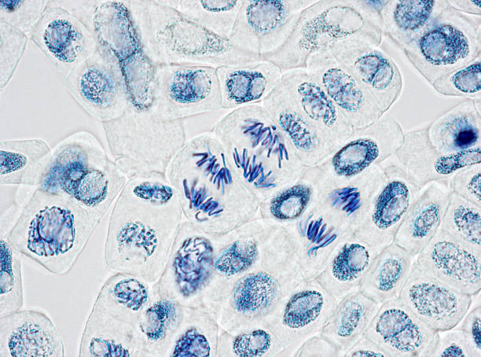
Duplicating DNA.
How DNA copies are made during mitosis and meiosis.

Slide 16
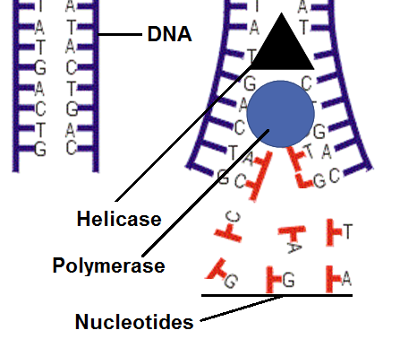
Making Copies
Because A & T and G & C are always found together, a cell can easily duplicate its DNA.
Each side of DNA provides a template for new copies.
DNA is first “unzipped” by a helicase protein.
Then a protein called DNA polymerase “fills in” the other side of the DNA, creating two identical copies.
For example, if a section of single stranded DNA was A - G - C - T, the polymerase enzyme would add T - C - G - A to fill in the other side.
This process allows cells to make copies of their DNA before dividing.
This ensures that as cells divide during mitosis, each gets a full copy of the DNA needed to assemble the proteins they need to function.
Source: biology.stackexchange.com

Slide 17
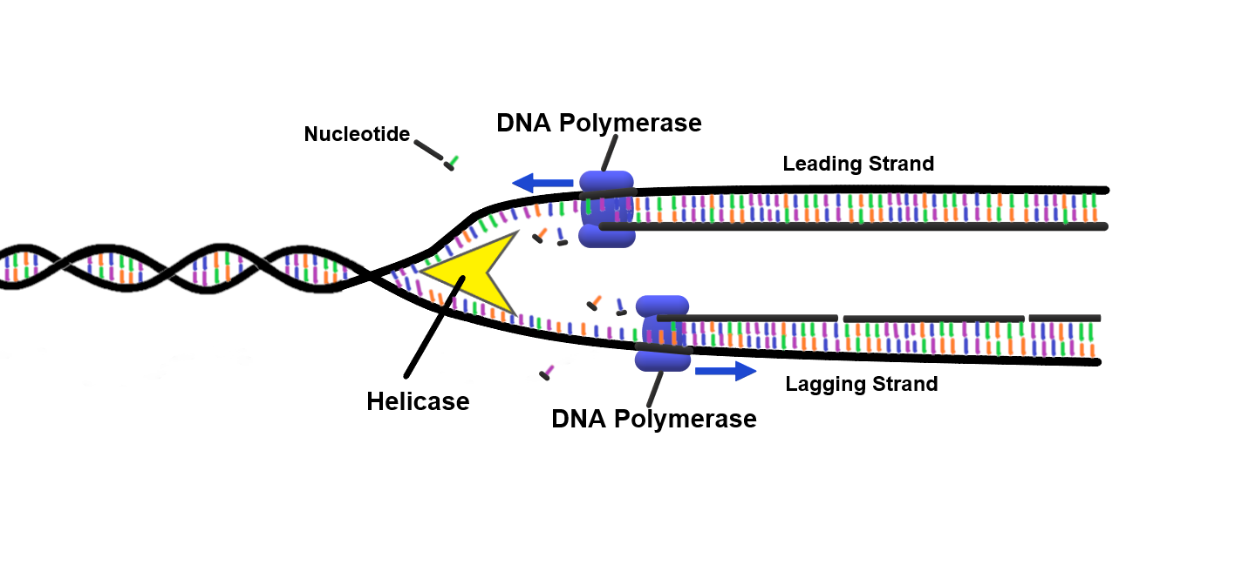
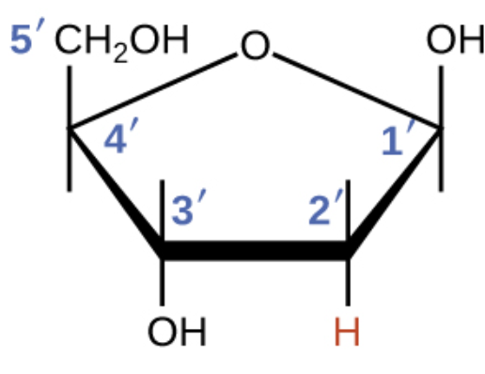
Image Source
DNA duplication requires a sense of direction to ensure DNA is copied correctly each time.
However, there is no obvious top, bottom, left, or right in DNA.
DNA is duplicated in a 5’ → 3’ direction.
5’ and 3’ refer to the carbon atoms on the sugar molecule.
The direction DNA is copied on one side will be opposite of the direction in which it is copied on the other side.
Image Source

Slide 18
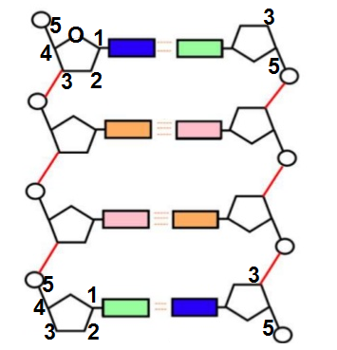
DNA Polymerase always copies DNA in a 5 → 3 direction.
The 5 → 3 direction on one side of DNA is opposite of the other side.
For example, the left side of this strand of DNA is copied from the top down.
However, the right side is copied from the bottom up.

Slide 19
Revising Our Claims
Revisit your ideas from Part 1.
How could you improve your responses to our Driving Questions?
What is DNA and how does it work?
What is DNA made from?
How does the structure of DNA determine its function?
How can a molecule provide instructions for the assembly of another molecule?
Image Source: Wikimedia

Slide 20
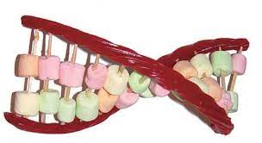
Looking Ahead: Part 3 Investigation
In Part 3 you will be conducting two investigations.
In Part A, you will use your understanding of DNA to determine how nucleotide components fit together.
In Part B, you perform a similar investigation using different kinds of candies to create edible DNA.
Image Source: Michigan.gov

Slide 21
Key Points
Species are primarily classified by their traits.
Traits are determined by the proteins their cells produce, which is determined by their DNA.
The primary function of DNA in all living organisms is to store information for how to assemble proteins.
DNA is a polymer made of repeating molecules called nucleotides.
Each nucleotide has 3 parts: a phosphate, a sugar, and one of four bases.
Phosphate and sugar molecules provide structure to DNA; the base molecules are what code information for assembling proteins.

Slide 22
Key Points
Due to differences in size and bonding sites, only two combinations are possible among the four bases: A only bonds with T, and G only bonds with C. These are called complementary base pairs.
Groups of 3 bases (called codons) code for specific amino acids. The order of codons in a gene determines the order of amino acids in a protein. This determines the kind of protein that is assembled.
To replicate DNA, a protein called helicase separates the two strands. A protein called DNA polymerase then adds complementary bases to each strand to create two identical strands.
DNA is always copied in a 5’ → 3’ direction. These numbers refer to the carbon atoms on the sugar molecule.

Slide 23
Key Vocab
DNA: a polymer made from nucleotide monomers that stores information about how to assemble proteins.
Nucleotide: a monomer in the DNA polymer consisting of a phosphate, sugar, and base molecule.
Phosphate: a part of a nucleotide that provides structure to DNA.
Sugar: a part of a nucleotide that holds bases in place.
Base: a part of a nucleotide that stores information.
Complementary Base Pairs: the only combinations of bases that are possible in DNA (A pairs with T; G pairs with C).
Helicase: the protein that separates the two DNA strands.
DNA Polymerase: the protein that makes copies of DNA.
Codon: a group of three bases in DNA that codes for a specific amino acid.

