Slide 1
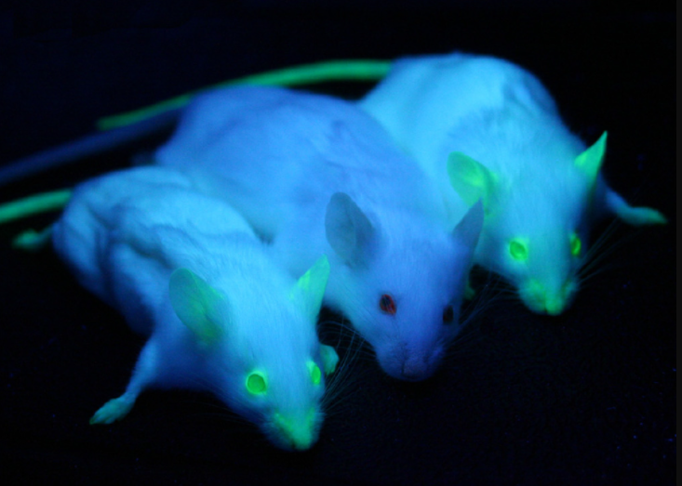
WUHS Biology: Genetic Modification Mini-Unit
Packet 1 – How can we move genes to a new species?

Slide 2
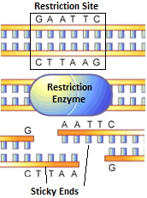
Genetic Modification Mini-Unit
Driving Question: How can we move genes to a new species?
Why would a gene from one species work in the cells of a different species?
How is the gene removed and inserted?
What is CRISPR-Cas9?
Source: www.scq.ubc.ca

Slide 3
Genetic Engineering
Genetic engineering is the process of changing the DNA of an organism by adding or removing DNA from an organism’s genome.
A genome is the complete set of genes in an organism’s cells.
Genetically modified organisms (GMOs) are organisms that have been genetically engineered (genes were added or deleted from their genome).
Genetically modified organisms express an inserted gene in the same way they would express any other gene in their DNA.
The added gene is copied by mRNA and moved to a ribosome.
tRNA then delivers amino acids from consumed food to assemble the new cellular protein.
Image Source: Wikimedia
The mouse on the left has been genetically modified so that its cells contain the gene needed to produce glowing proteins.

Slide 4
Restriction Enzymes
Genetic engineering most often involves the removal of a gene from one organism so that it can be inserted it into another organism.
Restriction enzymes can be used to cut out a gene from a genome.
A restriction enzyme is a protein that cuts DNA any time it encounters a specific sequence (such as GAATTC).
A restriction enzyme is like a chemical scissors for DNA.
The specific sequence at which a restriction enzyme cuts DNA is called the restriction site.
There are many kinds of restriction enzymes, and each one has a unique restriction site.
For example, the the EcoRI restriction enzyme cuts DNA anytime it encounters the sequence GAATTC.
EcoRI is pronounced "eco R one“.
Source: www.scq.ubc.ca

Slide 5
Sticky Ends
Most restriction enzymes cut DNA in a zig-zag fashion.
This causes one portion of the double-stranded DNA to stick out farther than the other portion. This is called a sticky end.
If both the inserted gene and the genome are cut with the same restriction enzyme, the gene will often insert itself into the genome.
The sticky ends of the cut gene will be complementary to the cut genome.
For example, if the inserted gene and the genome are cut so that they have AATT and TTAA for sticky ends, the AATT side of the inserted gene will be attracted to the TTAA side of the genome (because A’s always bond to T’s).
Source: www.bbc.co.uk

Slide 6
Bt Corn
Genetically modified organisms (GMOs) are increasingly common in society.
For example, most corn planted in the US is Bt corn (USDA, 2023).
Bt corn produces proteins that fight harmful insects.
The insect-fighting protein in Bt corn was originally found in bacteria called Bacillus thuringiensis.
Scientists moved the gene for this protein from the DNA of this bacteria to the genome of corn.
The cells of the corn produce this new protein just like any other protein: through transcription and translation.
GMOs are also commonly used for medicine.
For example, almost all insulin used to treat individuals with diabetes is produced using genetically modified bacteria.
Bt Corn (right) produces proteins that repel insects that cause crop damage.
Image Source: Flickr
Most insulin used to treat diabetes is produced by GMO bacteria.

Slide 7
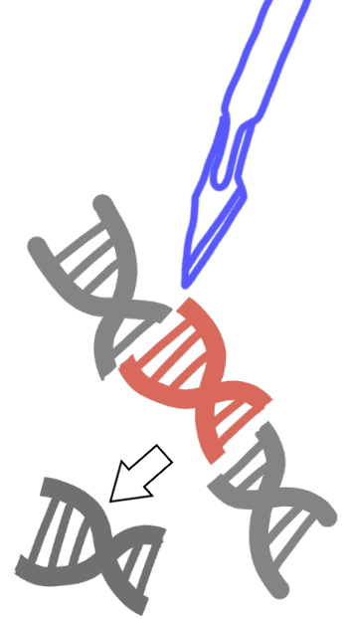
CRISPR-Cas9
The newest method of genetic modification is called CRISPR-Cas9.
Earlier forms of genetic modification would take months or even years; CRISPR can modify genomes in a matter of days.
CRISPR can also be used to modify the genome of fully-developed organisms (instead of just a single fertilized egg cell in earlier methods).
The CRISPR system uses guide RNA (gRNA) to find a specific gene within an organism’s DNA.
An enzyme called Cas9 then cuts the DNA at that location.
Once the DNA is cut, the cell's natural repair mechanisms can be used to either inactivate or replace the targeted gene.
CRISPR-Cas9 will likely revolutionize medicine & agriculture by allowing scientists to edit genes with more precision, accuracy, and efficiency.
Image Source
Notes:
Prior methods of genetic modification depended on changing genes before the fertilized egg started dividing. In addition to being faster, CRISPR can also modify the genes of developed organisms, providing a much greater range of opportunities for genetic modification.

Slide 8
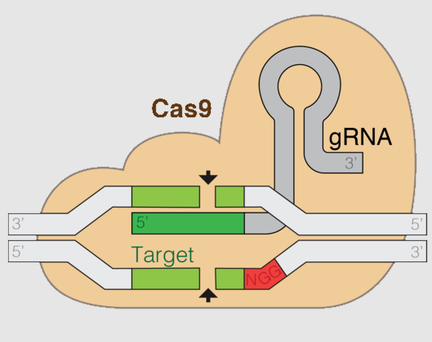
CRISPR-Cas9: What It Is
CRISPR-Cas9 is a two-part system.
CRISPR* uses guide RNA (gRNA) to find the gene that will be changed.
Cas9 is an enzyme that cuts DNA whenever it encounters this specific sequence of DNA (like a chemical scissors).
The gene is cut by Cas9 can be removed, inactivated, or replaced by another gene.
CRISPR-Cas9 is similar to a restriction enzyme - it cuts DNA wherever a specific sequence of bases occurs.
However, unlike a restriction enzyme, CRISPR-Cas9 can also remove an entire gene from a genome.
Newer versions of CRISPR-Cas9 can rewrite the DNA of an organism one base at a time.
*CRISPR is an acronym for “Clustered Regularly Interspaced Short Palindromic Repeats”
Image Source: Wikipedia

Slide 9
Revising Our Claims
Revisit your ideas from Part 1.
How could you improve your responses to our Driving Questions?
Driving Question: How can we move genes to a new species?
Why would a gene from one species work in the cells of a different species?
How is the gene removed and inserted?
What is CRISPR-Cas9?
Image Source

Slide 10
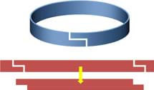
Looking Ahead: Part 3 Investigation
In Part 3 you will use models to demonstrate how restriction enzymes cut DNA and enable genes to be moved to new species.
Image Source

Slide 11
Key Points
Due to similarities between cells, genes from one organism can be moved to the cells of another organism.
Genetic engineering is the process of changing the DNA of an organism by adding or removing DNA from an organism’s genome (the complete set of genes in an organism’s cells).
Genetically modified organisms (GMOs) are organisms that have been genetically engineered.
Restriction enzymes cut DNA any time it encounters a specific sequence (such as GAATTC); this sequence is the restriction site.
A restriction enzyme is like a chemical scissors for DNA.
Source: www.scq.ubc.ca

Slide 12
Key Points
Most restriction enzymes cut DNA in a zig-zag fashion, which causes one portion of the double-stranded DNA to stick out farther than the other portion (sticky end).
If a gene and genome are cut with the same restriction enzyme, the gene will insert itself due to complementary bases.
Genetically modified organisms are now widely used in the United States, particularly for medicine and food.
Examples include Bt corn as well as the insulin used to treat patients with diabetes.
CRISPR-Cas9 is a new gene editing technique that cuts DNA wherever a specific sequence of bases occurs.
gRNA guides the Cas9 enzyme to the gene that need to be removed or edited. Cas9 cuts the DNA at this site. As the cell fixes the break, it can disable the gene or replace it with another gene.
CRISPR-Cas9 is far faster and more effective than prior options for genetic engineering.

Slide 13
Key Vocab
Genetic engineering is the process of changing the DNA of an organism by adding or removing DNA from an organism’s genome (the complete set of genes in an organism’s cells).
Genetically modified organisms (GMOs) are organisms that have been genetically engineered
A restriction enzyme is a protein that cuts DNA any time it encounters a specific sequence (restriction site).
Sticky end: when DNA is cut so that one portion of the double-stranded DNA sticks out farther than the other portion.
CRISPR-Cas9: a new gene editing technique that cuts DNA wherever a specific sequence of bases occurs.
gRNA guides the Cas9 enzyme to the gene that need to be removed or edited.

