Slide 1
WUHS Biology: Plants Unit
Packet 2 – How do plants get their food and gain mass?
Image Source

Slide 2
Plants Unit – Packet 2 Driving Question
Driving Question: How do plants get their food and gain mass?
How do plants acquire the carbs, fats, and proteins their cells need using enzymes?
How do plants use soil minerals?
How do enzymes work?

Slide 3
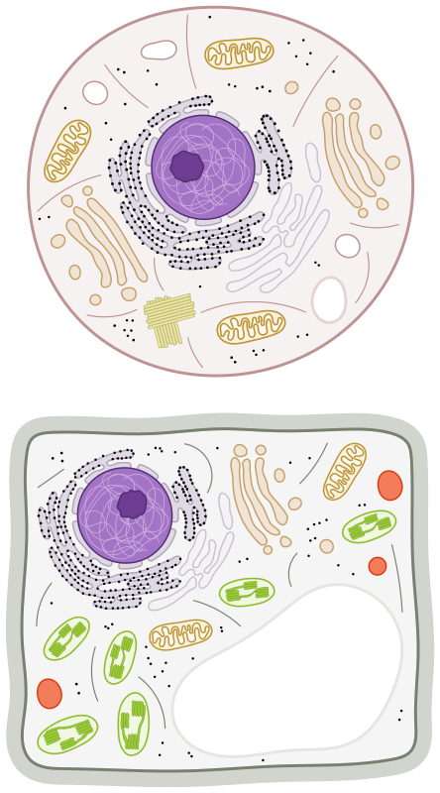
Recap of Packet 1
Image Source
Animal cell
Plant and animal cells are composed of many of the same macromolecules and organelles.
Plant cells have three key organelles not found in animal cells (cell walls, vacuoles, and chloroplasts).
The cell wall is a tough shell made from cellulose (long chains of glucose). It acts like a plant’s skeleton.
Mitochondria
Ribosome
The vacuoles of plant cells are storage organelles.
Plants store water and keep waste products in their vacuoles.
Nucleus
Cell Wall
The chloroplast is the organelle that produces glucose molecules. The chloroplast uses light energy (like sunlight) to produce glucose and oxygen from CO₂ and H₂O in a process known as photosynthesis.
Vacuole
Chloroplast
Plant cell
Plant cells have 3 key organelles not found in animal cells.

Slide 4
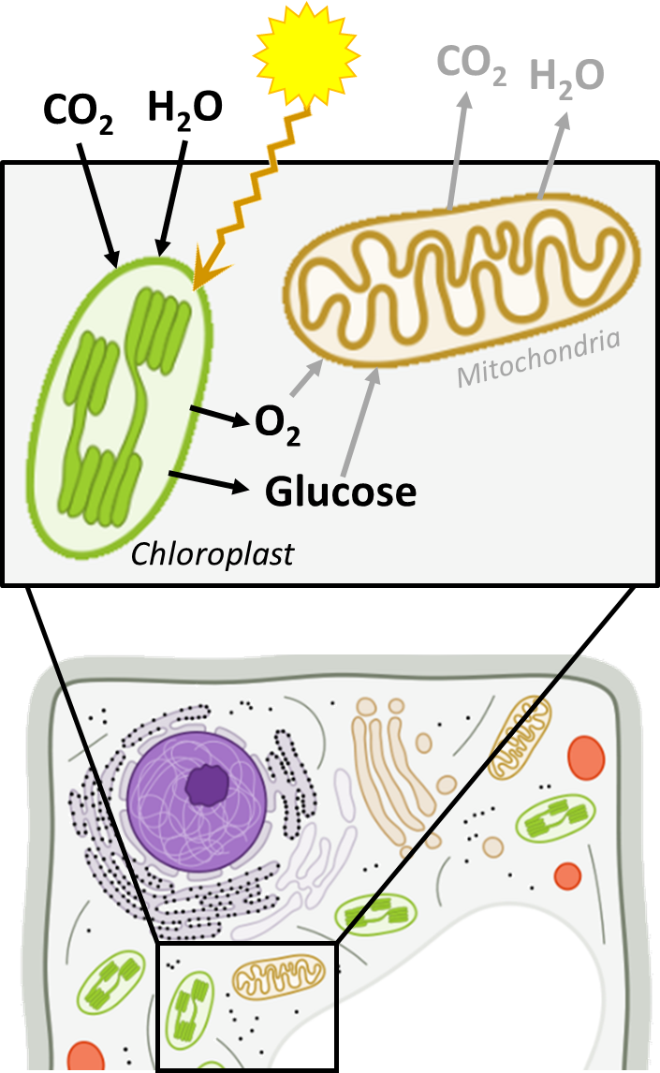
Recap of Packet 1
Most of the glucose and oxygen produced in the chloroplast are moved to the mitochondria for cellular respiration to recharge ATP.
Some glucose from photosynthesis is used to assemble cellulose, which makes up most of the mass of a plant.
Xylem consists of long tubes of cells that use evaporation to move water and minerals upward from the roots to its leaves.
Phloem forms long tubes of cells that use gravity to move molecules like glucose down from the leaves to other cells for respiration and biosynthesis.
During photosynthesis, CO₂ and H₂O are rearranged to form glucose and oxygen. Most glucose is used for cell respiration. Some forms cellulose.

Slide 5
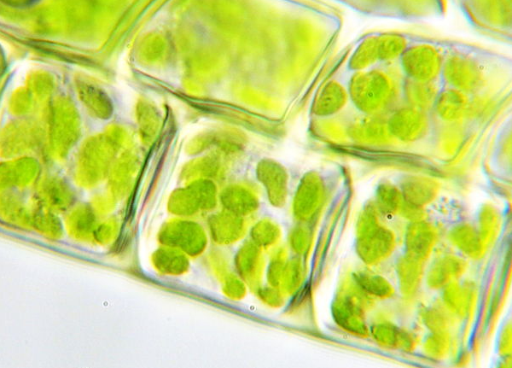
Acquiring Macromolecules
All cells, including plant cells, need carbohydrates, fats, and proteins to function.
Animals acquire these macromolecules by consuming other organisms.
However, most plants cannot consume other organisms and must produce their own macromolecules.
Plant cells assemble glucose (and oxygen) using atoms from carbon dioxide and water.
Most of this glucose is used for cellular respiration.
Some is used to create cellulose to form the plant cell walls.
The atoms in glucose can also be used to make the fatty acids and amino acids needed by plant cells.
Image Source

Slide 6
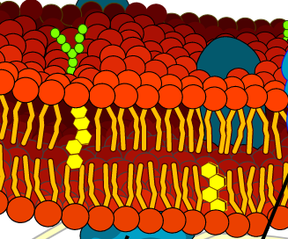
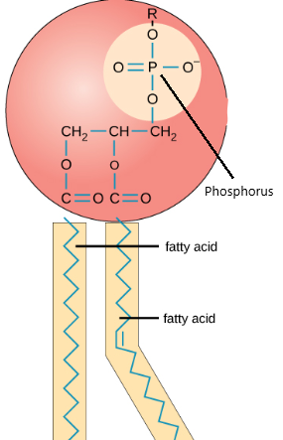
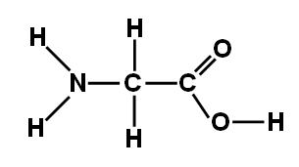
Enzymes
Image Source
Plant cells produce all the molecules their cells need using the atoms in glucose and soil minerals.
All carbohydrates, fats, and proteins are formed from the atoms in glucose and soil minerals (if needed).
For example, plant cells can rearrange the atoms in glucose to form fatty acids.
These fatty acids combine with phosphorus atoms in the soil to form plant cell membranes.
Plant cells can also rearrange the atoms in glucose with nitrogen from the soil to form the amino acids.
These amino acids are assembled into proteins that enable the cell to function.
Cell membranes are made from a combination of fatty acids and phosphorus.
Image Source
Amino acids are made using atoms from glucose and nitrogen from soil.

Slide 7
Tracing Changes to Glucose in Plant Cells
Glucose Is Produced in Photosynthesis
Fatty Acids are Assembled into Fats
Combined with Nitrogen to Form Amino Acids
Amino Acids are Assembled into Proteins
Assembled into Carbohydrates like Starch & Cellulose
Fatty Acids Combine with Phosphorus to Form Membranes
Cellulose Forms Cell Walls (most of plant’s mass)
Starch Provides Long Term Energy Storage
Rearranged into Fatty Acids
Used for Cell Respiration
Rearranged back into CO₂ and H₂O.
CO₂
H₂O
Soil Phosphorus
Soil Nitrogen

Slide 8
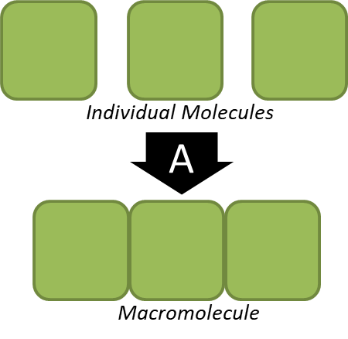
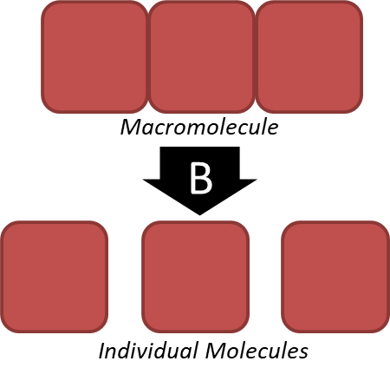
Enzymes
Enzymes are what enable plant cells to change glucose molecules into other molecules.
Enzymes are proteins that assemble, disassemble, or rearrange molecules to form new molecules.
Enzymes reduce the time and energy required for chemical reactions to occur in living organisms.
Enzymes can change other molecules over and over without being altered or destroyed.
Enzymes move atoms to where they need to be in order for a new molecule to be formed.
However, the molecular structure of the enzyme itself will stay the same before and after a reaction.
Enzymes are proteins that a) assemble, b) disassemble, or c) rearrange molecules.

Slide 9
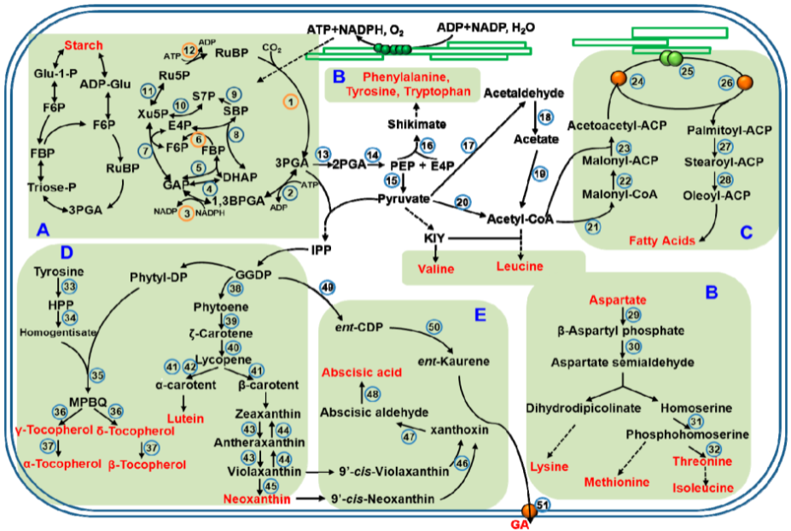
Enzyme Reactions
This shows the pathway from glucose to many other plant molecules, including carbohydrates, fatty acids, and amino acids.
All plant molecules are formed from atoms in glucose and soil minerals.
This image shows many of the enzymatic reactions in cells that create macromolecules needed by the cell.
These include fatty acids (upper right), carbohydrates like starch (upper left), and amino acids such as valine and lysine (shown in red).
Most of these reactions need multiple enzymes and have multiple steps.
CO₂ is absorbed
H₂O is absorbed
Source: Chen, et al., 2018

Slide 10
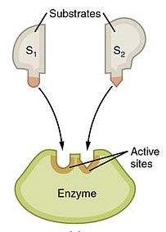
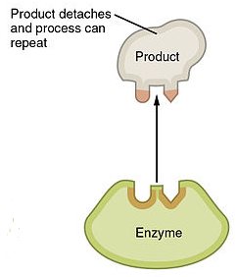
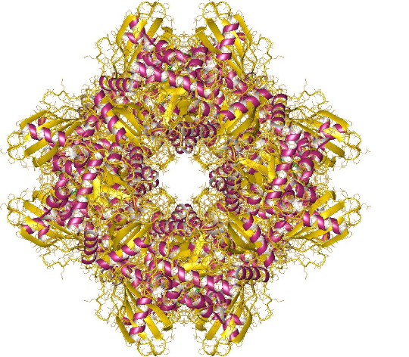
Enzymes
Image Source
There are many different types of enzymes in plant cells.
Cells contain thousands of different kinds of enzymes.
Each enzyme is specific to a particular kind of reaction involving individual types of molecules.
For example, rubisco is the enzyme that rearranges the atoms in CO₂ and H₂O to form glucose and oxygen.
Thousands of other enzymes are involved with thousands of other different reactions within each cell.
Each enzyme enables a specific reaction.
Image Source
Rubisco is an enzyme that assembles glucose by taking carbon atoms from CO₂.

Slide 11
How Enzymes Work
The mechanisms of different enzymes

Slide 12
Assembling Macromolecules
Some enzymes assemble individual molecules into macromolecules.
Enzymes do this by removing oxygen & hydrogen atoms from each molecule.
This causes the individual molecules to attach to each other, forming the macromolecule.
For example, the enzyme starch synthase assembles individual glucose molecules into carbohydrate macromolecules.
These carbohydrate macromolecules can be used for long-term energy storage.
A similar enzyme called cellulose synthase works in the same way to assemble glucose to form the cellulose found in plant cell walls.
Starch synthase removes oxygen & hydrogen atoms from glucose. This causes glucose molecules to attach, forming a carbohydrate.
Image Source

Slide 13
Disassembling Macromolecules
Some enzymes are used to disassemble macromolecules.
To do this, enzymes insert water between the molecules in macromolecules.
This causes the molecules to separate, disassembling the macromolecule.
For example, the enzyme amylase inserts water to disassemble carbohydrates into individual glucose molecules.
This glucose can then be used for cell respiration in the plant cell’s mitochondria.
This glucose can also be rearranged into other molecules needed in the plant cell.
Amylase disassembles carbohydrates by inserting water molecules between each glucose molecule. This causes each glucose to separate from each other.
Image Source

Slide 14
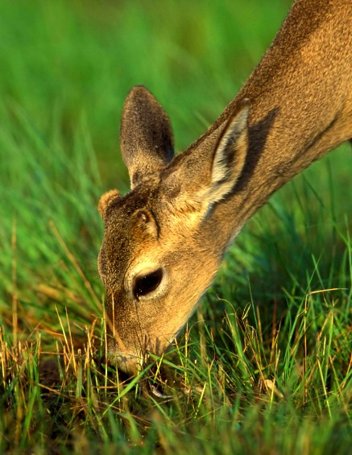
Species Interactions
How enzymes allow species to interact
Image Source

Slide 15
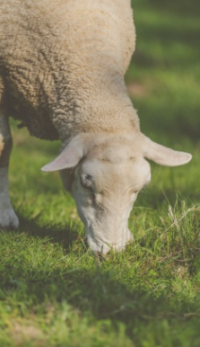
Enzymes & Species Interactions
Enzymes enable different species to interact with each other.
For example, when animals consume plants, they must use their digestive enzymes to disassemble plant macromolecules (carbs, fats, and proteins).
Animal cells then use other enzymes to perform cellular respiration and biosynthesis.
Without enzymes, cells would be unable to produce the molecules they need from other molecules in their environment.
Plants and animals depend on enzymes to create the molecules their cells are made from using the atoms they can acquire from their surroundings.
Image Source
Source: Public Domain Pics

Slide 16
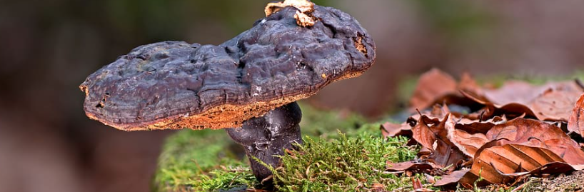
Decomposers
When plants & animals die, their cells are broken down by decomposers.
Decomposers (like fungi & bacteria) are organisms that break down dead tissues.
Decomposers use enzymes to disassemble the macromolecules in the cells of dead organisms.
Decomposer cells then use other enzymes for cellular respiration and biosynthesis.
Decomposers are necessary for species to continue interacting.
Decomposers convert most of the mass of dead organisms back into the CO₂ and H₂O needed for photosynthesis in plants.
Decomposers secrete enzymes that enable them to break down macromolecules within the cells of dead tissue. Decomposers then use glucose, amino acids, and fatty acids within their own cells.
Source: Pixfuel

Slide 17
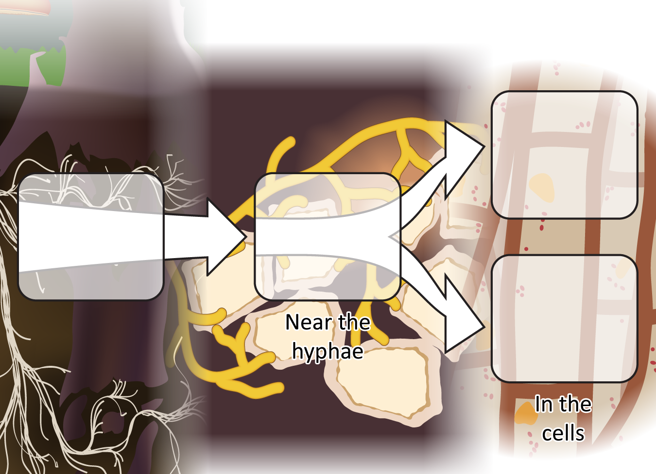
Decomposer cells use digested food in two ways
Materials for growth: Biosynthesis
Food (dead tissue)
Digestion via enzymes
Energy: Cellular respiration
Notes:
Review the ways in which decomposers use food.
Use Slides 3-6 of the PPT to review what students have figured out about how decomposers use food.
Slide 6 reminds students that after food is digested outside the decomposers the molecules can either be used for growth through biosynthesis or to obtain energy through cellular respiration.
Tell students that their explanations today will be to tell this whole story for other types of decomposers.
Image Credit: Craig Douglas, Michigan State University

Slide 18
Revising Our Claims
Revisit your ideas from Part 1.
How could you improve your responses to our Driving Questions?
Driving Question: How do plants get their food and gain mass?
How do plants acquire the carbs, fats, and proteins their cells need using enzymes?
How do plants use soil minerals?
How do enzymes work?
Image Source

Slide 19
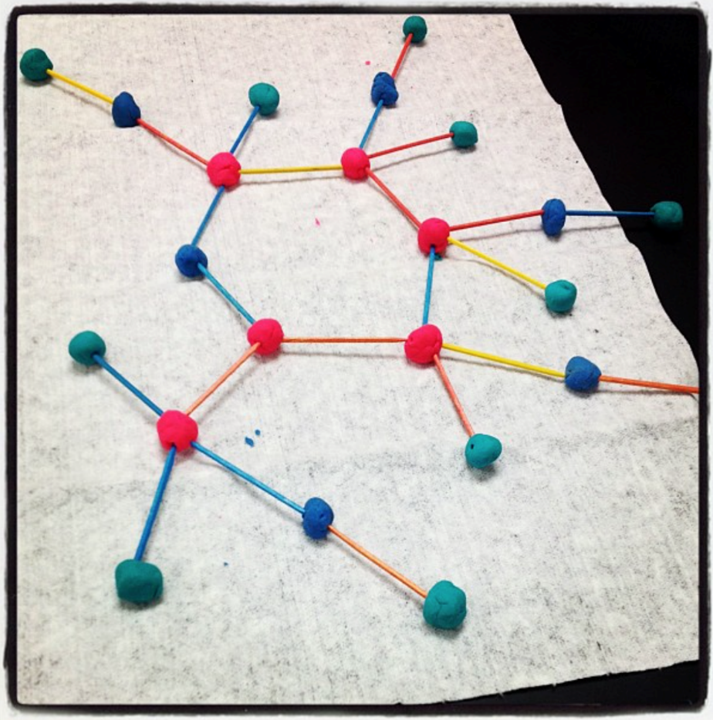
Looking Ahead: Part 3 Investigation
In Part 3, you will use molecular models to explain how glucose is created during photosynthesis.
You will also use these models to explain how glucose can be changed by enzymes into other molecules the plant needs.
Image Source

Slide 20
Key Points
All cells need carbohydrates, fats, and proteins to function. Most plants cannot consume other organisms and must produce their own macromolecules.
All carbohydrates, fats, and proteins in plant cells are formed from the atoms in glucose and soil minerals.
Enzymes are what enable plant cells to take atoms from glucose molecules and soil minerals to form other molecules.
Enzymes reduce the time and energy required for chemical reactions to occur in living organisms.
Enzymes can change other molecules over and over without being altered or destroyed.

Slide 21
Key Points
Some enzymes assemble individual molecules into macromolecules by removing oxygen & hydrogen atoms from each molecule.
This causes the individual molecules to attach to each other, forming the macromolecule.
Some enzymes are used to disassemble macromolecules by inserting water molecules into macromolecules.
This causes molecules to separate, disassembling the macromolecule.
Enzymes enable different species to interact with each other.
Without enzymes, cells would be unable to produce the molecules they need from other molecules in their environment.
When plants & animals die, their cells are broken down by decomposers such as bacteria and fungi.
Decomposers use enzymes to disassemble the macromolecules in the cells of dead organisms for use in cell respiration and biosynthesis.

Slide 22
Key Vocab
Enzymes are proteins that assemble, disassemble, or rearrange molecules to form new molecules.
Decomposers (like fungi & bacteria) are organisms that break down dead tissues.

